Slide 1
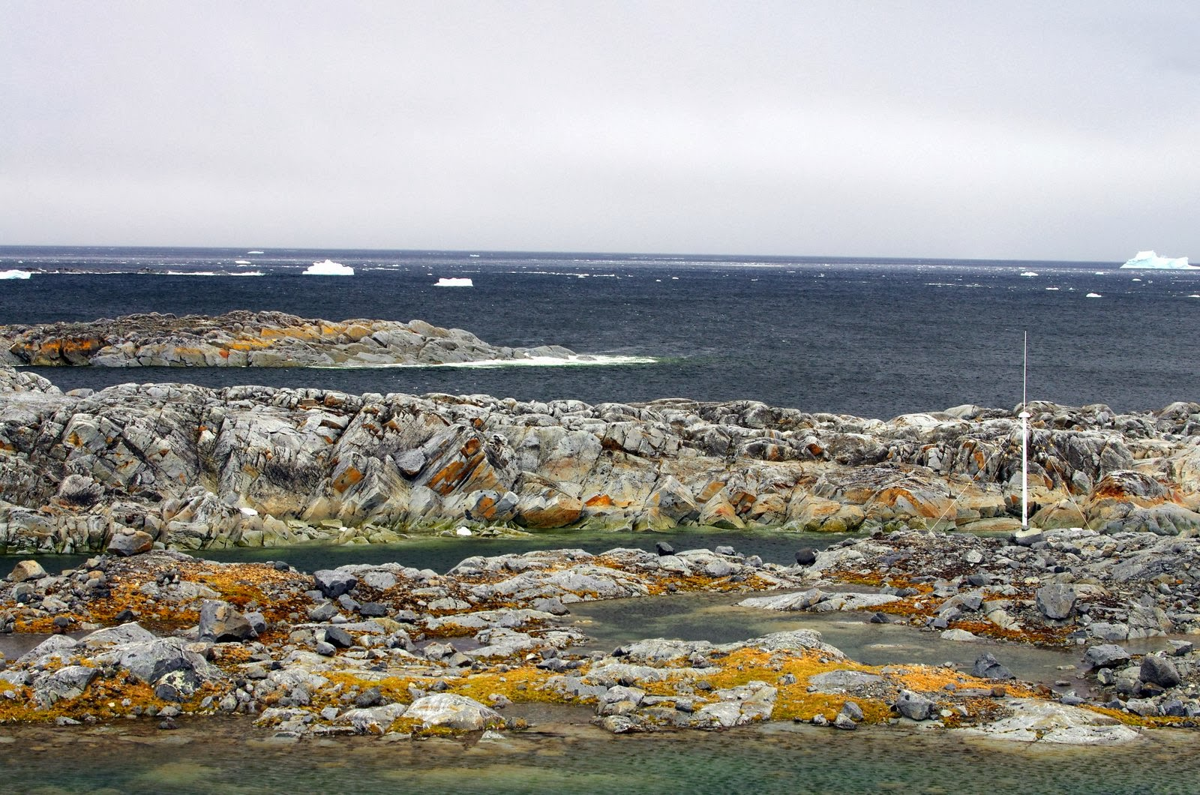







Central place foragers select ocean surface features based on species-specific foraging strategies
Matthew Oliver and Cordie Goodrich
University of Delaware
Josh Kohut and Filipa Carvalho
Rutgers University
Kim Bernard
Oregon State University
Bill Fraser and Donna Patterson-Fraser
Polar Oceans Research Group
Megan Cimino
Scripps Institute of Oceanography
Peter Winsor and Hank Statscewich
University of Alaska, Fairbanks
Erick Fredj
Jerusalem College of Technology
In Collaboration with PAL-LTER
PORG

Slide 2
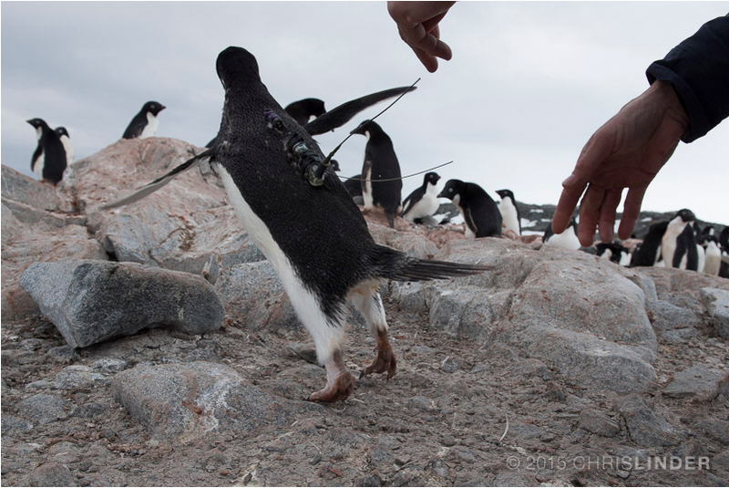
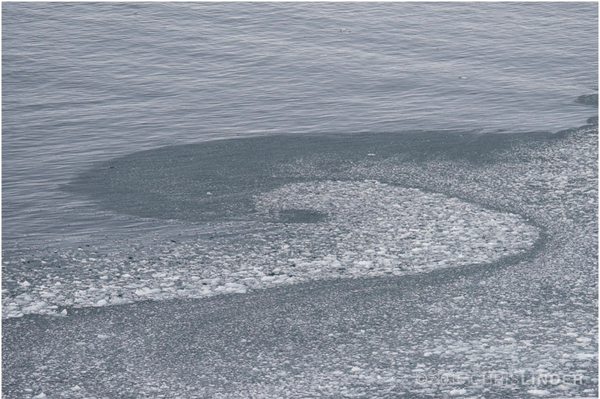
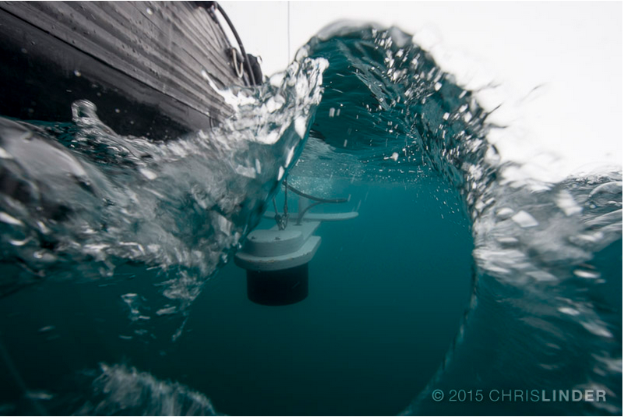
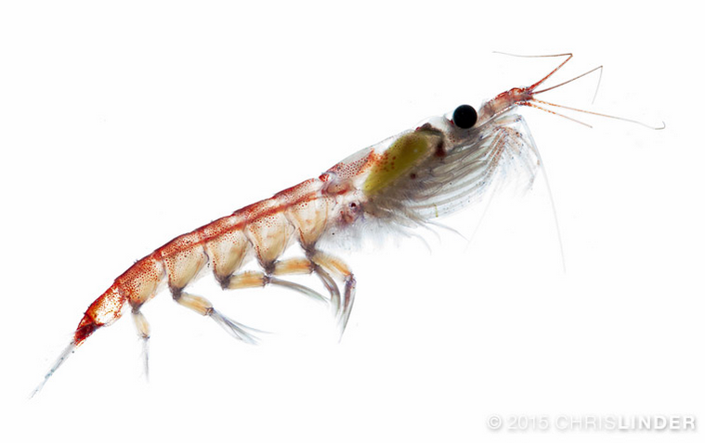
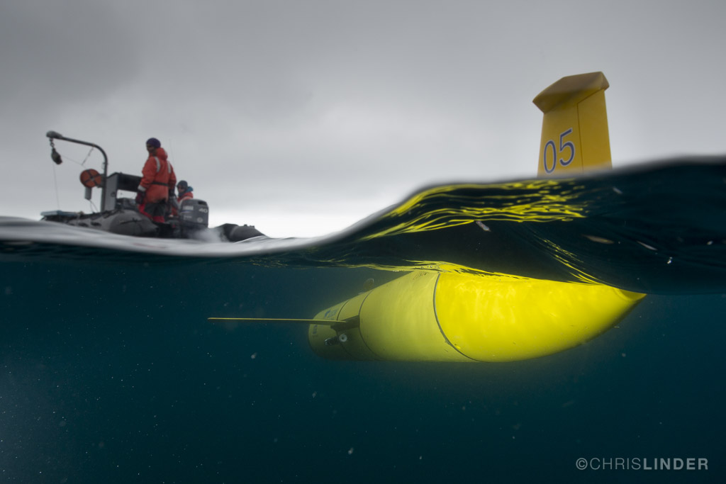
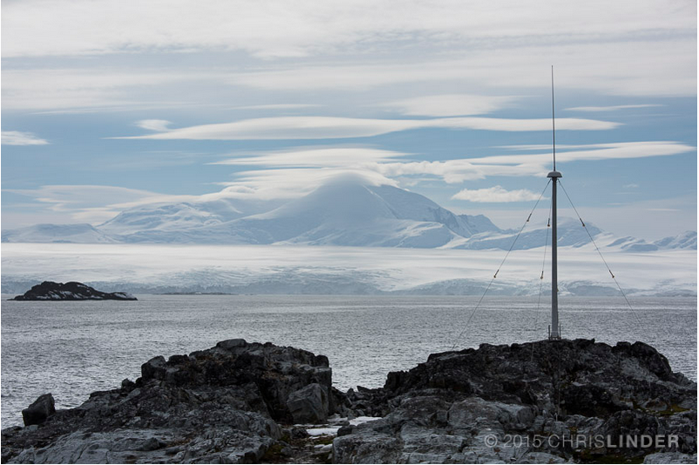
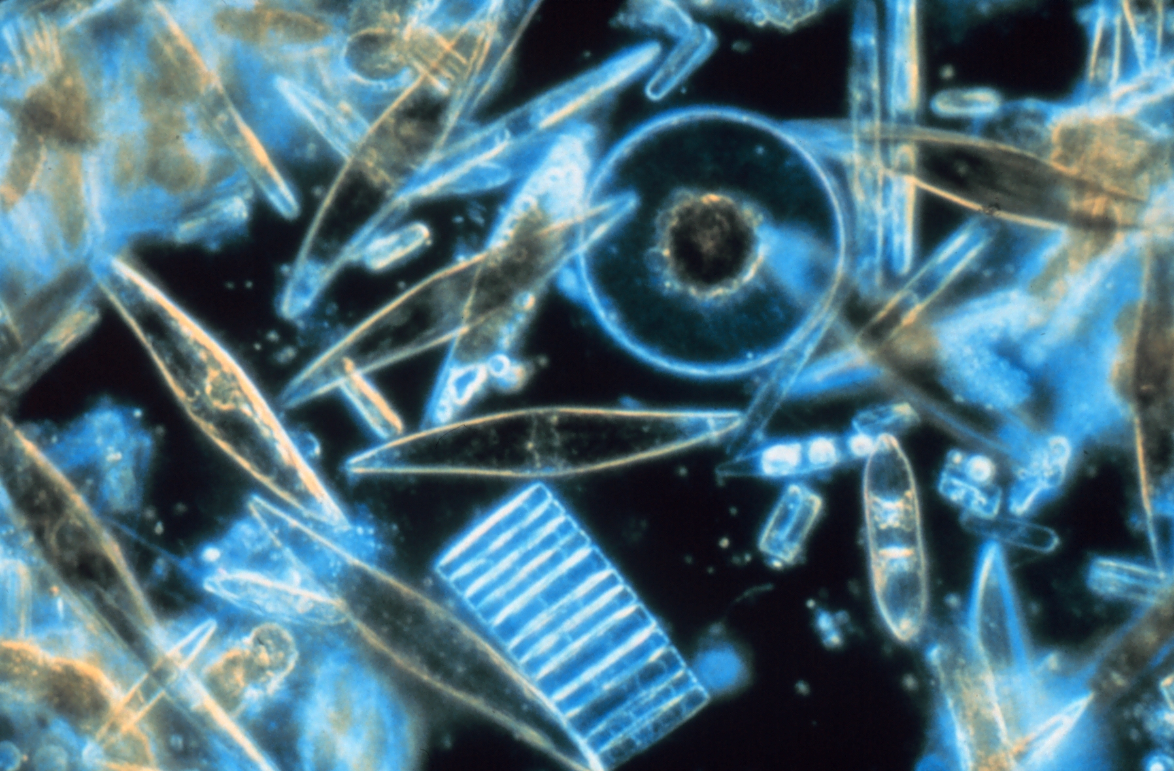
PORG
An Integrated Polar Observatory
Do surface circulation features influence food webs?
Do penguins target surface circulation features?

Slide 3
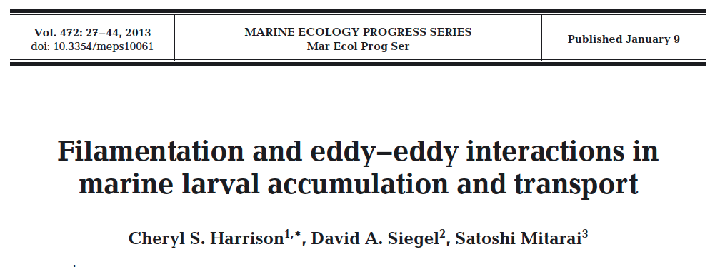
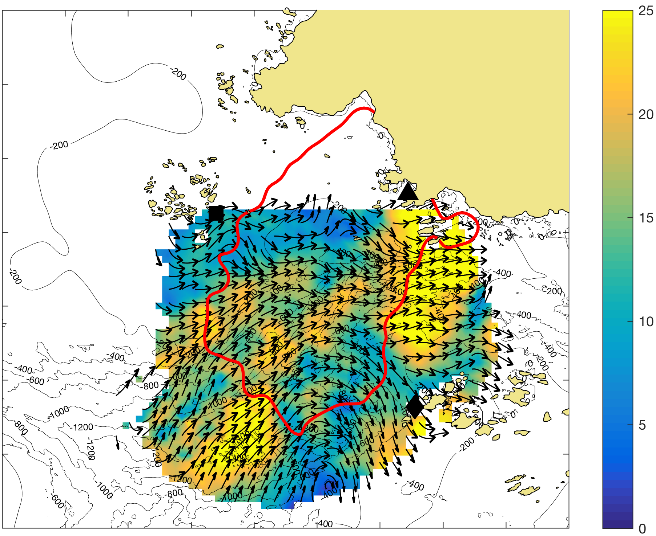
PORG
Buoyant particles tend to move toward, and then along attracting Lagrangian Coherent Structures (aLCS)
Buoyant particles tend to move along, and then away from rLCS
Thanks to C. Harrison for this figure!

Slide 4

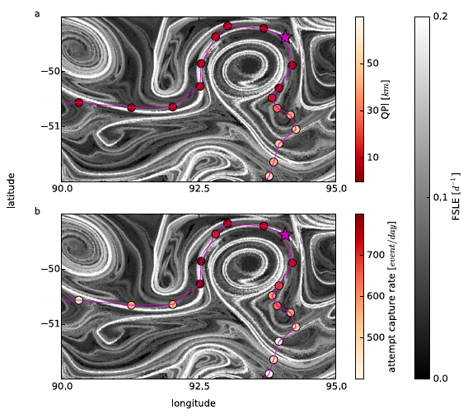
PORG
Background Cases with Predators
Elephant seal paths in the southern ocean seem to line up with attractive Lagrangian Coherent Structures
(in this case it is FSLE)
https://www.coolantarctica.com

Slide 5
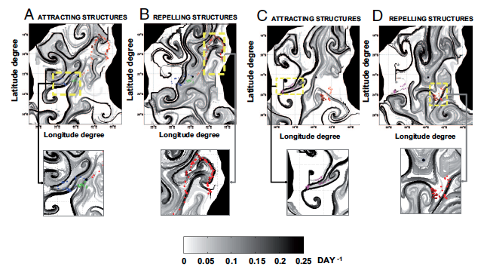
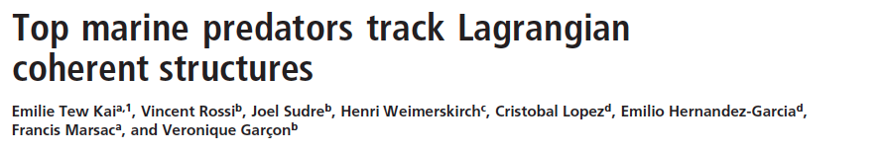
PORG
Background Cases with Predators
Great Frigatebird paths seem to line up more with repulsive LCS structures
(in this case it is FSLE)
By Charlesjsharp - Own work, CC BY-SA 3.0, https://commons.wikimedia.org/w/index.php?curid=19033743

Slide 6
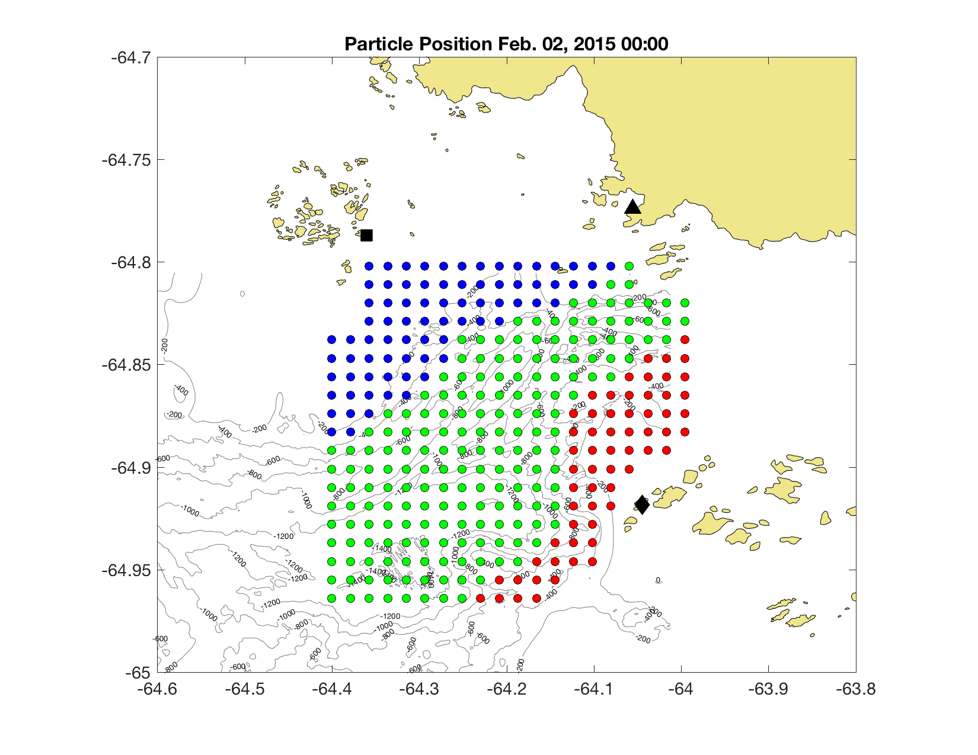
PORG
Hourly Surface Current Maps
500 m resolution
10 km
Surface Currents (cm/s)
10 km
Release drifters at T0 of 0Z and 12Z from January 5th to February 7th
Integration times of +12hrs (rFTLE) and -12hrs (aFTLE)

Slide 7
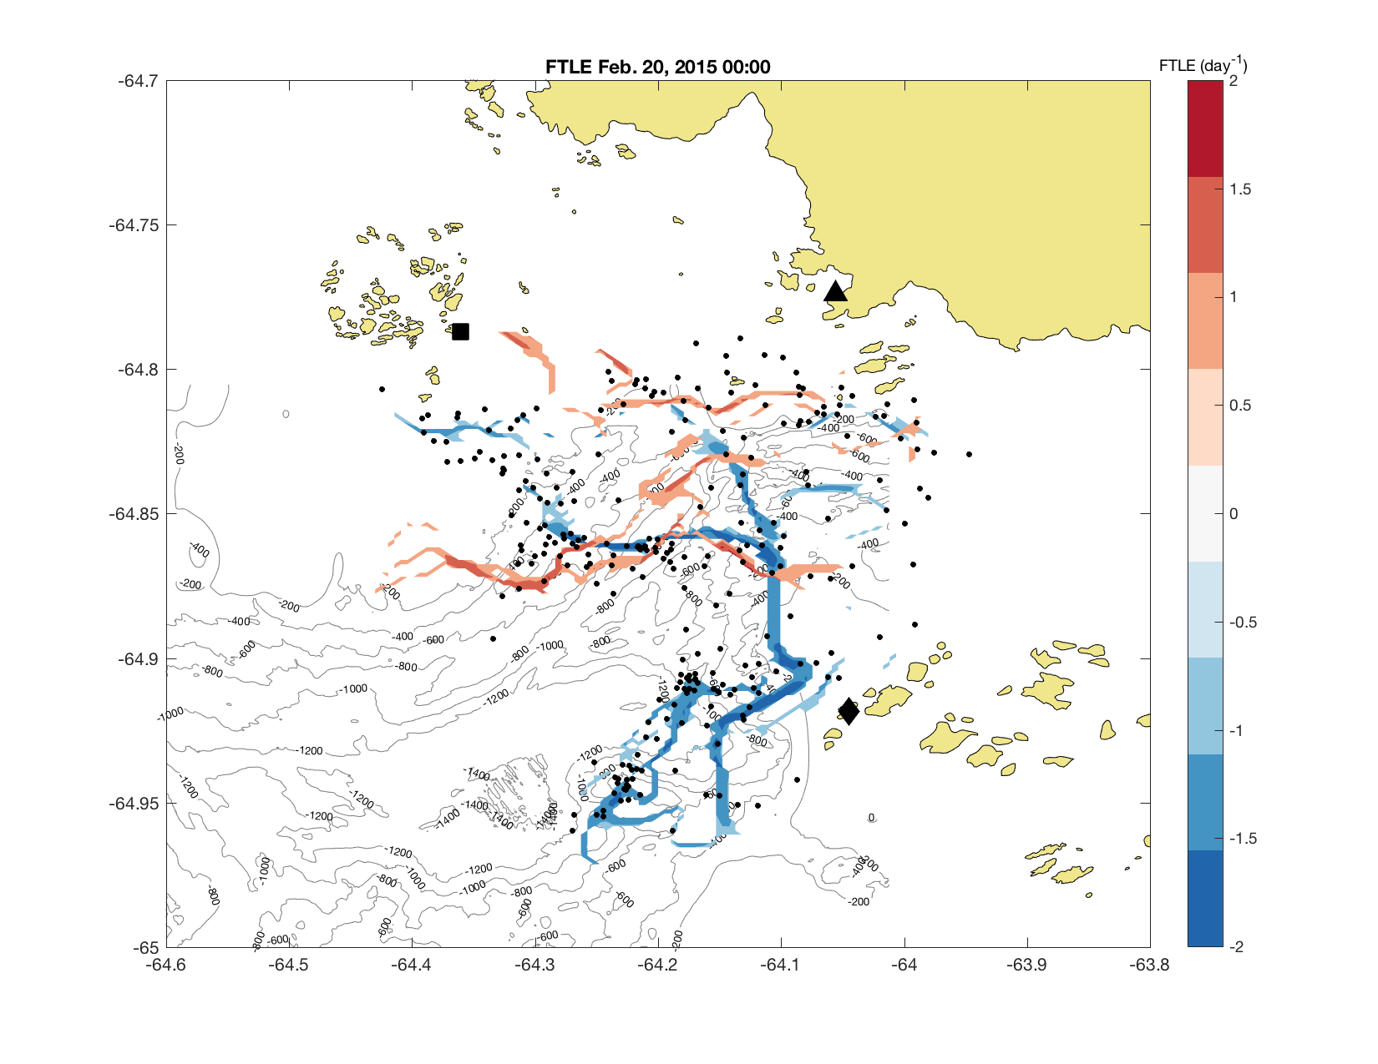
PORG
Notes:
Low FTLE values?

Slide 8
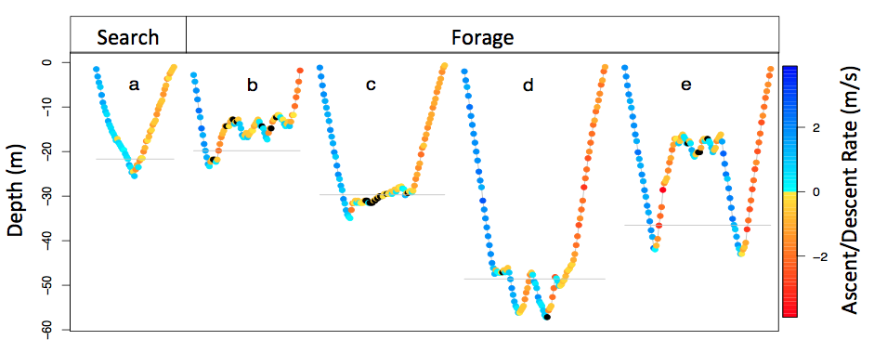
PORG
12 Adélie Penguins tagged
(8 female, 4 male)
7 Gentoo Penguins tagged
(5 male, 2 female)
Wildlife computer Spot 5 tags with Lotek LAT1400 TDR sampling at 2HZ
Only high quality ARGOS locations (class 1-3) were used
Argos Locations were classified into Searching, Foraging, and Transiting within 1, 2.5, 5, 15 min of ARGOS location time
Plateau, wiggles, bottom time
Cimino et al, 2016

Slide 9
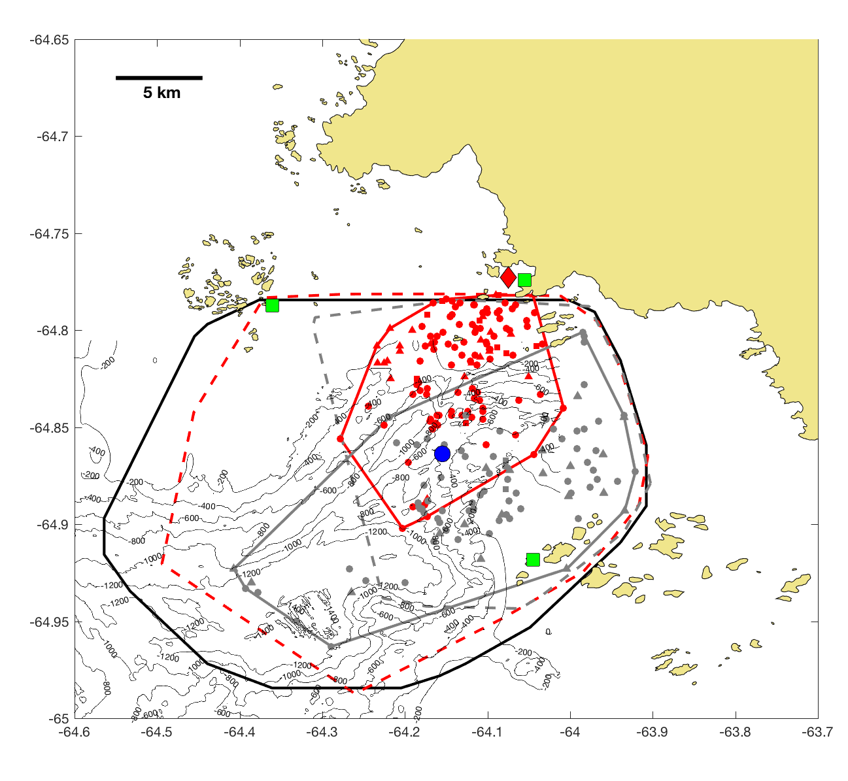
PORG
Adélie Penguins ARGOS locations (red) (class 1-3)
Gentoo Penguins ARGOS locations (grey) (class 1-3)
Profiling glider (blue dot)
Compare Penguin ARGOS locations to both aLCS and rLCS structures approximated by FTLE.
Critical to compare against field FTLE, and FTLE sampled by simulated penguins.
simm.bb package, with mean swim speeds of of 4 km hr⁻¹, and a max of 8 km hr⁻¹

Slide 10
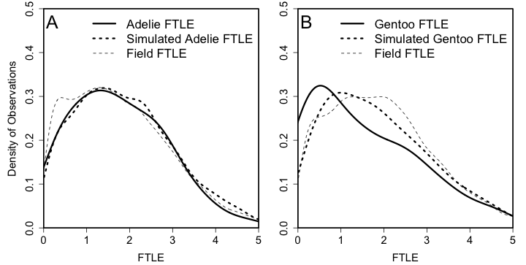
PORG
Penguin Selectivity for Attractive FTLE
KS tests show no selection for higher aFTLE compared the simulated Adélie
P = 0.955
KS tests show no selection for higher aFTLE compared the simulated Gentoo
P = 0.99

Slide 11
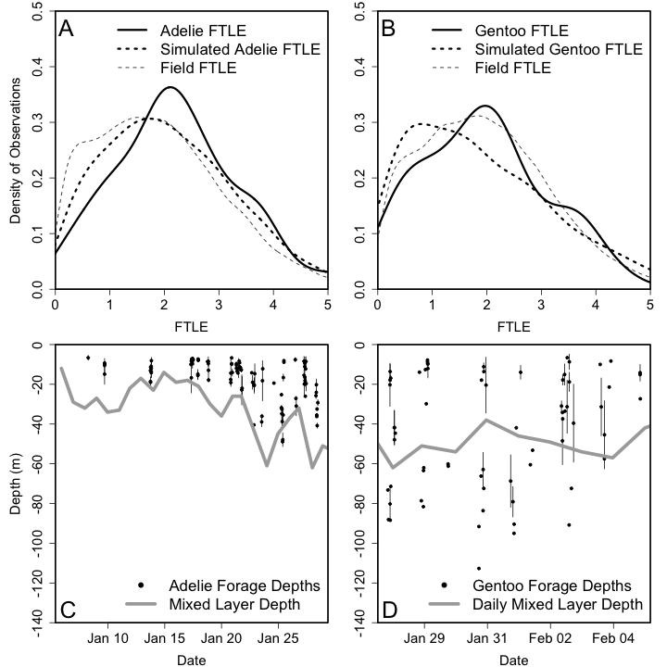
PORG
Penguin Selectivity for Repulsive FTLE
KS tests show selection for higher aFTLE compared the simulated Adélie penguin
P = 0.03
KS tests show no selection for higher aFTLE compared the simulated Gentoo penguin
P = 0.1

Slide 12
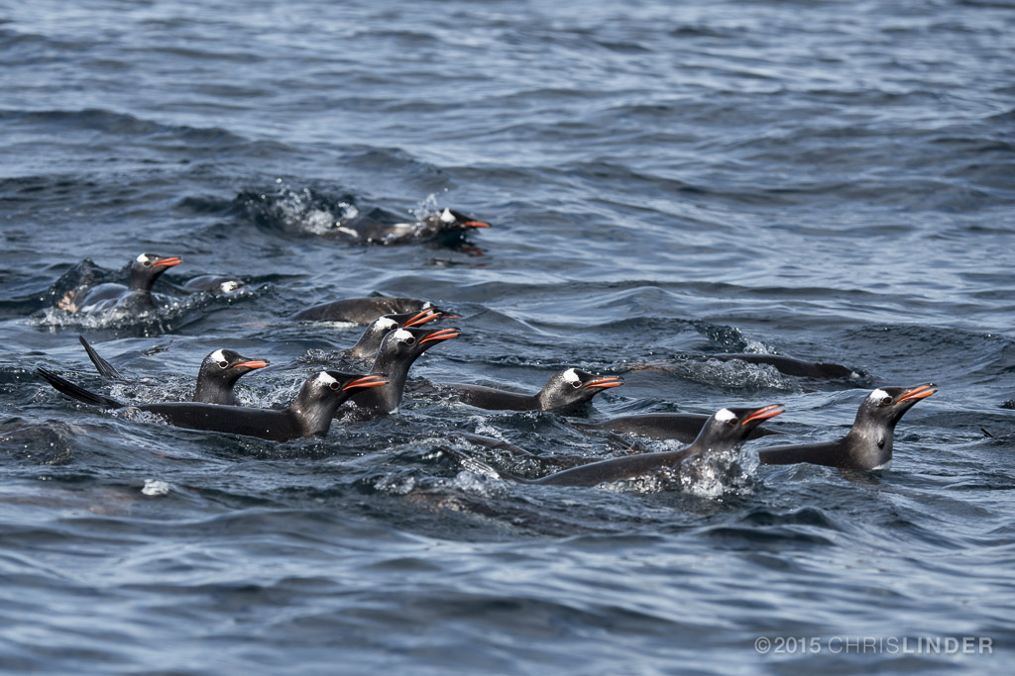
PORG
Penguin Selectivity for Repulsive FTLE
P = 0.03
P = 0.1
Gentoo penguins heading out to forage
The two species are using the water column very differently

Slide 13
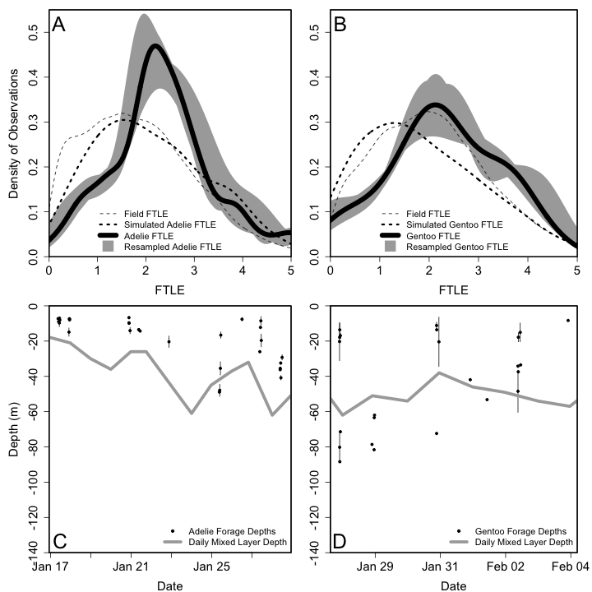
PORG
Penguin Selectivity for Repulsive FTLE
P << 0.01
The selection for the rLCS is enhanced when we look at penguins within 3 hours of T0
The selection is robust when we leave penguins out by individual or by trip (grey shades)
Results not sensitive to how the ARGOS locations were classified as Transiting, Searching, or Foraging.
P = 0.03
P = 0.038
P = 0.21
Selectivity for Gentoos depended on their depths

Slide 14
PORG
1 MHz sensor
Particle size > 620 microns
Presence / Absence Zooplankton + krill
Low High
Relative Acoustic Backscatter
Notes:
What we are interested in is the areas of high relative acoustic return,
where the ADCP is measuring krill.
Point out what it looks like
this isnt a krill instrument. Dont want to make assumptions about the number of krill but can say something about the presence or absence of krill
So we are going to take values above the 95th percentile and label them as krill presence and the rest is labeled as an absence.

Slide 15
PORG
1 MHz sensor
Particle size > 620 microns
Presence / Absence Zooplankton + krill

Slide 16
PORG
Zooplankton presence above the mixed layer
Kolmogorov-Smirnov Test:
91st Threshold: p-value = 0.04216
95th Threshold: p-value = 2.213 x 10⁻⁴
99th Threshold: p-value = 0.012
Kolmogorov-Smirnov Test:
91st Threshold: p-value = 1.637 x 10⁻⁵
95th Threshold: p-value = 1.732 x 10⁻⁵
99th Threshold: p-value = 0.005604

Slide 17
PORG
Conclusions
At this time our results suggest that penguins are selecting for repulsive FTLE
One possible reasons is that acoustic signals, presumably zooplankton+krill are also in repulsive FTLE
Similar result to the Frigatebirds
Future work
Run nested FTLE calculations with different integration times for better temporal matching
2) Look at instantaneous particle densities

