Slide 1
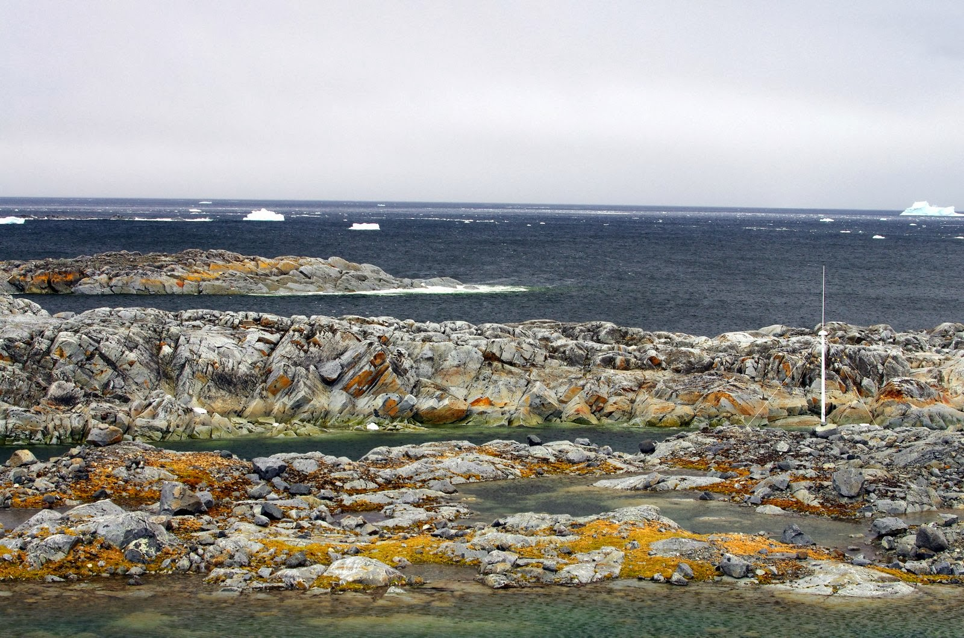

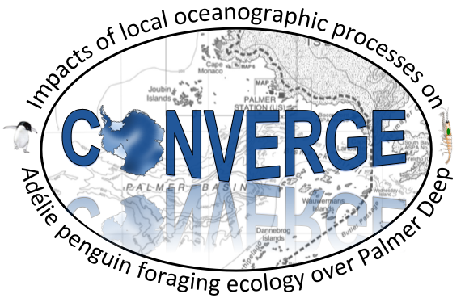
Integrated Polar Ocean Observatory suggests horizontal advection critical for maintaining biological hotspot in the West Antarctic Peninsula
Josh Kohut
Rutgers University
Kim Bernard
Oregon State University
Bill Fraser
Polar Oceans Research Group
Matt Oliver
University of Delaware
Peter Winsor and Hank Statscewich
University of Alaska, Fairbanks
Erick Fredj
Jerusalem College of Technology
In Collaboration with PAL-LTER

Slide 2






Western Antarctic Peninsula Canyons are
“Biological Hotspots”
Deep undersea canyons link the ACC to coastal “Biological Hotspots”. (Martinson and McKee, 2012).
Upwelling of deep water (UCDW) in these canyons supports local phytoplankton growth (Prézelin et al., 2004).
Predictable and elevated plankton availability (Kavanaugh et al., 2015).
Despite variation in climate (Domack et al., 2001), penguin colonies have persisted in these hotspots for 1,000s of years (Emslie et al., 1998).
PORG

Slide 3
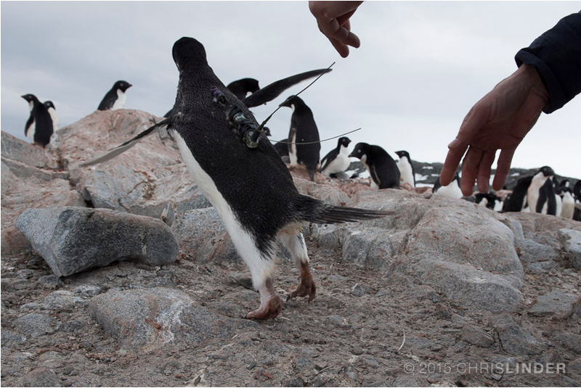
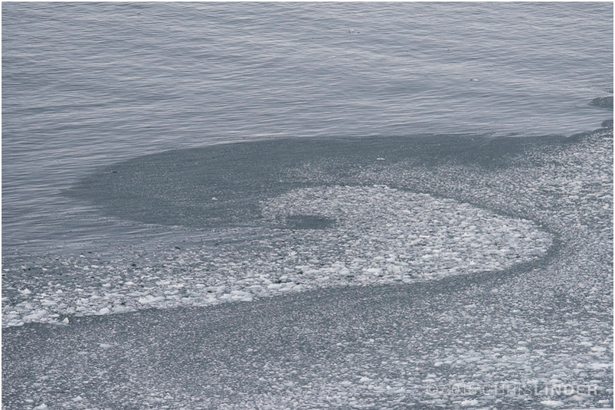
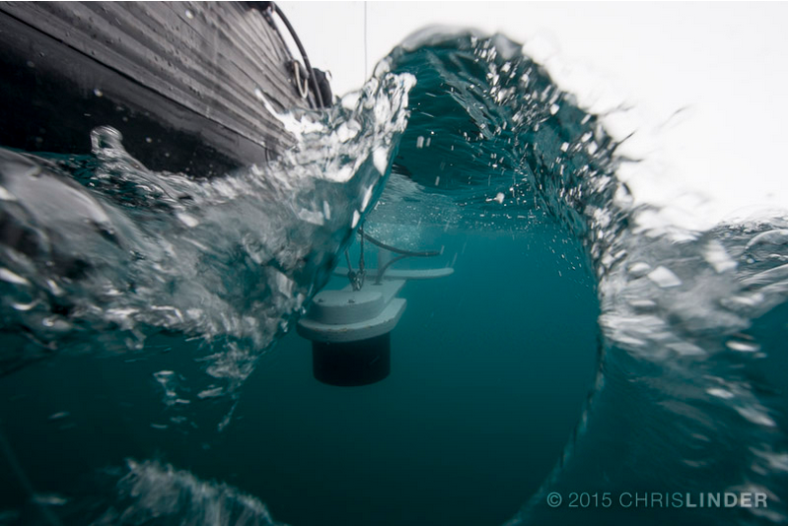
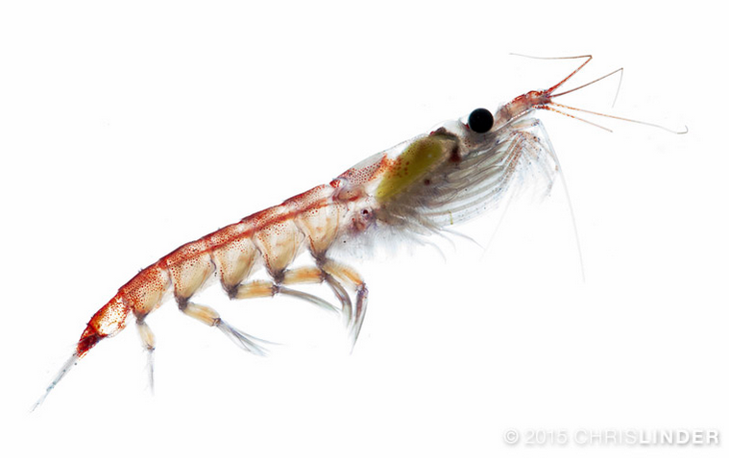
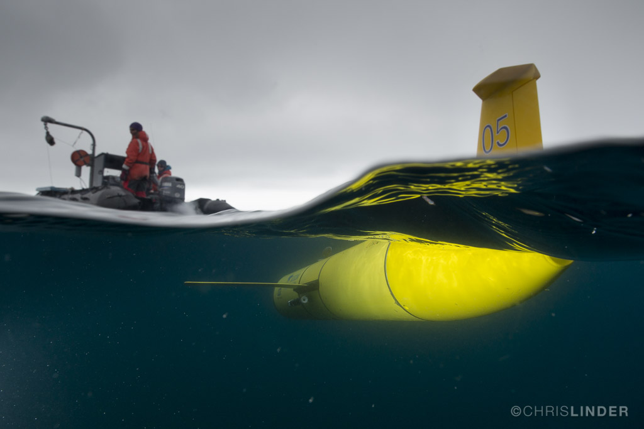
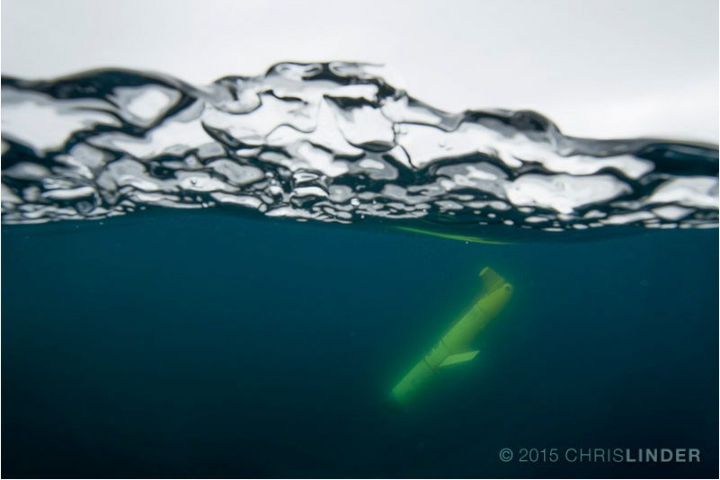
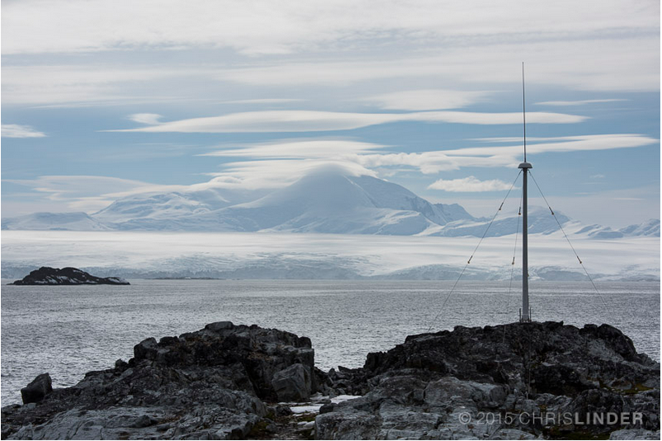
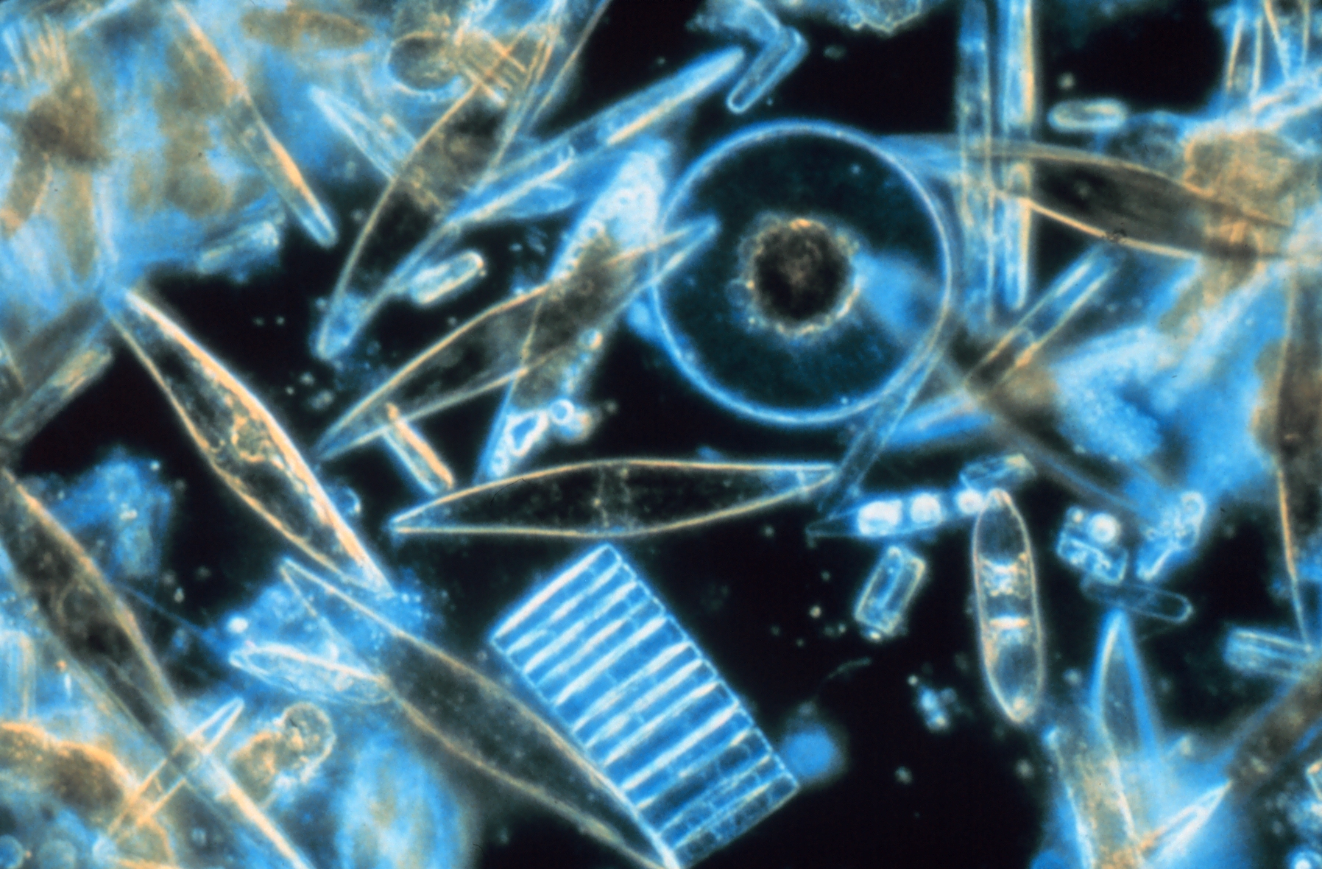
An Integrated Polar Observatory
EP51B-09: Oliver et al. Friday AM
EP42A-05: Goodrich et al. Thursday AM
PORG

Slide 4
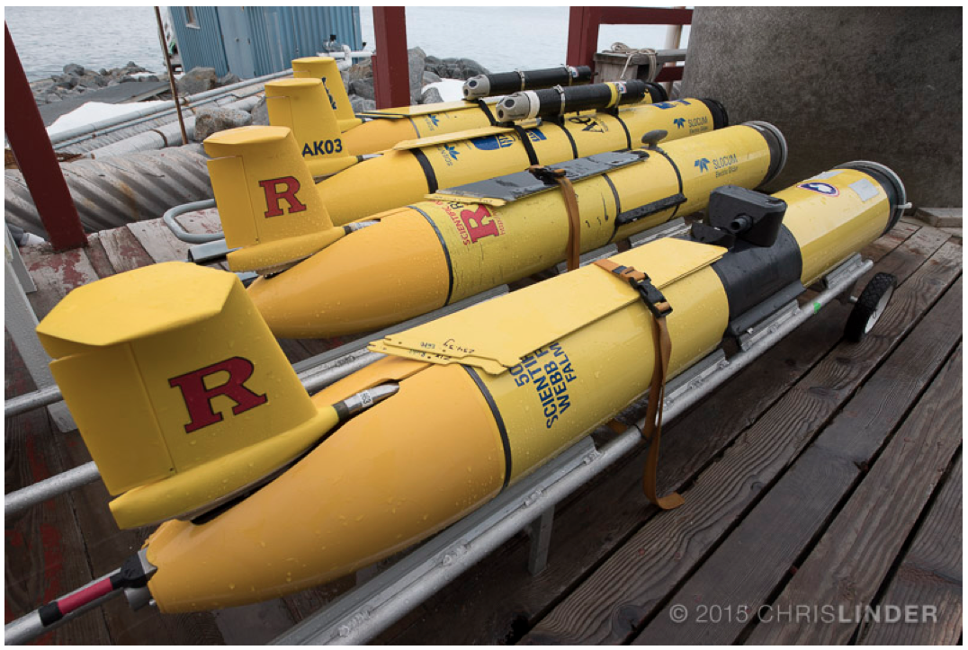
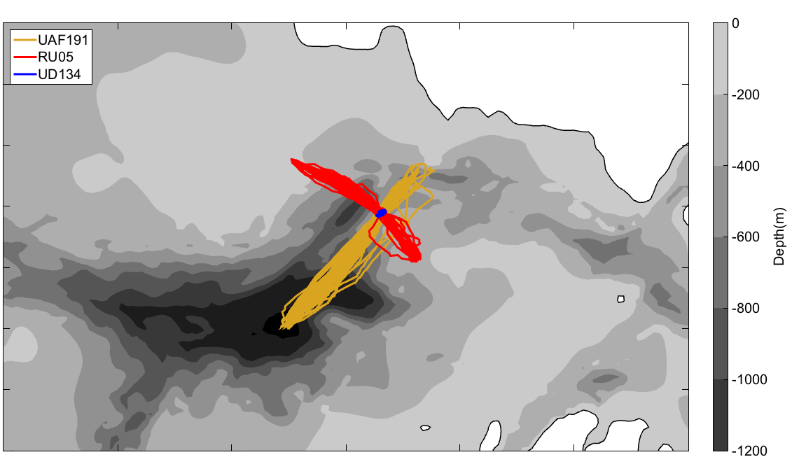
A coordinated fleet of gliders
Anvers Island
Along Canyon
Cross Canyon
Stationary
10 km
PORG

Slide 5
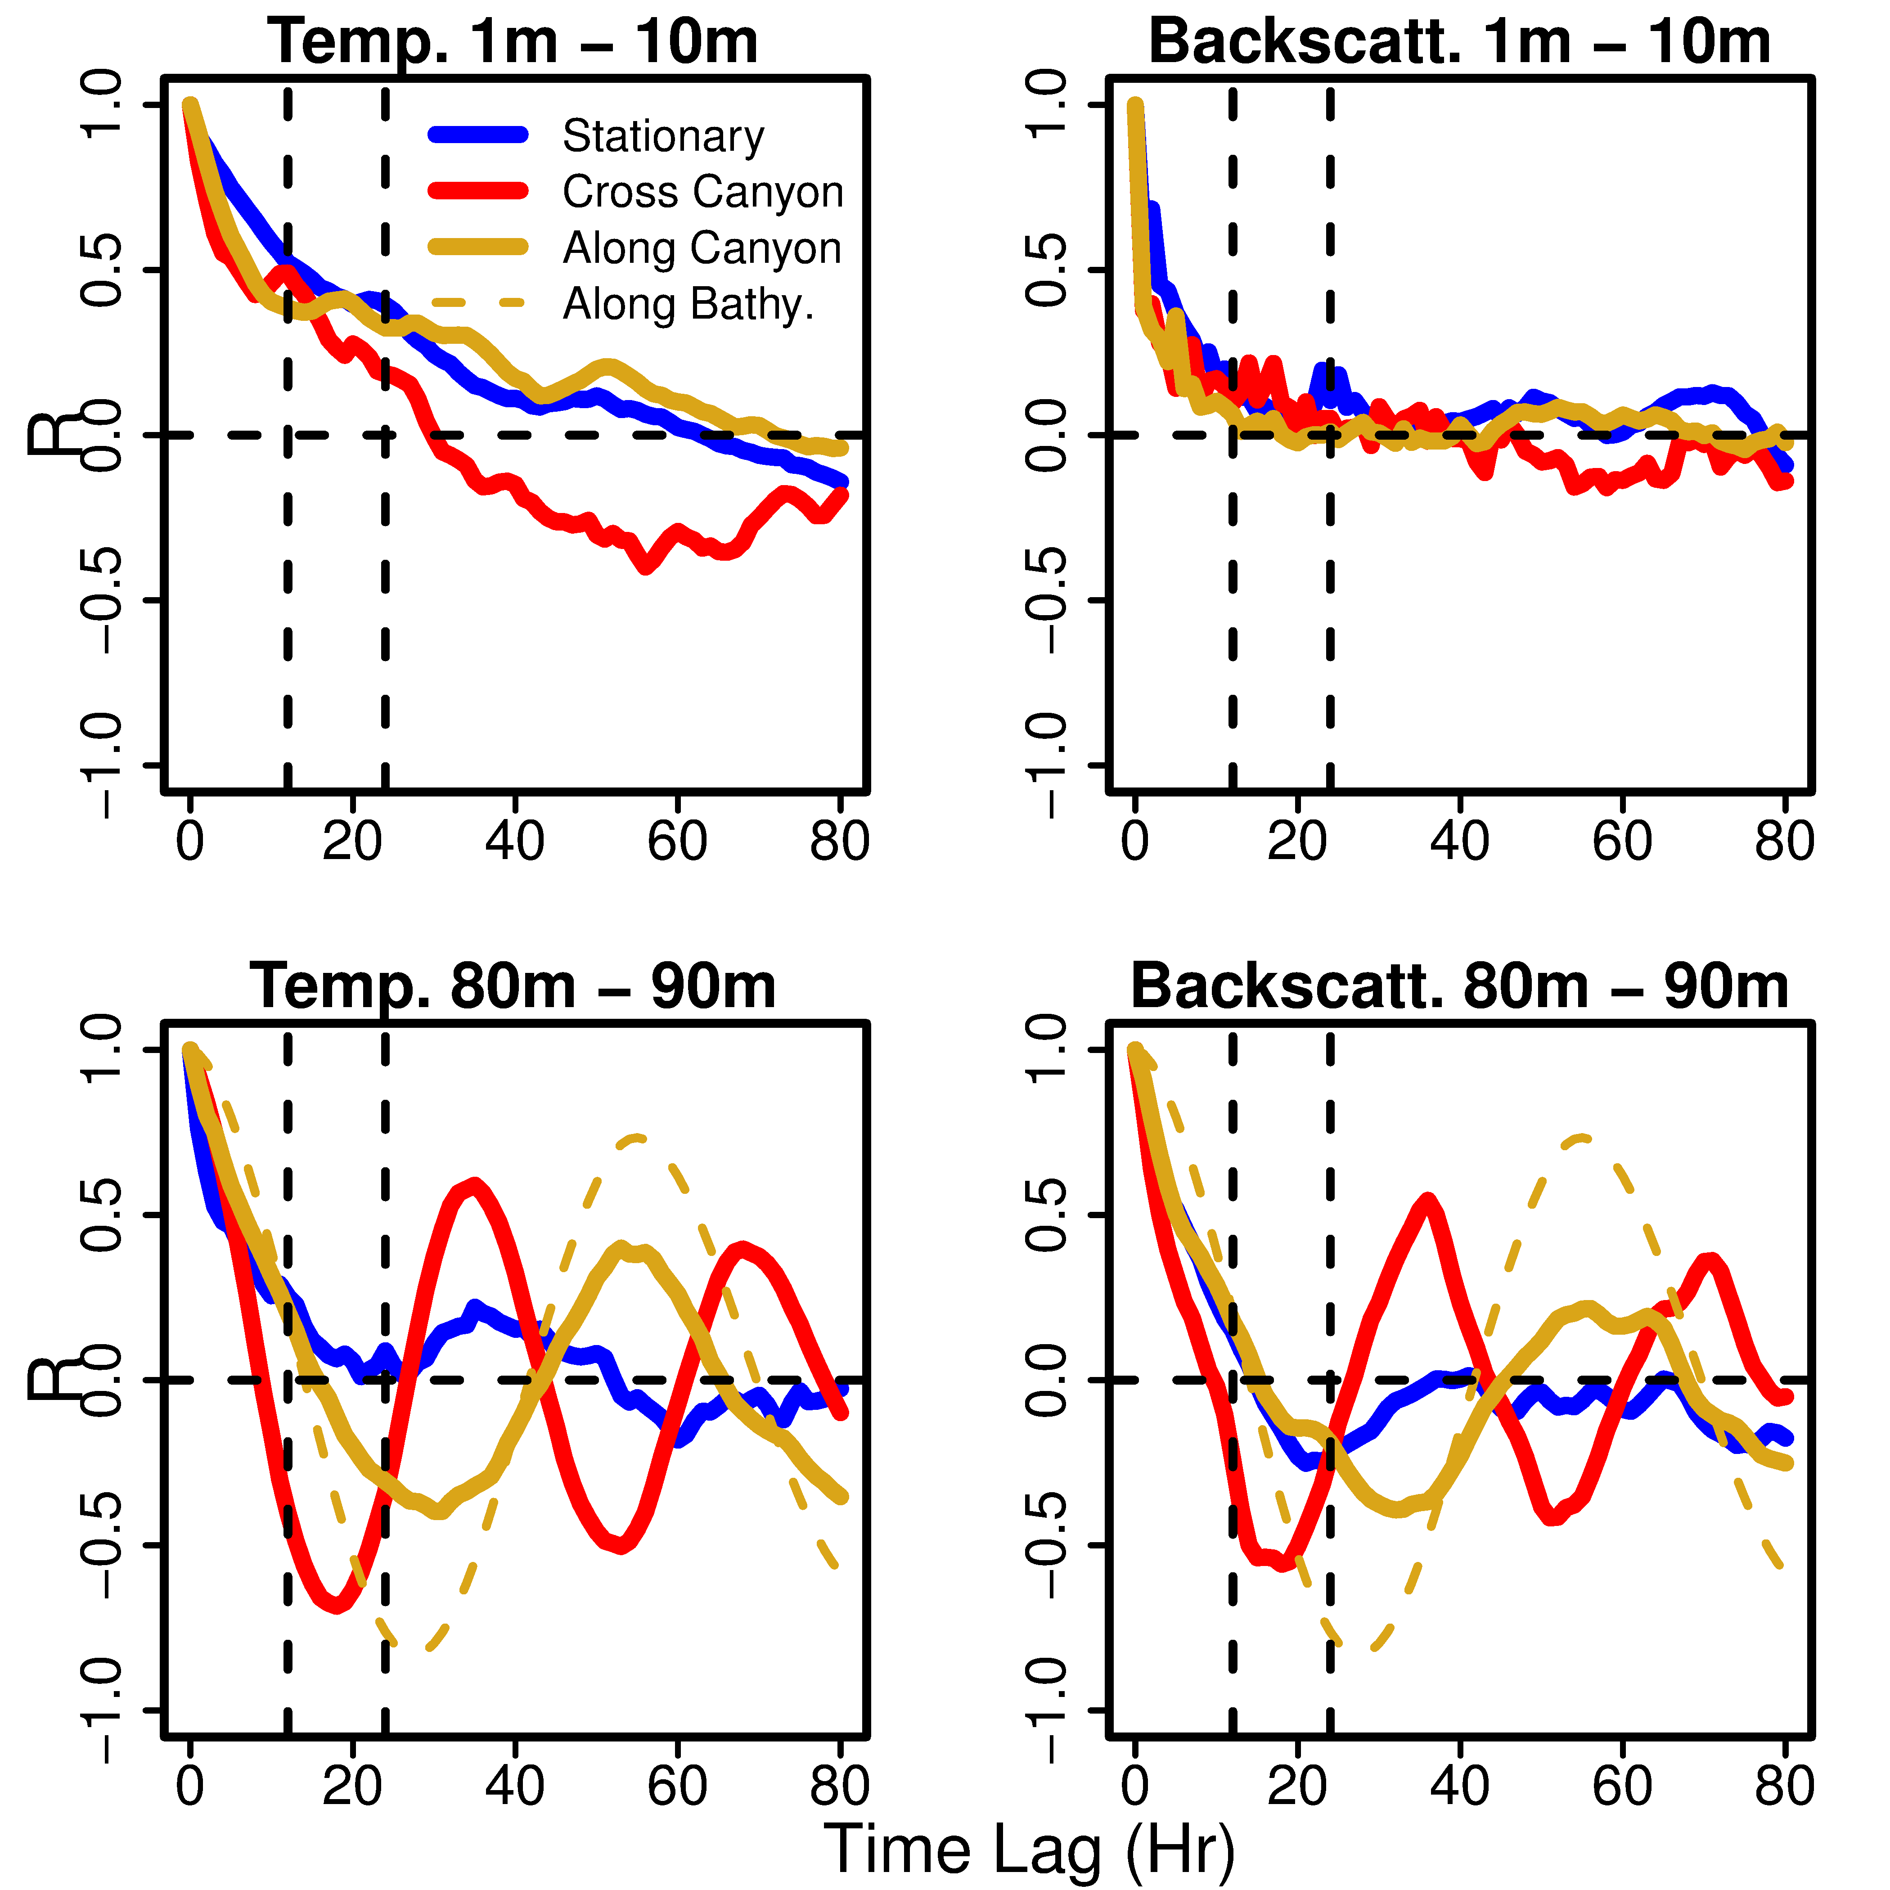
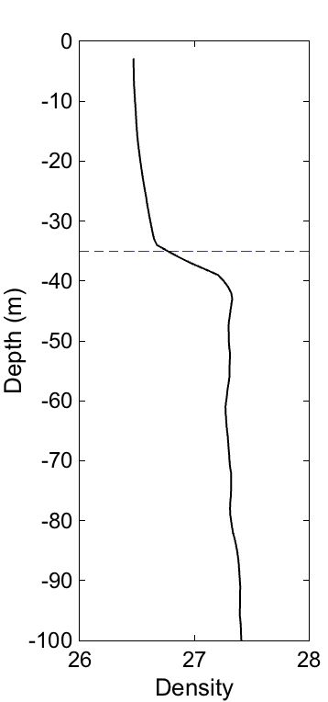
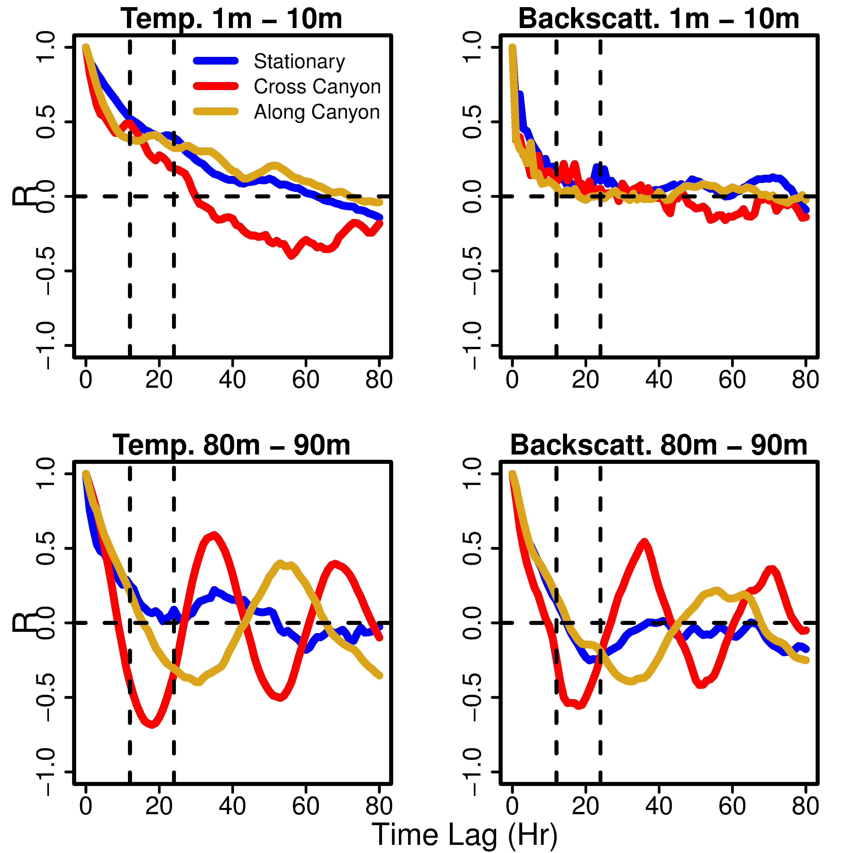
Teasing out temporal and spatial variability
Temperature Backscatter
Correlation (R)
Time Lag (Hours)
PORG

Slide 6
Teasing out temporal and spatial variability
Temperature Backscatter
Correlation (R)
Time Lag (Hours)
PORG

Slide 7
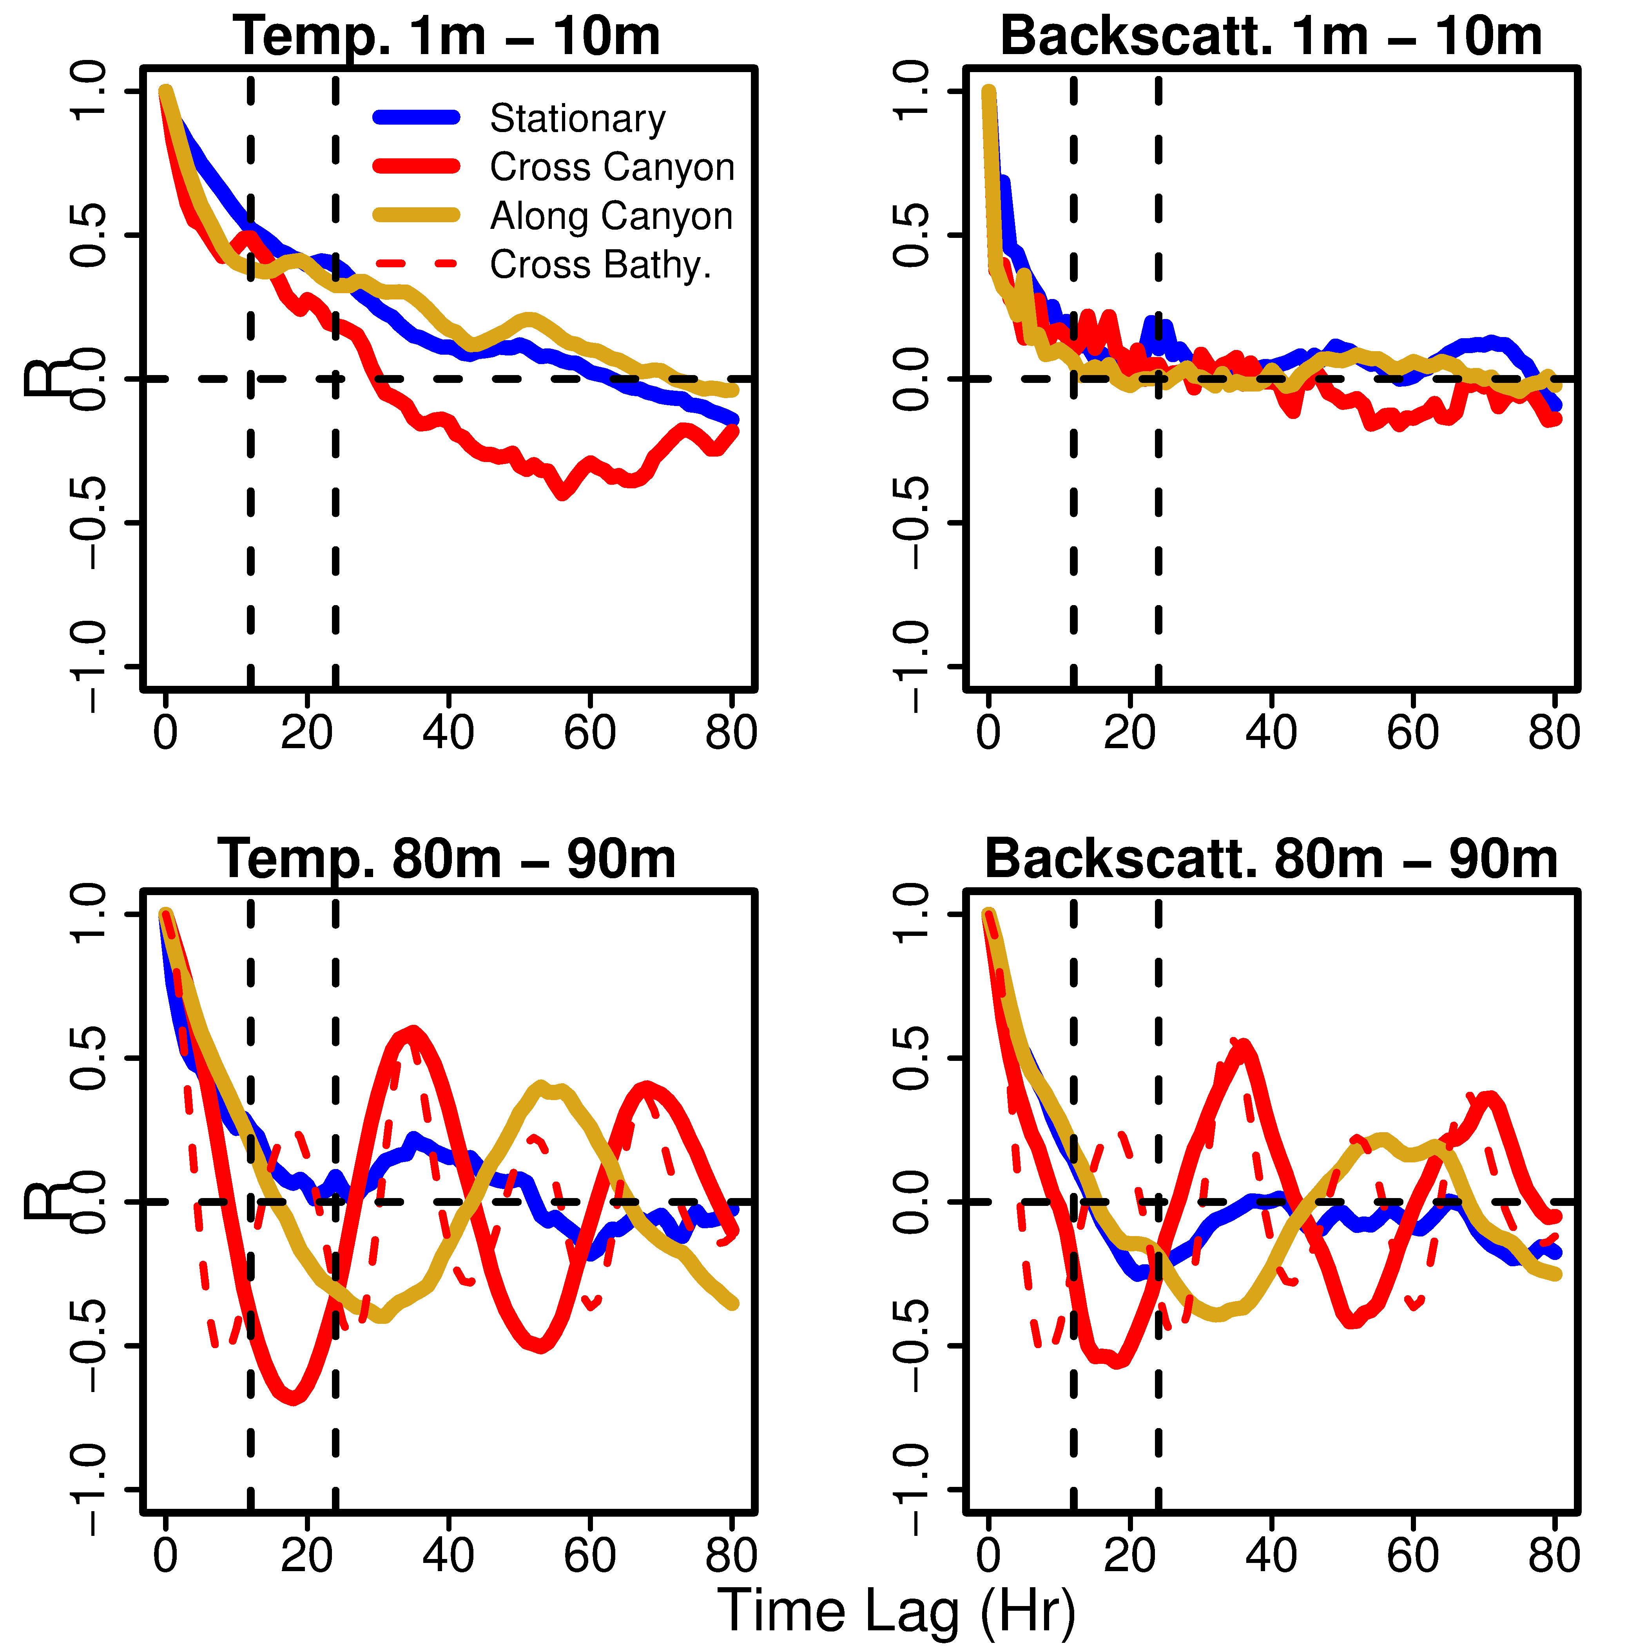
Teasing out temporal and spatial variability
Temperature Backscatter
Correlation (R)
Time Lag (Hours)
PORG

Slide 8
Teasing out temporal and spatial variability
Temperature Backscatter
Correlation (R)
Time Lag (Hours)
PORG

Slide 9
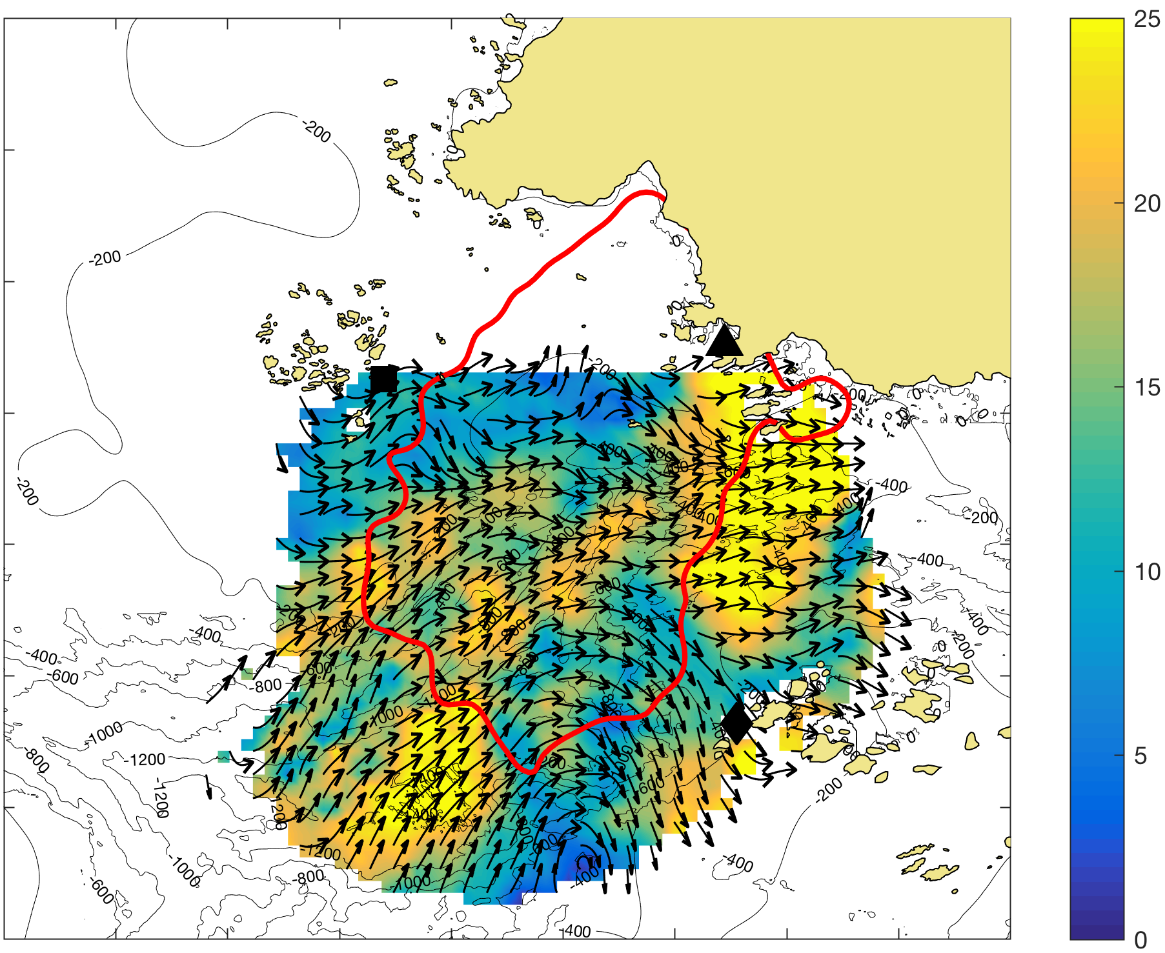
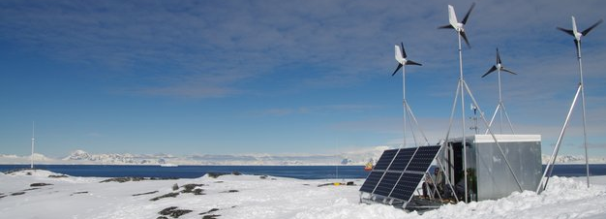
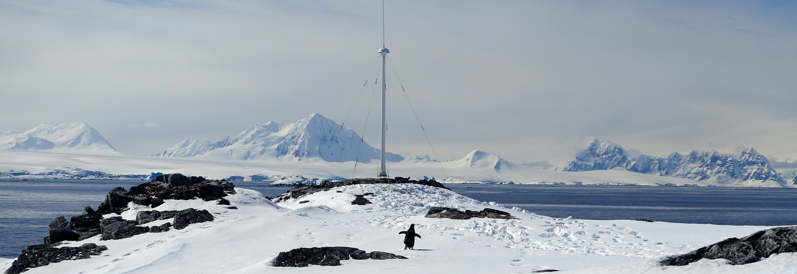
Hourly Surface Current Maps
500 m resolution
3 Site HF Radar Network
10 km
Surface Currents (cm/s)
PORG

Slide 10
Surface Residence Time
January – February 2015
10 km
T_{o}: Release a single drifter on the initial grid every 6 hours
Track each drifter until it exits the domain
Residence Time (T): The time it takes for the fraction of drifters remaining to be reduced to 36.79% (e-folding time scale) of the original number released. (Piñones et al., 2011)
Surface Currents (cm/s)
T
PORG

Slide 11
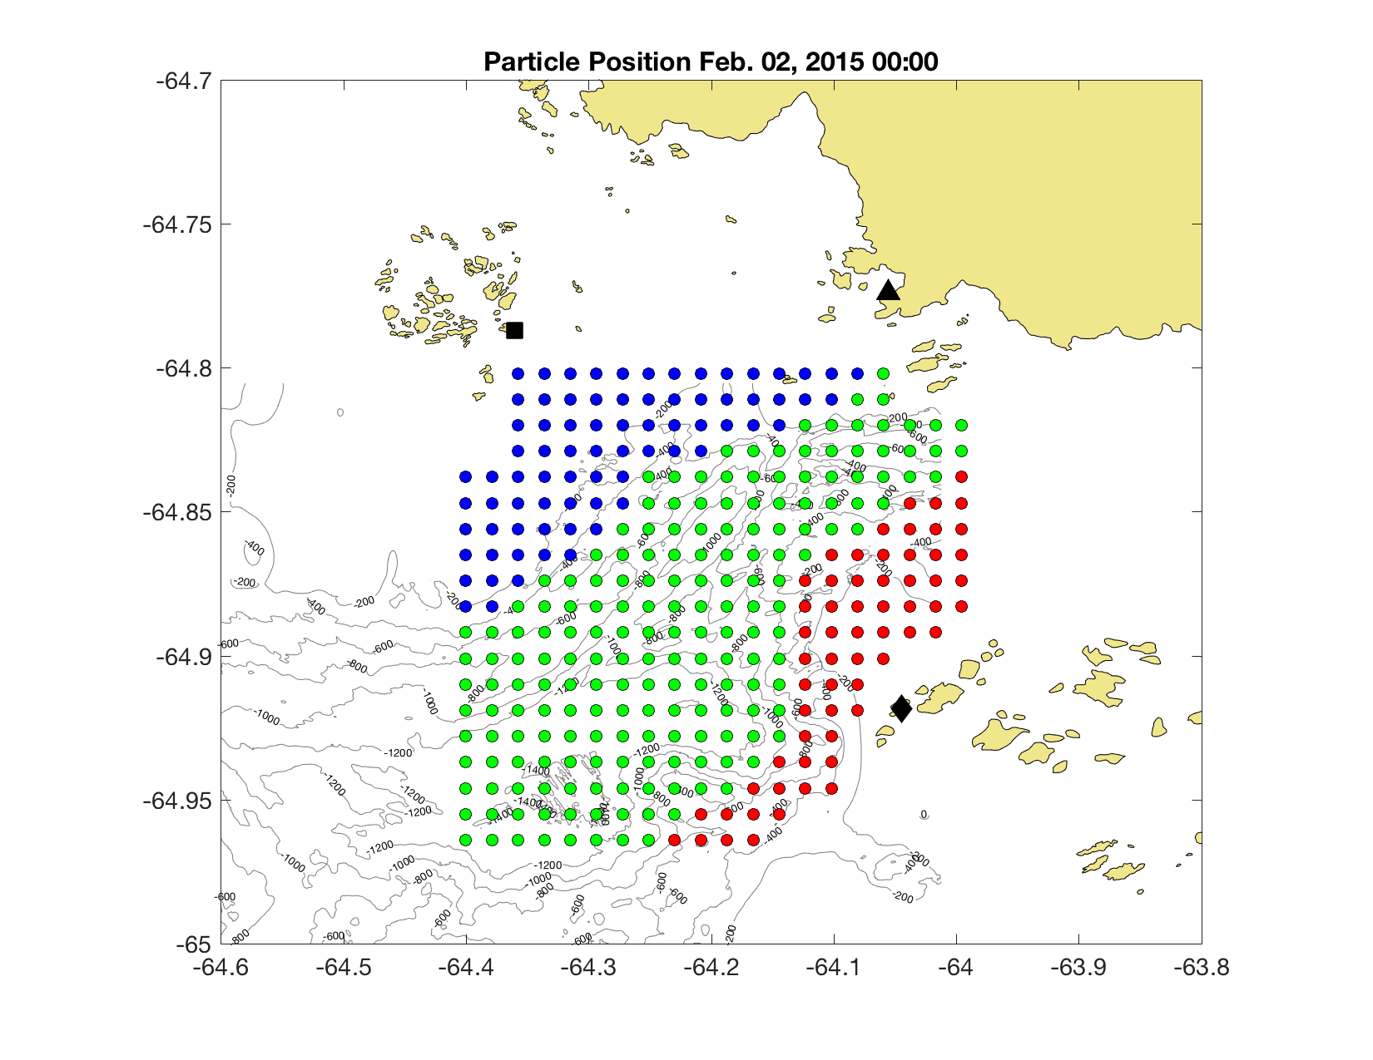
Hourly Surface Current Maps
500 m resolution
10 km
Surface Currents (cm/s)
10 km
PORG

Slide 12
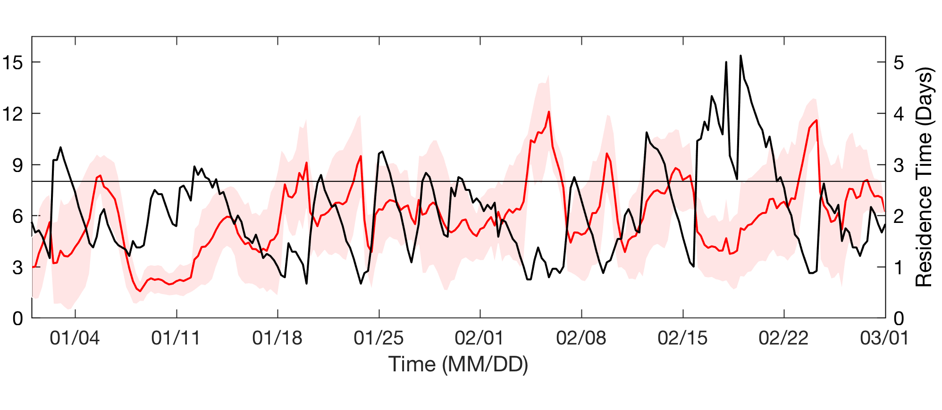
Surface Residence Time vs. Surface Winds
January – February 2015
10 km
Residence times over 4 days
occur during weak winds
Wind Speed (m/s)
PORG

Slide 13
Surface Residence Time vs. Surface Winds
January – February 2015
10 km
Residence times over 4 days
occur during weak winds
Residence times over 4 days
occur during weak winds
Winds over 8 m/s lead to
Residence times < 2 days
Wind Speed (m/s)
PORG

Slide 14


Surface Residence Time vs. Surface Winds
January – February 2015
Strong Northerly Winds
Short Residence Times:
ED: 18 hours
CAN: 15 hours
  JIF: 1 day, 21 hours
  WIF: 9 hours
Wind Speed (m/s)
PORG

Slide 15
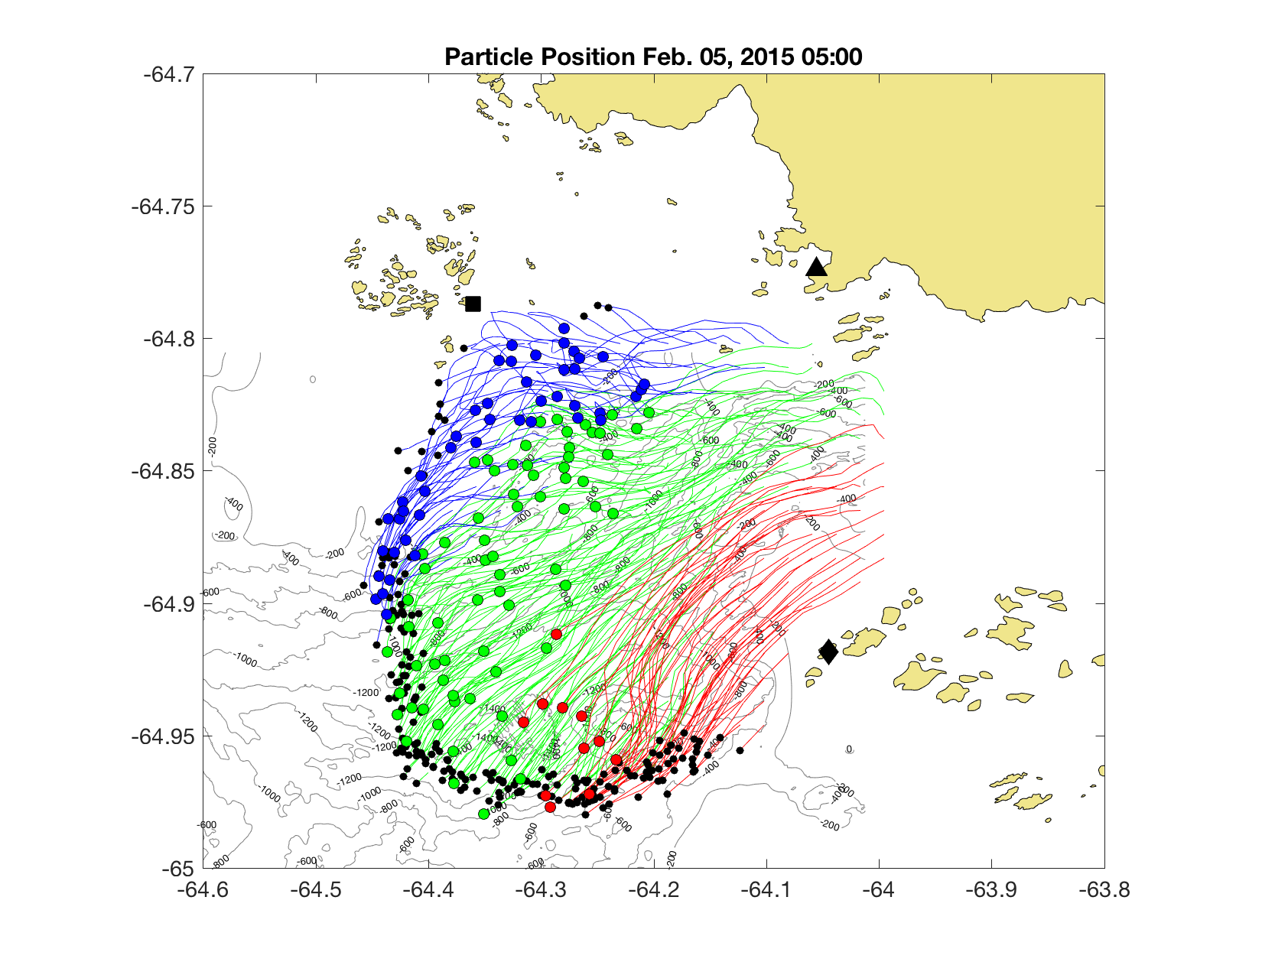

Surface Residence Time vs. Surface Winds
January – February 2015
Weak Variable Winds
Long Residence Times:
ED: 5 days, 3 hours
CAN: 5 days, 3 hours
  JIF: 5 days, 13 hours
  WIF: 1 day, 4 hours
Wind Speed (m/s)
PORG

Slide 16
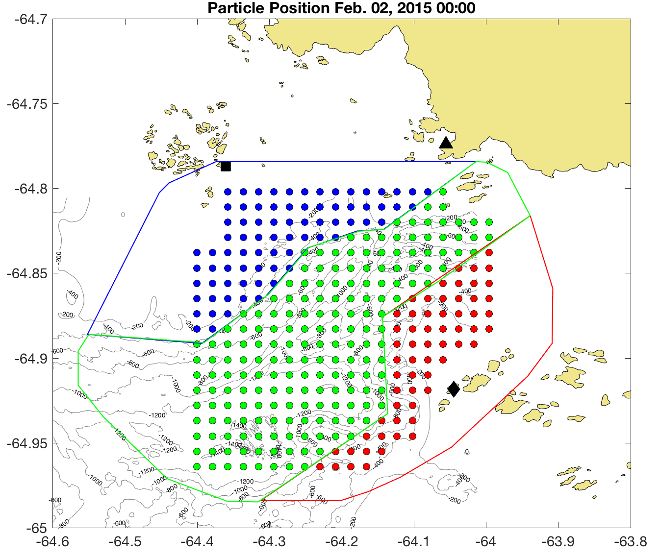
Surface Residence Time
January – February 2015
10 km
Entire Domain (ED):
2.1 ± 0.9 Days
Central Canyon (CAN)
2.4 ± 1.1 Days
Joubin Islands Flank (JIF)
2.5 ± 1.6 Days
Wauwermans Islands Flank (WIF)
1.2 ± 0.9 Days
Longest:
7.8 Days
Shortest:
0.2 Days
Estimated Palmer Deep phytoplankton specific growth rate doubling time of 7 – 70 days.
(Moline 1996)
PORG

Slide 17
An Integrated Polar Observatory
Glider surveys indicate that the surface layer is isolated from the influence of the underlying canyon bathymetry.
The HFR surface currents indicate that surface residence times are short (~ 2 days) and primarily dependent on local winds.
Observed surface residence times are much less than phytoplankton growth rates (~2 << 7 to 70 days).
Raises new questions on the mechanics of this biological hotspot that may serve more as a conveyor of phytoplankton biomass produced elsewhere, continually replenishing the base of the food web.
PORG

