Slide 1
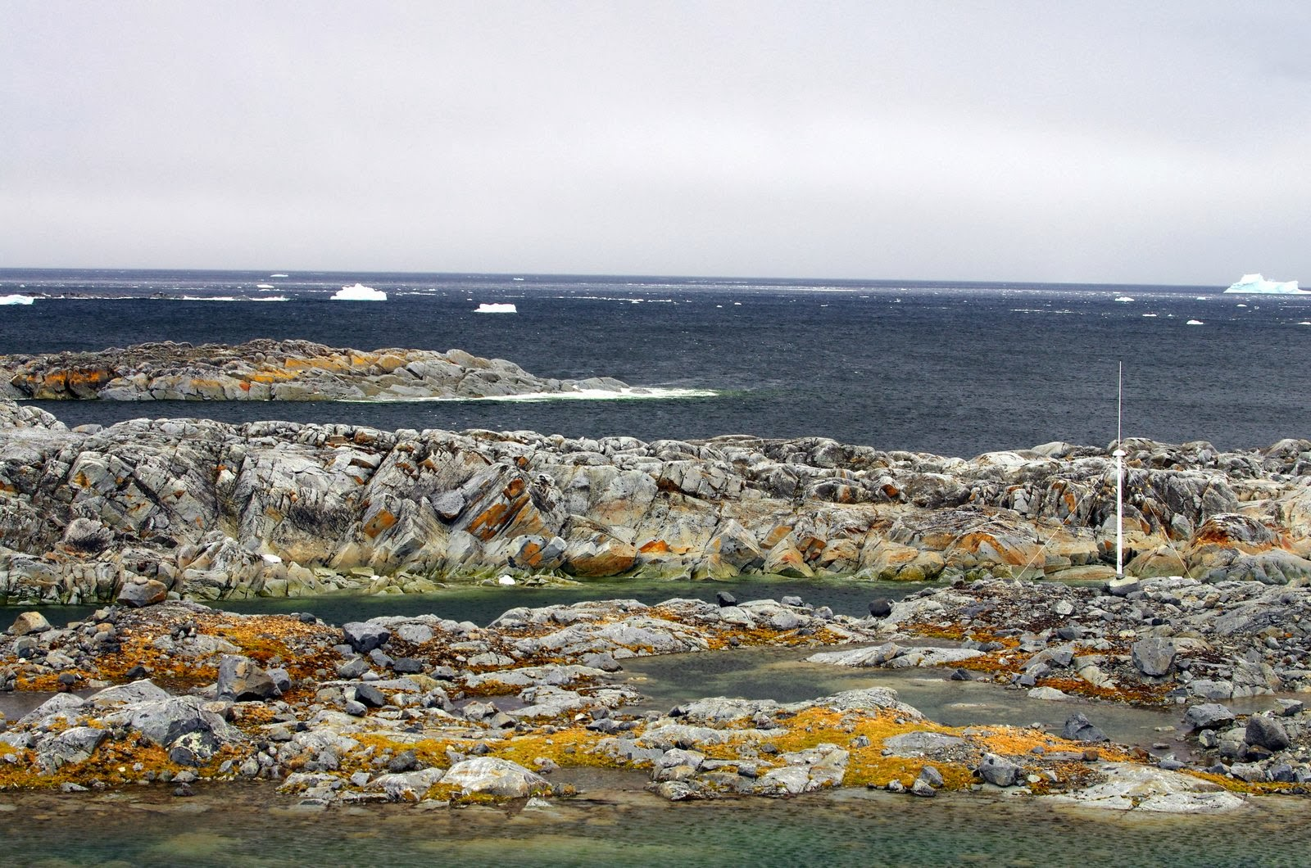
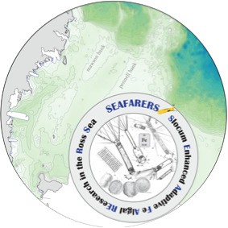
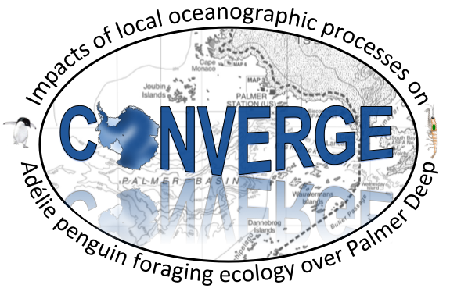


A scientist’s perspective on how broader impacts
impact our science
Josh Kohut, Kristin Hunter-Thomson, and Janice McDonnell
Rutgers University
Harold Clark
Liberty Science Center
AND MANY MANY MANY MANY MORE!!!!!

Slide 2
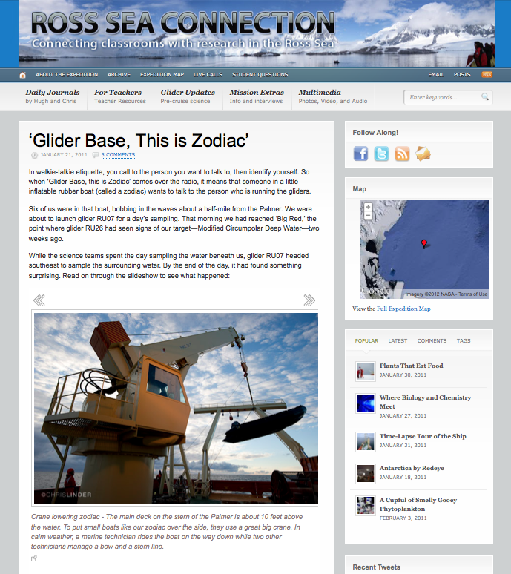
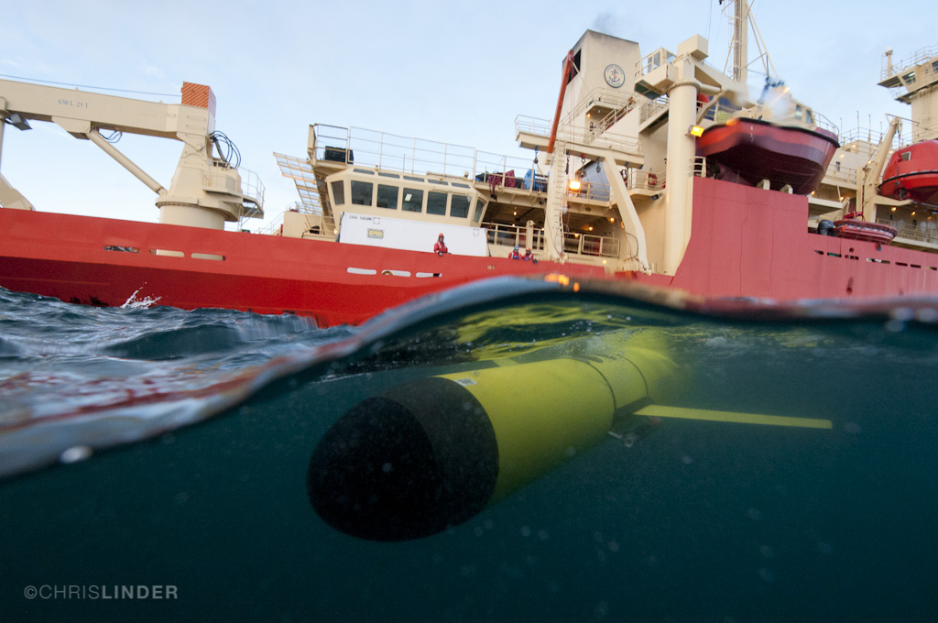

The Ross Sea
Connection
Dec 2010-Feb 2011
Connecting classrooms with research in the Ross Sea
Teacher Professional Development
Live Research Blog
Live Audio links from the classroom to the ship

Slide 3
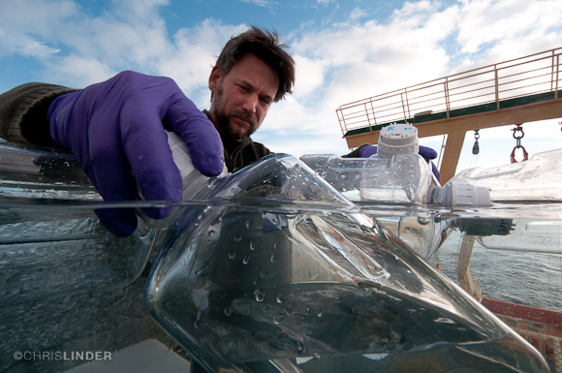
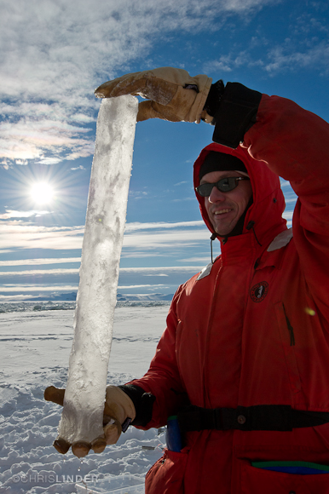
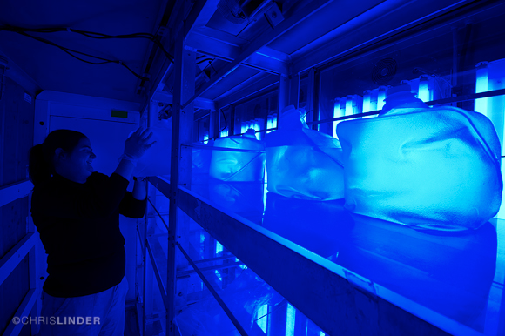
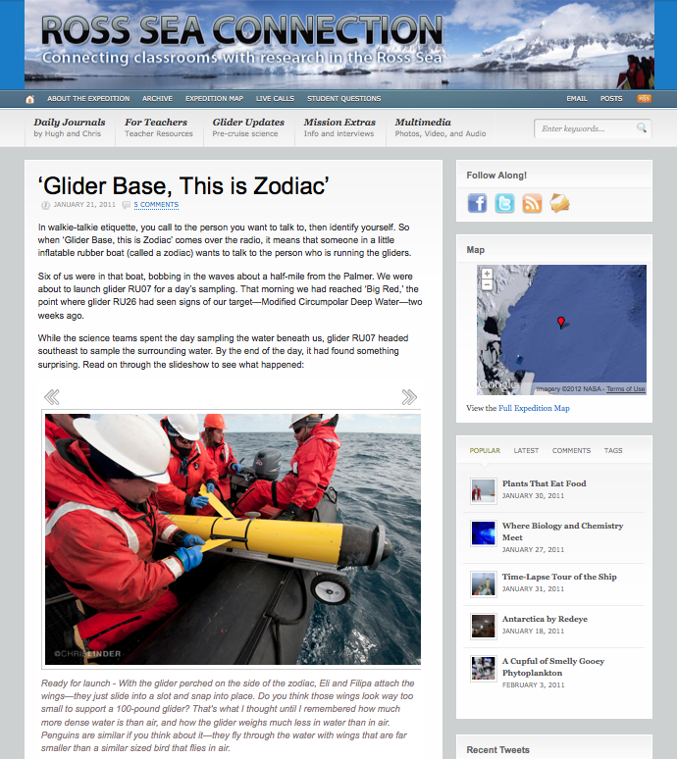
The Ross Sea
Connection
Scientists’ Impressions
‘I was quite impressed with this whole broader impacts project.’
‘I enjoyed it and was happy to see such a professional approach to this.’
‘Just a big thank you to all those involved to make it so easy to be part of this great program.’

Slide 4
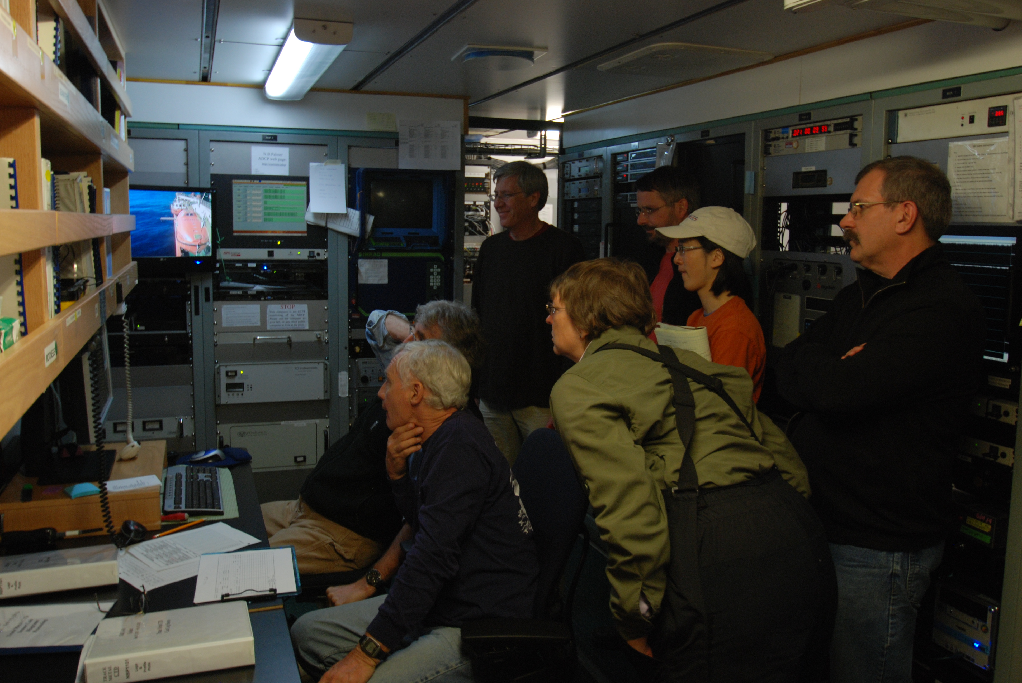
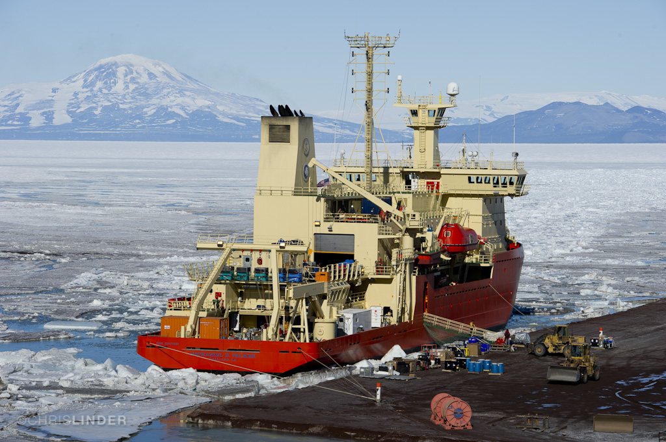
The Ross Sea
Connection
Connecting to the scientists
Enthusiasm and willingness of the research scientists to meet with teachers speak with students during
Online profiles of the scientists created a personal bond between the teachers, students and scientists.
Connecting to real scientists: student concerns with earthquake in Christchurch, New Zealand.
It became everyone’s research mission.

Slide 5
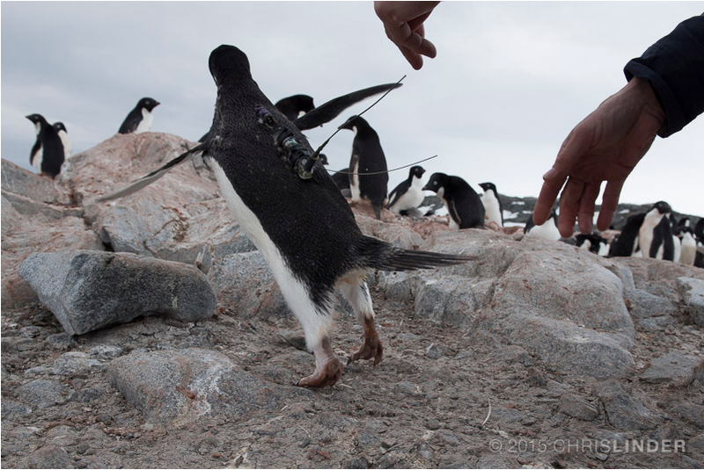
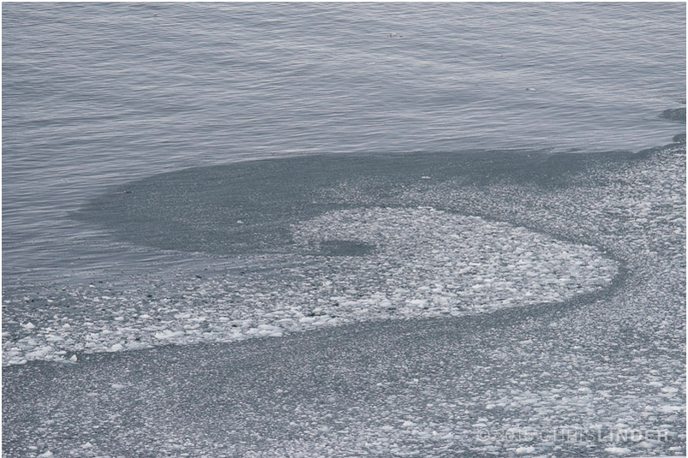
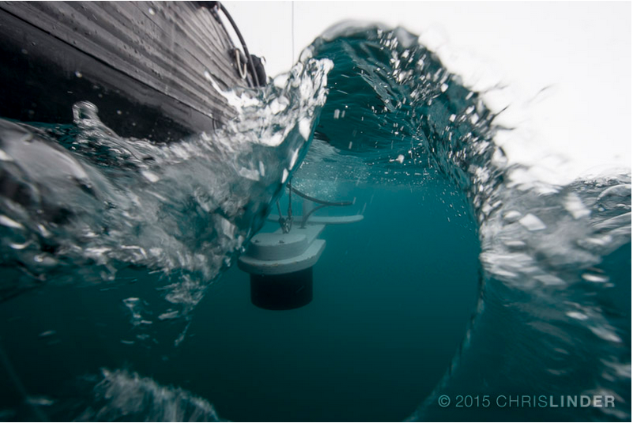
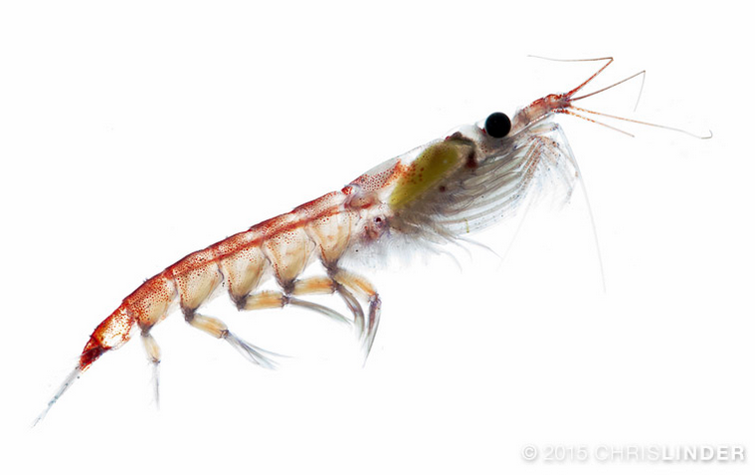
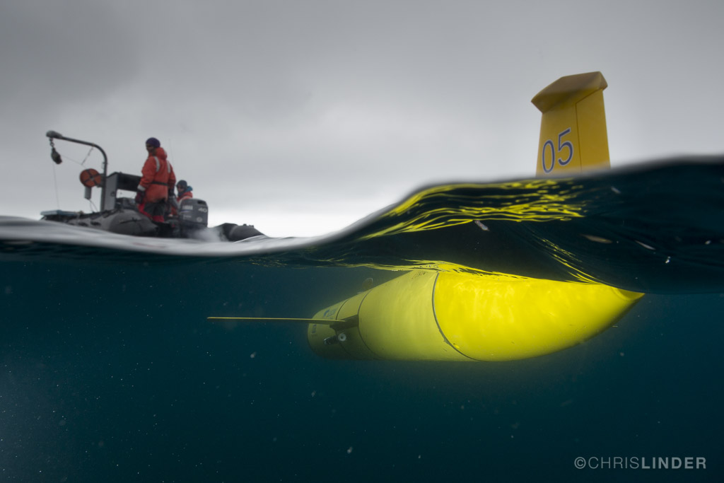
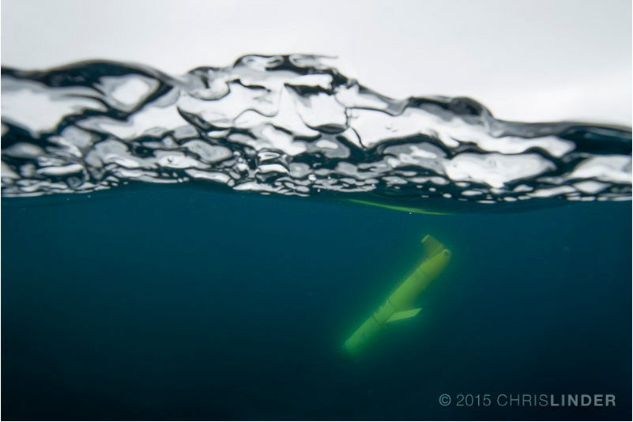
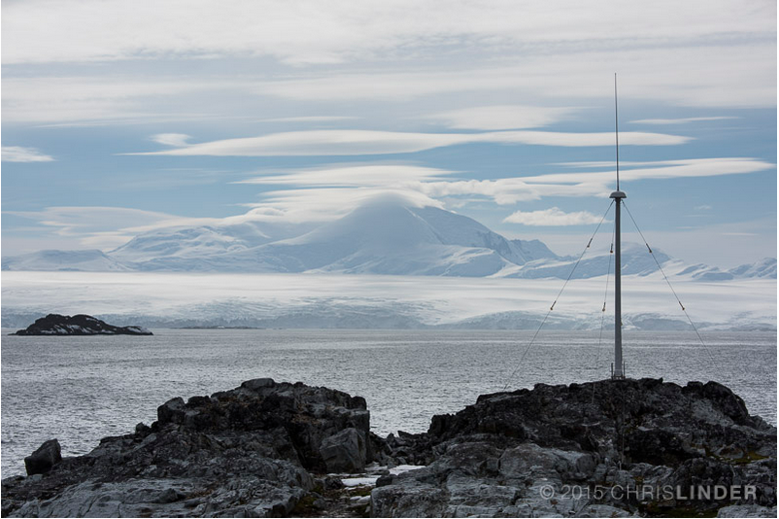
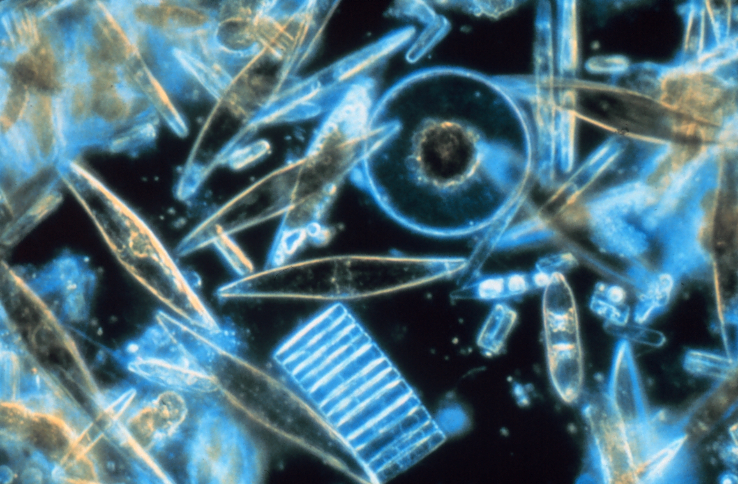
Project CONVERGE

Slide 6
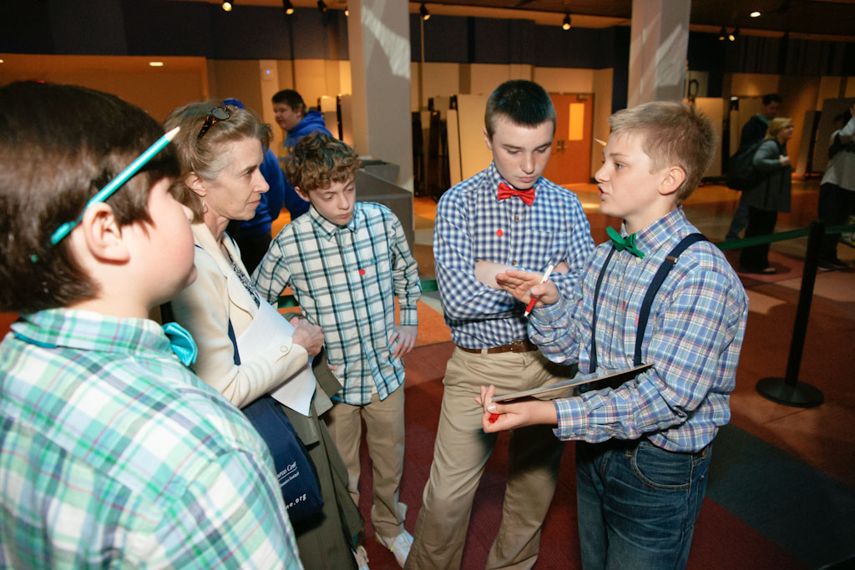
Desired Outcomes
For Middle School Students:
An increased engagement in science, and resulting self-identification as a scientist.
For Middle School Educators:
Improved practice in teaching the nature and process of science.
….. through participating in a real science mission and having students developing and conduct their own related science investigations.
Notes:
Recommendations for scientists of developed and vetted models of outreach to engage students, teachers, and/or general public in STEM.

Slide 7
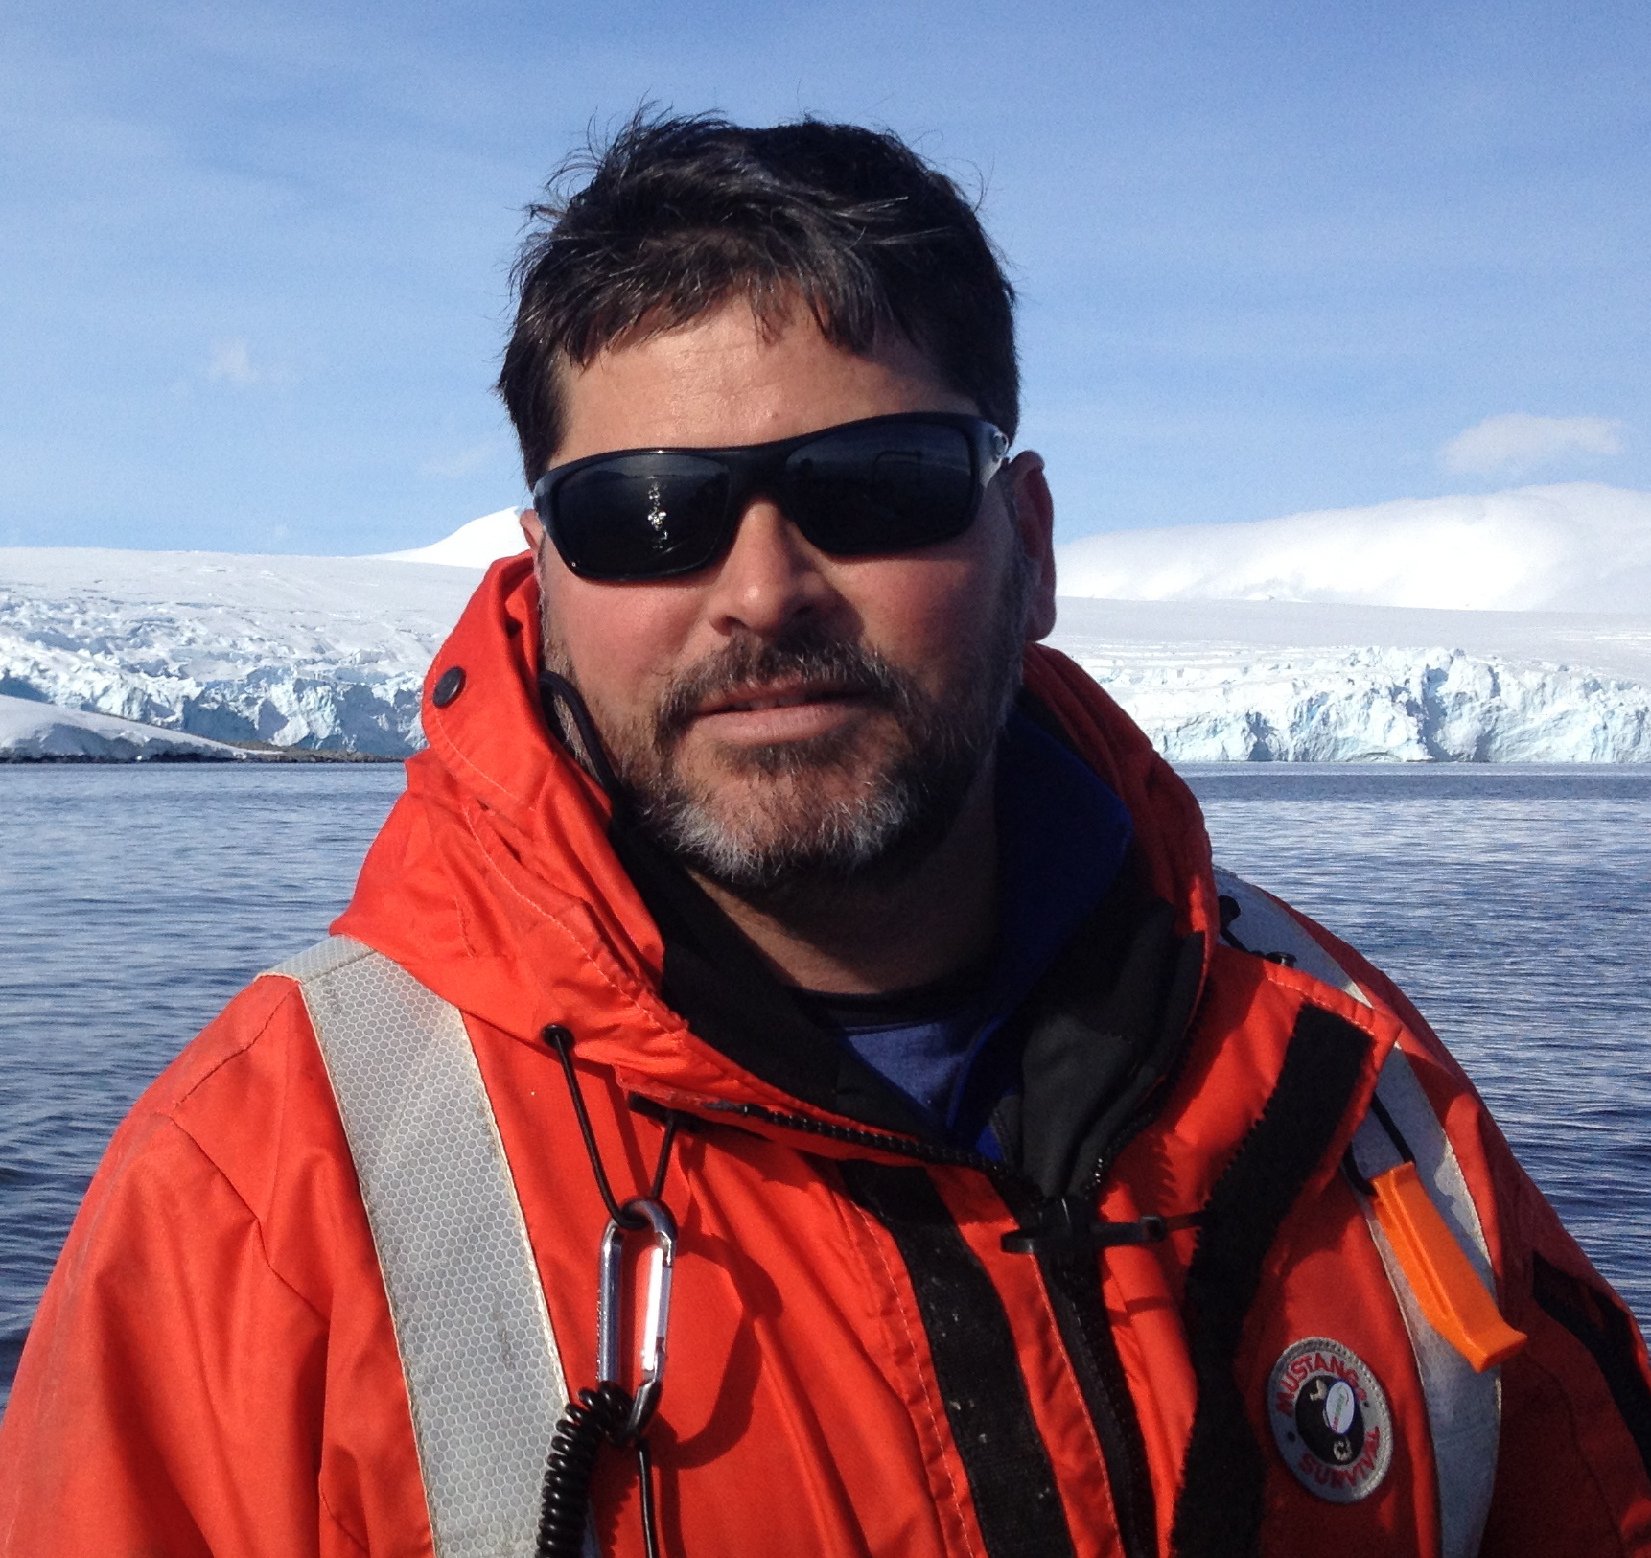
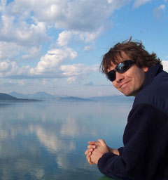
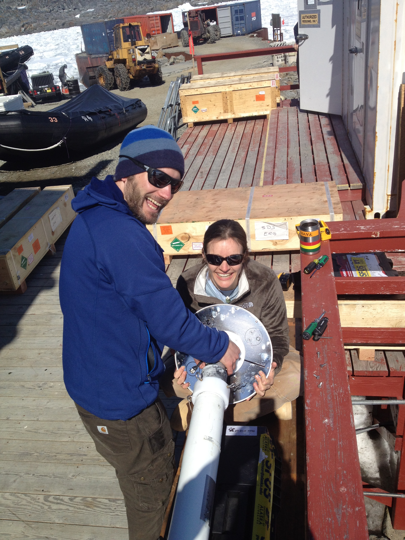
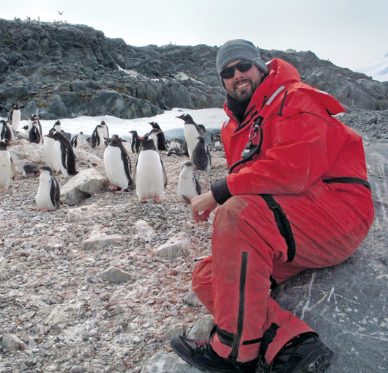
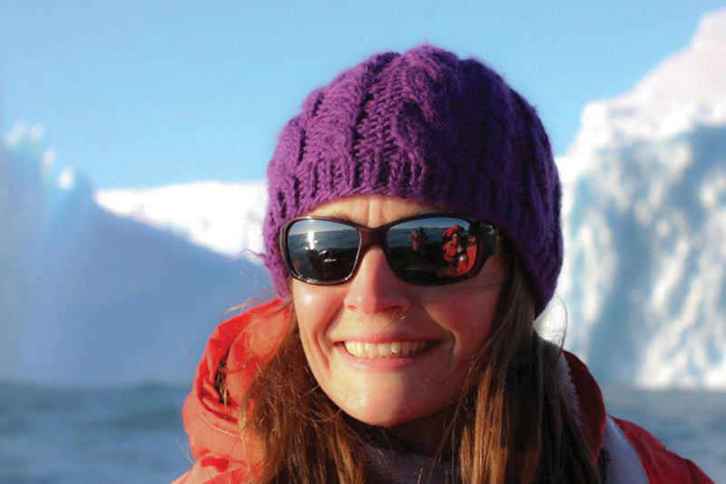
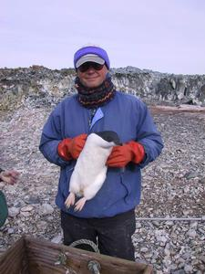
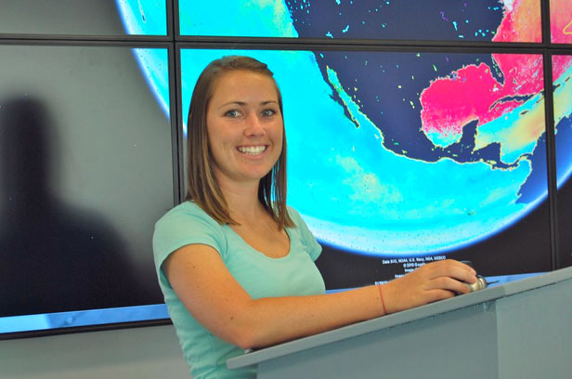
The Science Team
Physics
Phytoplankton (Plants)
Krill (food)
Penguins
(Top Predator)
… and many more!

Slide 8
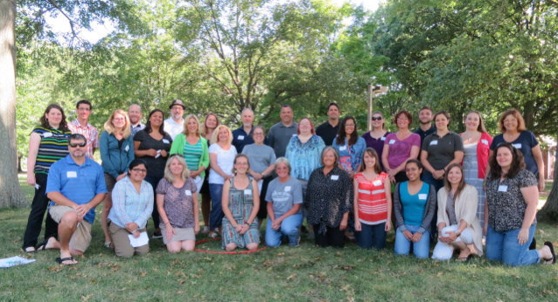
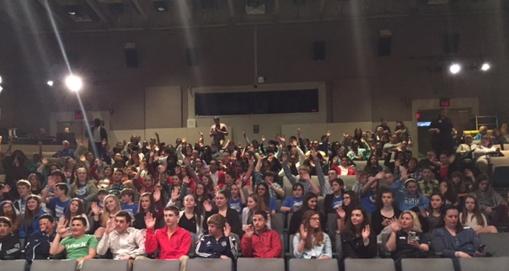
21 teachers
> 1,100 Students

Slide 9
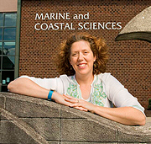
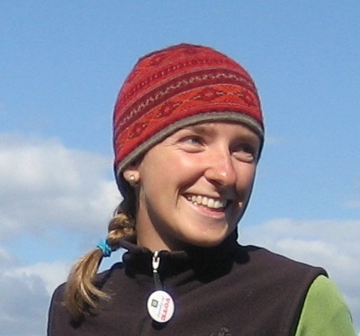


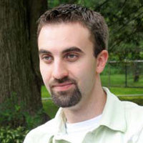
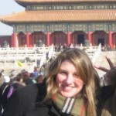
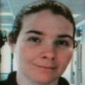
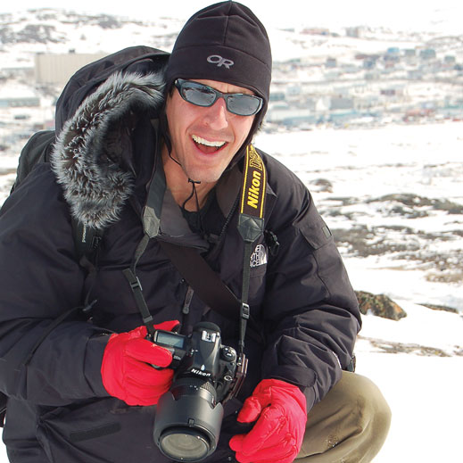
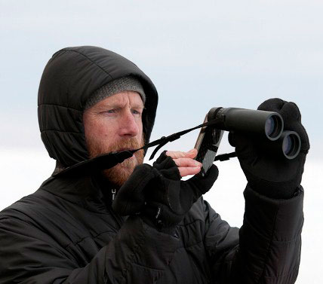
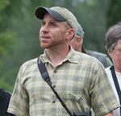
Kristin
Harold
Janice
Kate
Sage
Carrie
Katie
Chris
Hugh
Charles
Notes:
So who are we all on the Education Team?
Rutgers – Janice, Sage, Carrie, and myself
LSC – Kate, Katie, Harold
Chris – photographer
Cornell – Hugh (writer), and Charles

Slide 10
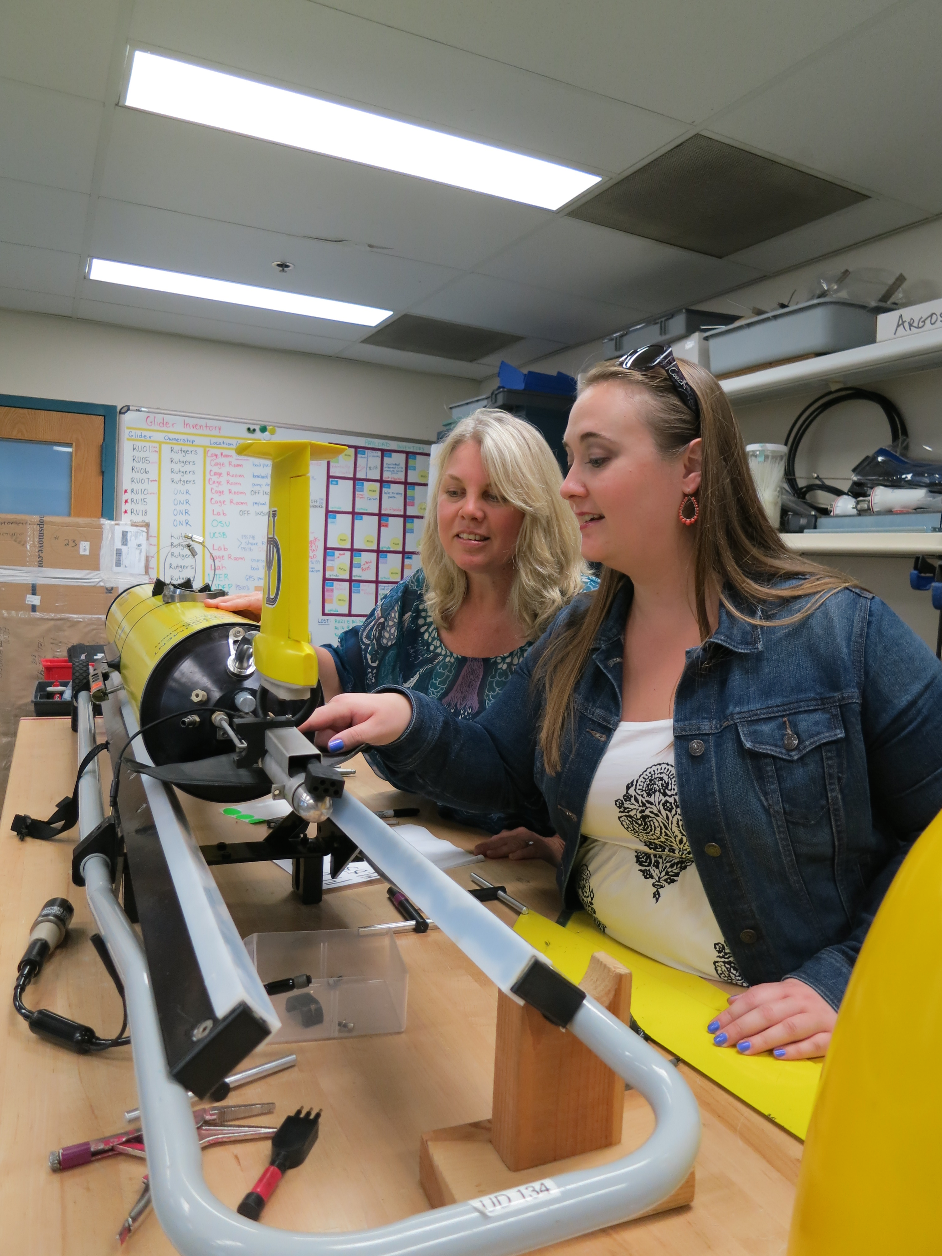
Year-long Program
Integrated with our Science
  Teacher Workshop (August)
  Science blog, VTCs, and CONVERGE data access (January)
  Mini-proposals and investigations (February/March)
  Student Research Symposium (April)
Notes:
Finally, the year-long classroom piece, which was called Project CONVERGE. There were 22 middle and high school science teachers whom were accepted to participate in the project and completed the week long training in August. These were the components of the project, but let me go through them in more detail…

Slide 11
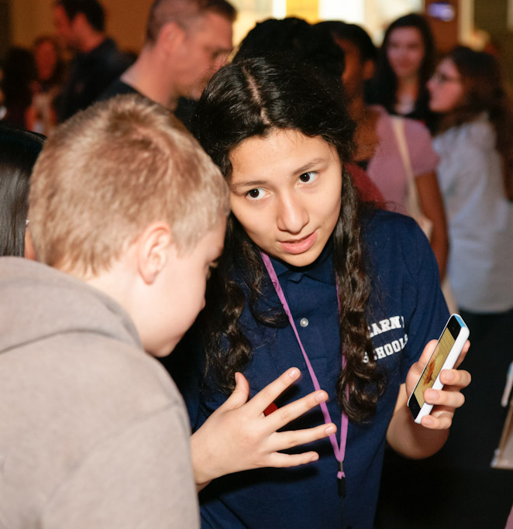
Investigations & mini-proposals
Student designed
Testable question
Collected & analyzed data
Submit 1-page mini-proposal to Education Team to receive feedback on question, design, and overall scope.
Notes:
After the students learned about what the science team did through the lessons, blog, and calls it was time for them to be scientists and develop their own investigations. As I mentioned earlier, we focused on helping the students to truly develop a testable question and to match their investigation design to be able to answer that question. To help the students in this design process and to have them more realistically mimic what the science team did, the students had to submit a 1-pg mini-proposal to the Kristin and Kate about their investigation to receive feedback and suggestions.
Of the submitted proposals: 29% did experiments, 26% used online data that was not from CONVERGE, and 46% used CONVERGE data for their investigations. Of the proposals that used CONVERGE data: 31% used krill data, 27% used CODAR data, 27% used penguin data, and 16% used glider data.

Slide 12
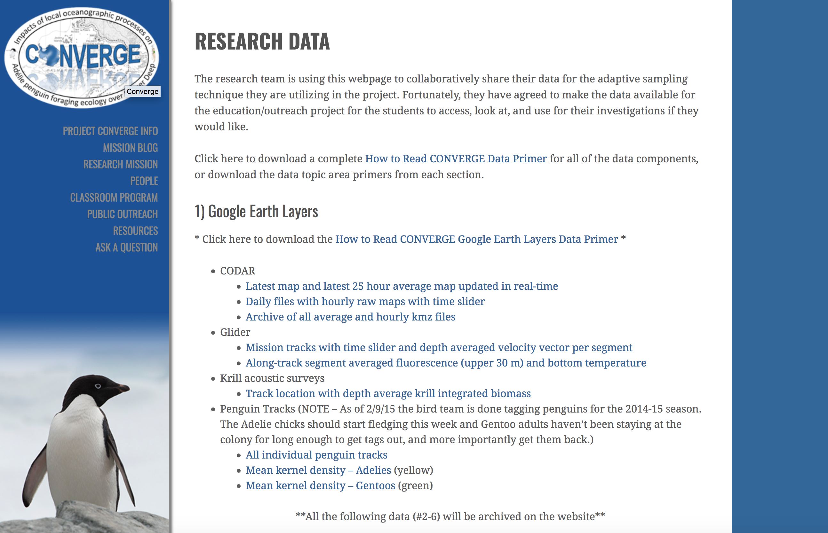
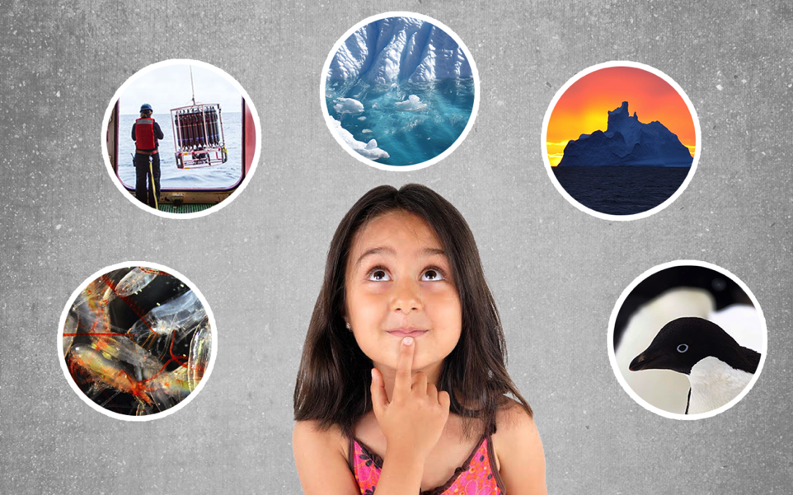
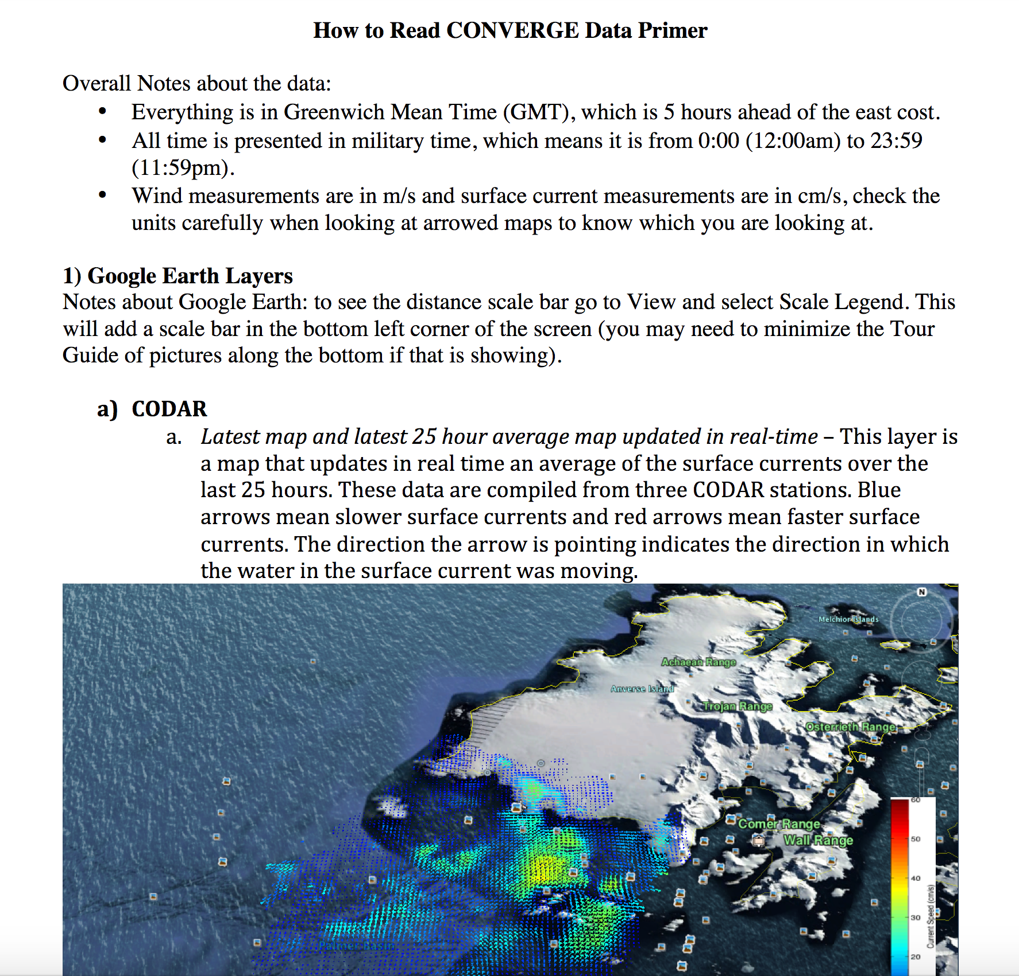
Student (and Scientist!) Research:
The critical role of the data primer
Data Primer:
31 pages of Data Goodness!!

Slide 13
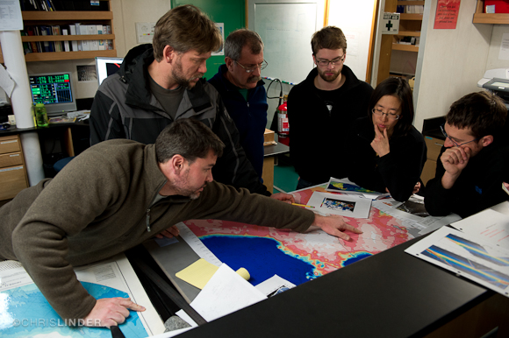
Student (and Scientist!)
Research:
The critical role of the data primer
  Of the 165 submitted proposals:
    29% did experiments
    46% analyzed CONVERGE data
  Of those that used CONVERGE data:
    31% used krill data
    27% used CODAR data
    27% used penguin data
    16% used glider data
  Enabled our multi-disciplinary team to communicate across disciplines!!

Slide 14

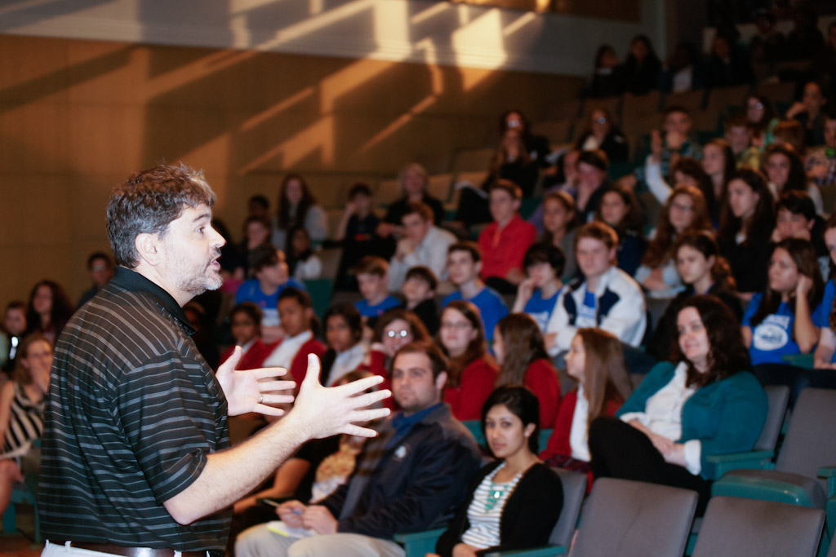
Student Research Symposium
April 17, 2015
At Liberty Science Center (Jersey City, NJ)
10-15 students from each school
Scientists presented update on work and participated in Q&A session with students about science as a career
Students presented their work at Poster Session (scientists and education team provided feedback)
Notes:
The culminating event of Project CONVERGE was the Student Research Symposium in the spring at LSC. 10-15 kids per school, 18 of the 22 schools participated in the SRS, traveled to LSC to learn from the science team (Matt and Josh) about where things are at with the project, some preliminary findings, and what are the next steps for the data analysis and wrapping up the science mission. Additionally, the top three posters from each school was presented by the students at the Poster Session. All scientists participating in the day, as well as the Education Team, other RU scientists and LSC education staff provided feedback to the students. This face-to-face connection is extremely important for students identification as a scientist!

Slide 15
Evaluation
Teachers said:
“I realize how important it is to have the students become more invested in their learning by designing their own procedures.”
Students said:
“you had to actually think and figure out what you were looking at.”
“my group had to deal with a lot of [data]. It was very confusing and my entire group got a headache. Much respect to the people who deal with it everyday.”
Scientists said:
“Too often, we get wrapped up in our research and forget the importance of outreach. When this happens we end up segregating ourselves from the public.”
Blue Futures, Educating the next generation: MTS Journal Special Issue:
Kohut, J., et al., Project CONVERGE: A broader impact plan that engaged educators and students in the process of polar ocean science campaigns.

Slide 16

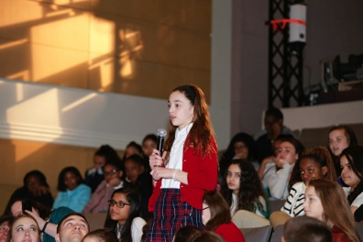
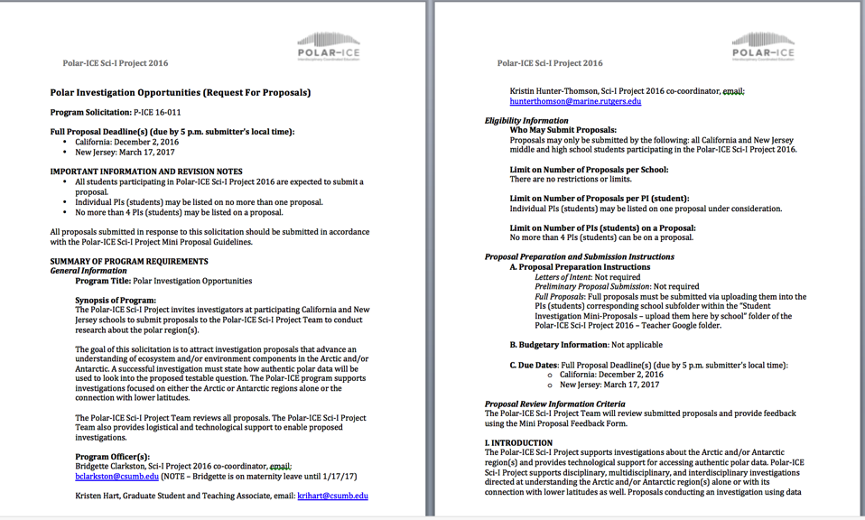
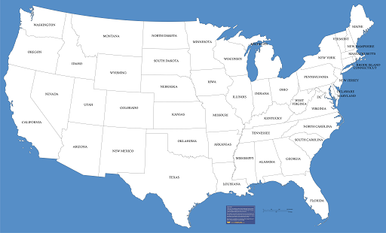
Immersing Students in Polar Research
A Formal RFP
Expanding Geographically
For much more information,
visit Hunter-Thomson et al., Today 4-6 pm
Poster # ED14B-2332

Slide 17
Summary
Educators and students: increased their understanding of the authentic process of science and use of real-world data.
Educators: changed their approach to teaching the process of science to be more active and student-led.
Students: saw themselves as contributing scientists and as active drivers of their learning process.
Scientists: were engaged in more effective collaboration and recognized the importance of evaluation and advancement of both intellectual merit and broader impact.
http://coseenow.net/ross-sea/
http://coseenow.net/converge/
http://polar-ice.org/

Slide 19
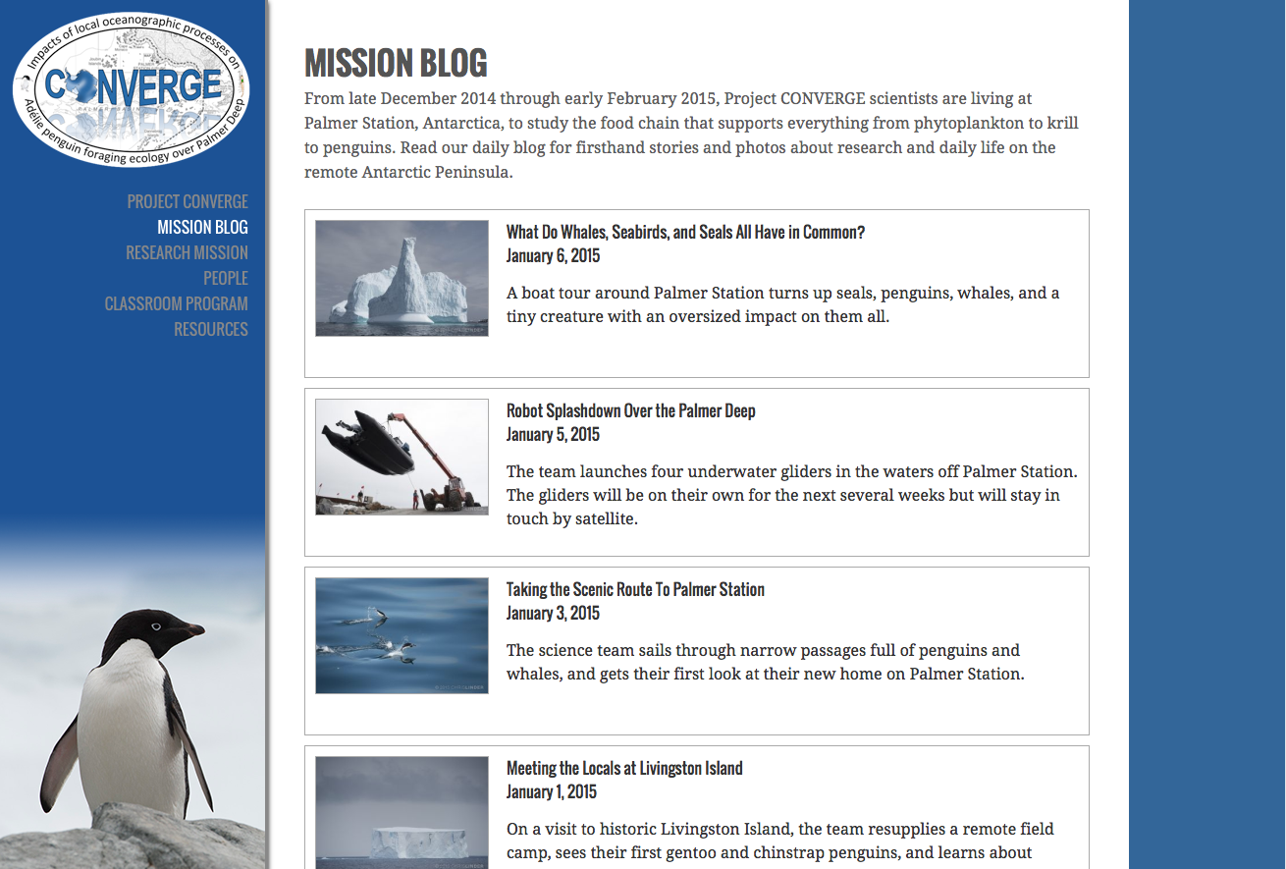
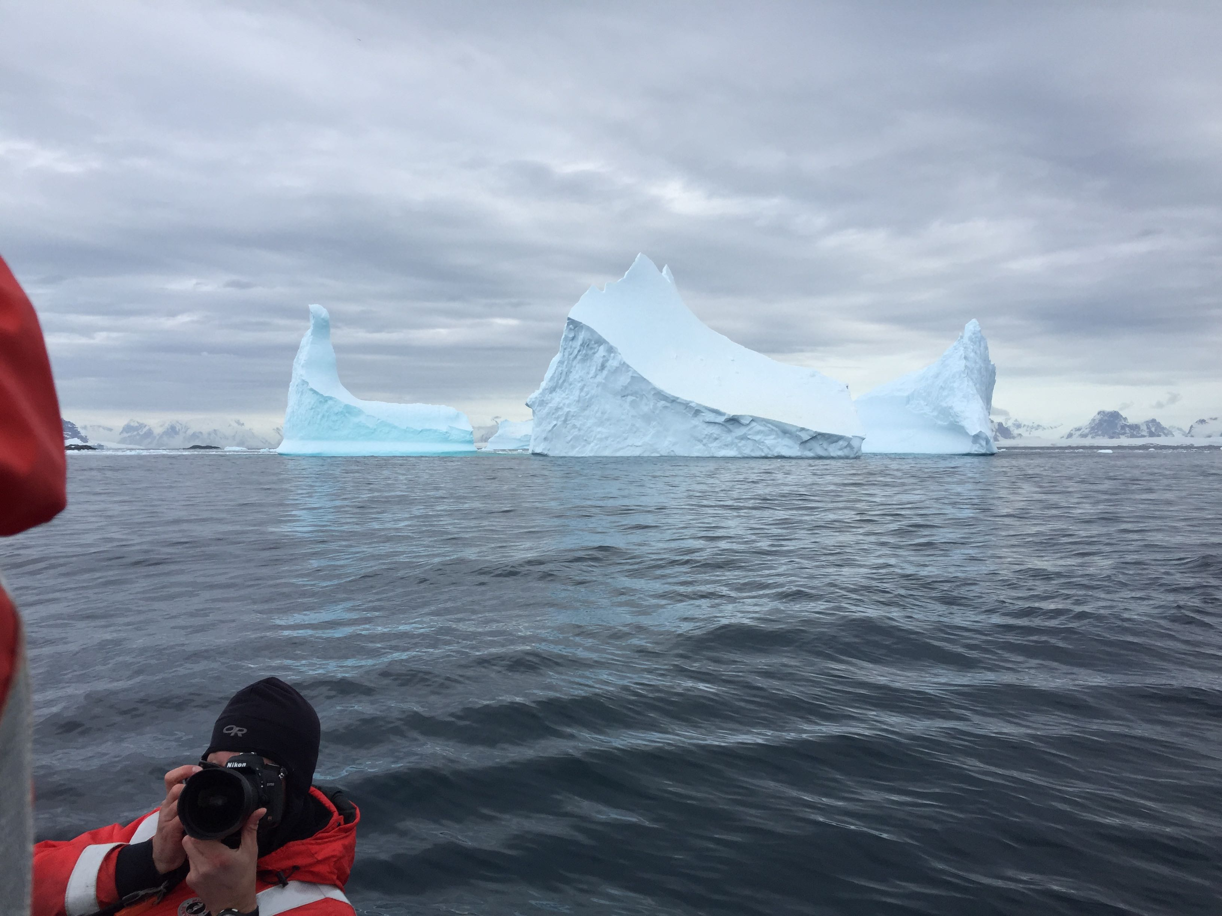
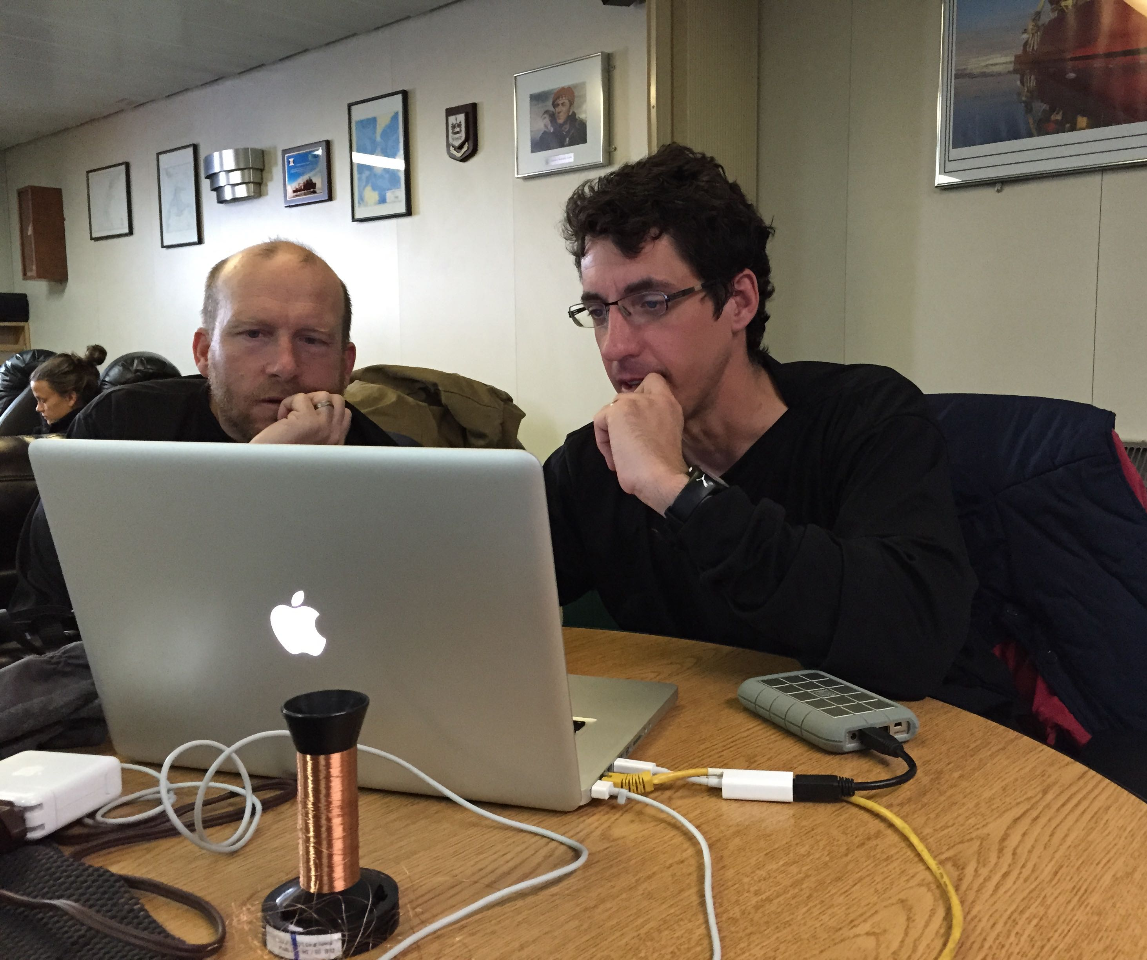
Mission Blog: 28 posts, 21,498 views, 537 comments/questions
http://coseenow.net/converge

