Slide 1
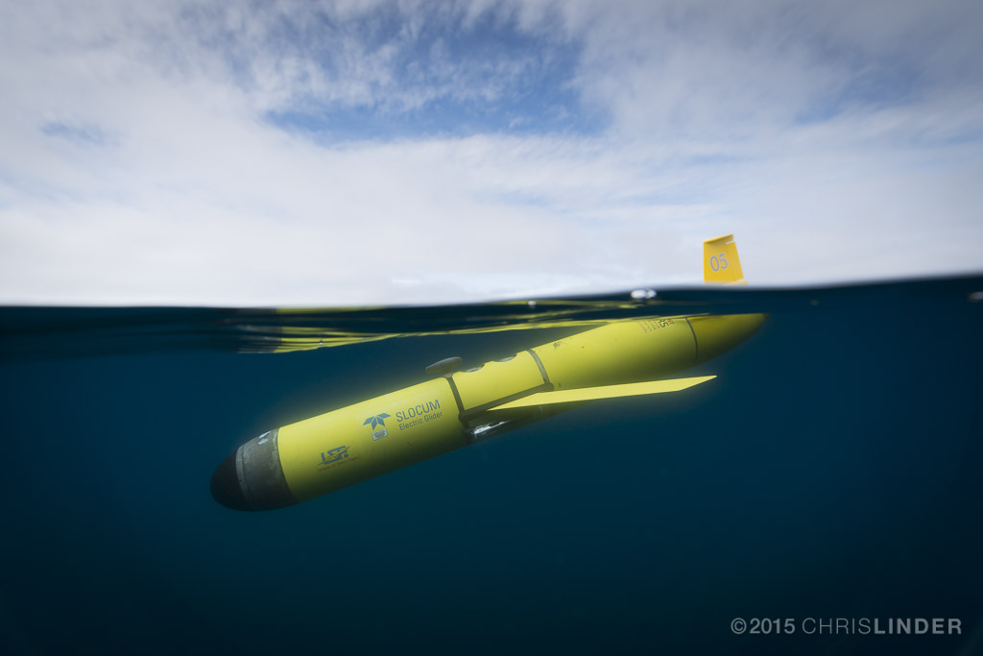
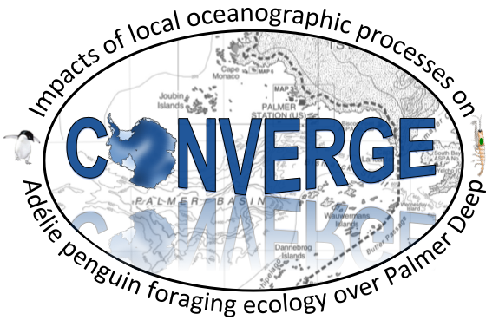

Project CONVERGE:
Biological and Physical Features Shape the Distribution of Zooplankton Patches in Palmer Canyon, Antarctica
Cordielyn Goodrich and Matt Oliver
University of Delaware
Megan Cimino
Scripps Institution of Oceanography
Kim Bernard
Oregon State University
Bill Fraser and Donna Patterson-Fraser
Polar Oceans Research Group
Josh Kohut, Laura Palamara, and Travis Miles
Rutgers University
Peter Winsor and Hank Statscewich
University of Alaska, Fairbanks
Erick Fredj
Jerusalem College of Technology
Notes:
This study is just one part of project converge.
Many people have taken part in this project including

Slide 2
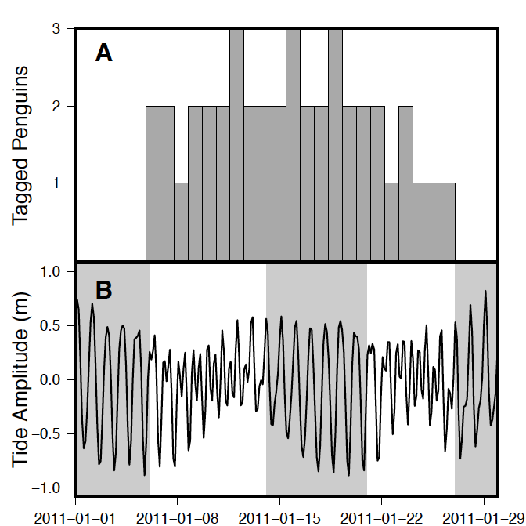
Palmer Deep, Western Antarctic Peninsula
Semi-Diurnal
Diurnal
Oliver et al. 2013
Notes:
-Oliver et al looked at Adeile penguin foraging tracks over ten years
and showed this change in foraging behavior with switching tidal regime
-Bernard and Steinberg sampled krill close to the Adeile penguin colony
saw a change in krill biomass
- penguin foraging behavior was a result of changing prey distribution

Slide 3
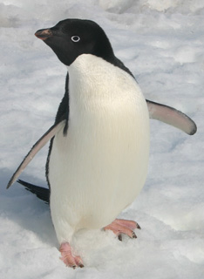
Tidal Regime Switching
Ten years of penguin foraging tracks
Change in foraging behavior based on tidal regime
Semi-Diurnal
Diurnal
Oliver et al. 2013
Notes:
-Oliver et al looked at Adeile penguin foraging tracks over ten years
and showed this change in foraging behavior with switching tidal regime
-Bernard and Steinberg sampled krill close to the Adeile penguin colony
saw a change in krill biomass
- penguin foraging behavior was a result of changing prey distribution

Slide 4
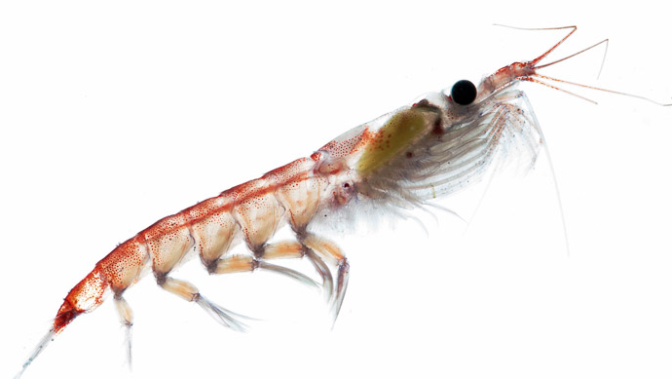
Tidal Regime Switching
Bernard and Steinberg 2013
Semi-Diurnal
Diurnal
Oliver et al. 2013
Notes:
-Oliver et al looked at Adeile penguin foraging tracks over ten years
and showed this change in foraging behavior with switching tidal regime
-Bernard and Steinberg sampled krill close to the Adeile penguin colony
saw a change in krill biomass
Tides are correlated
- penguin foraging behavior was a result of changing prey distribution

Slide 5
Project CONVERGE:
Notes:
Project converge was put together to further investigate the relationship between the physical oceanographic features and the ecosystem in palmer canyon.
Get a better idea of the convergent features which organize the food web in this area
Satellite tags used on penguins, gliders used to sample acoustics and optics, high frequency radar for sea surface currents
Going to focus on the glider portion and the HFR portion

Slide 6
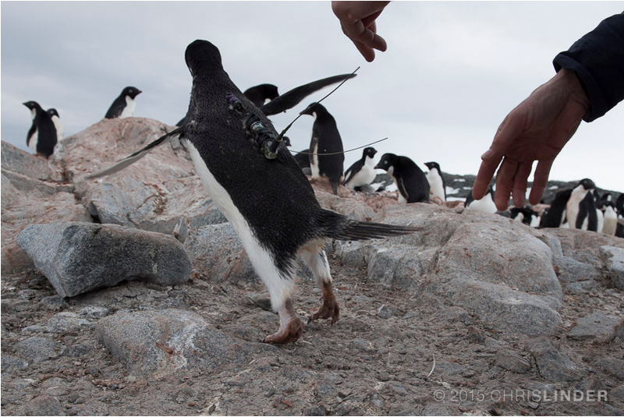
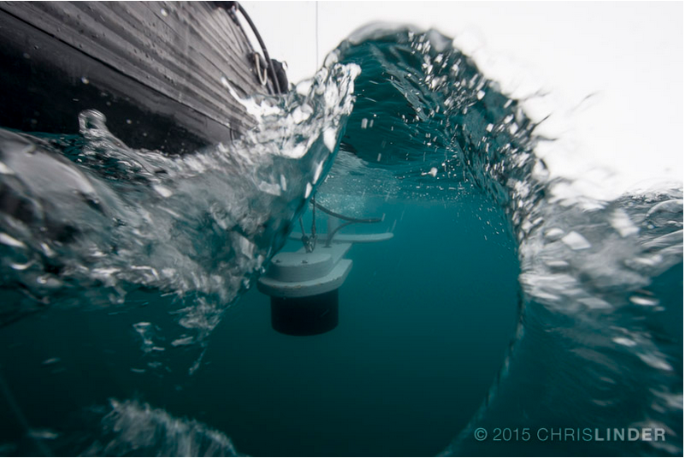
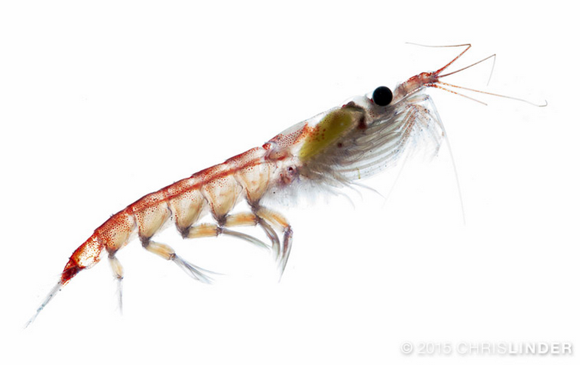
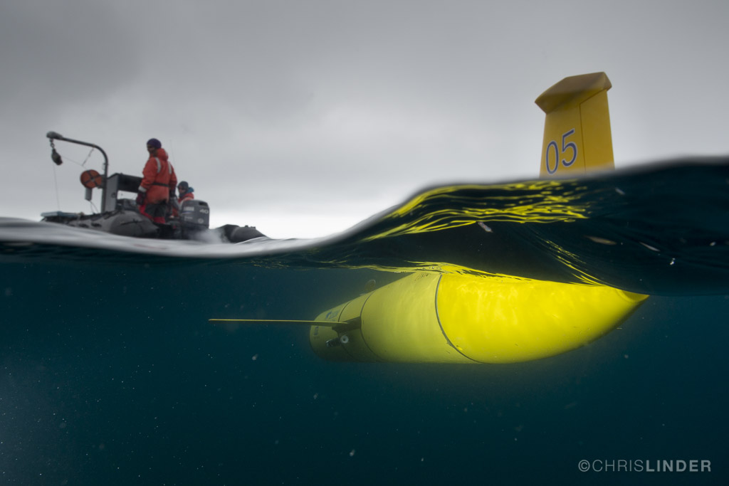
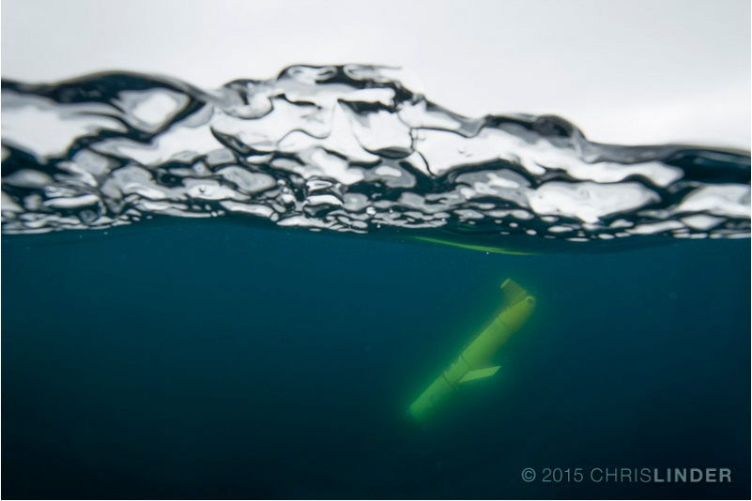
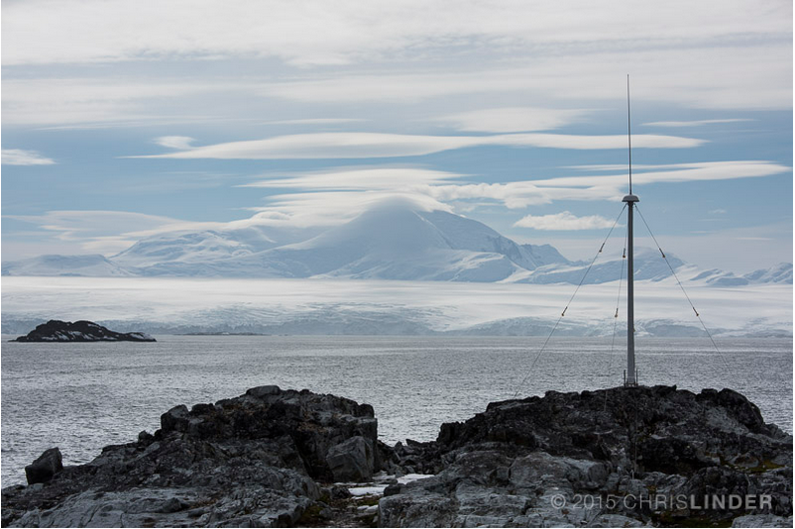
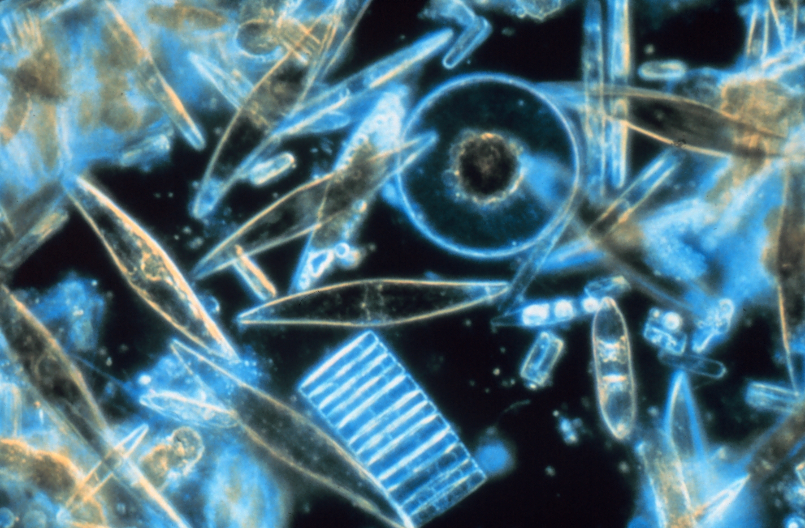
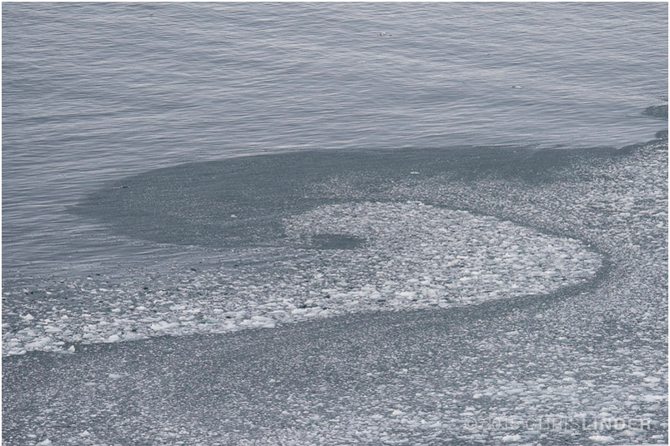
Project CONVERGE:
Notes:
Project converge was put together to further investigate the relationship between the physical oceanographic features and the ecosystem in palmer canyon.
Get a better idea of the convergent features which organize the food web in this area
Satellite tags used on penguins, gliders used to sample acoustics and optics, high frequency radar for sea surface currents
Going to focus on the glider portion and the HFR portion

Slide 7
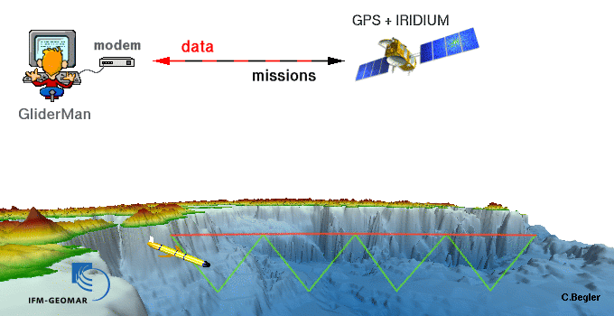
European Gliding Observatories
Notes:
Auv
Buoyancy driven

Slide 8
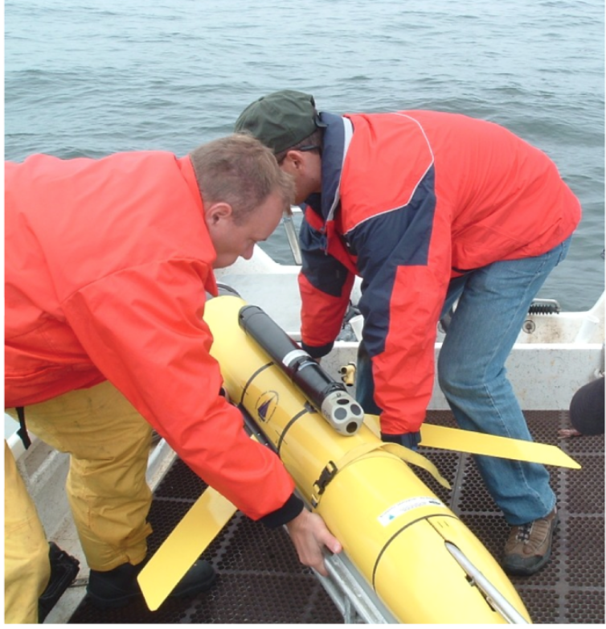
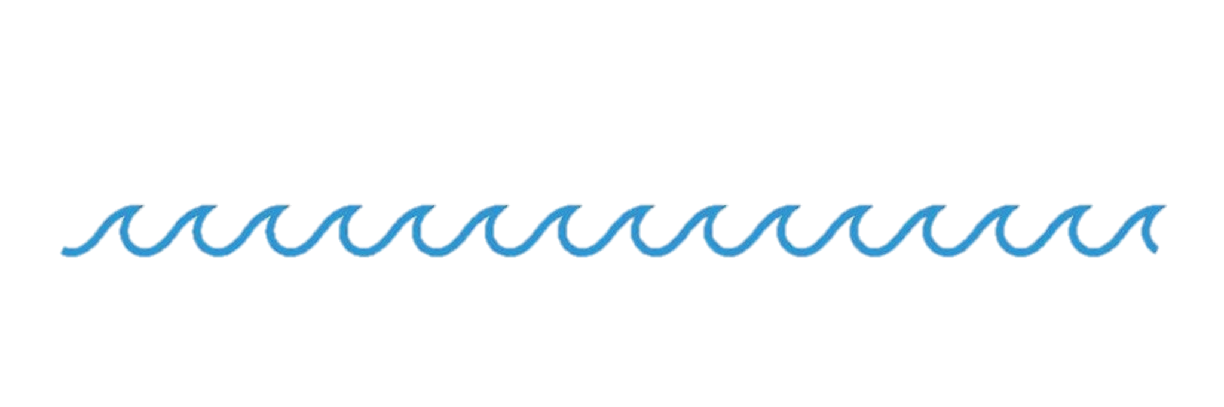
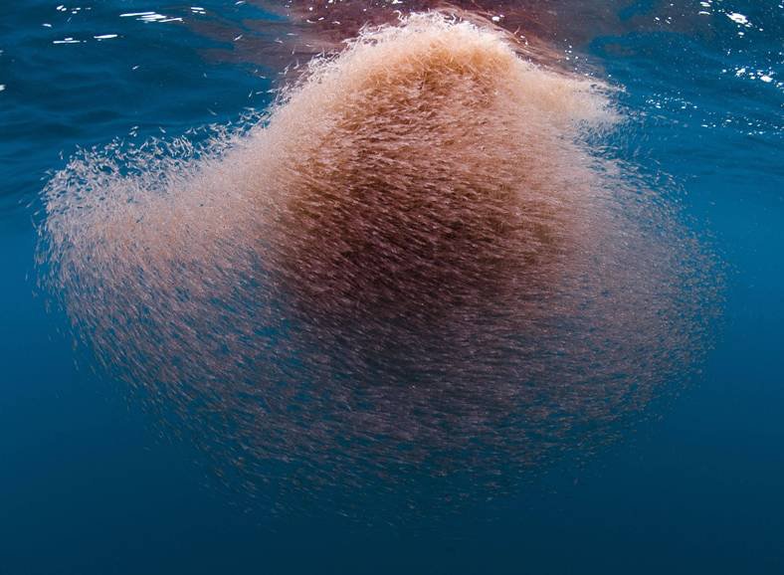
Acoustic Doppler Current Profiler (ADCP) Mounted on Glider
Notes:
1 mhz mounted on Slocum glider
Upward looking
Send out sound wave, records the intensity of the returning sound wave
Face of the ADCP tilted at 25 degrees so that it faces upward as the glider travels in the water column
When the glider travel through a krill aggregation you get really high acoustic return

Slide 9
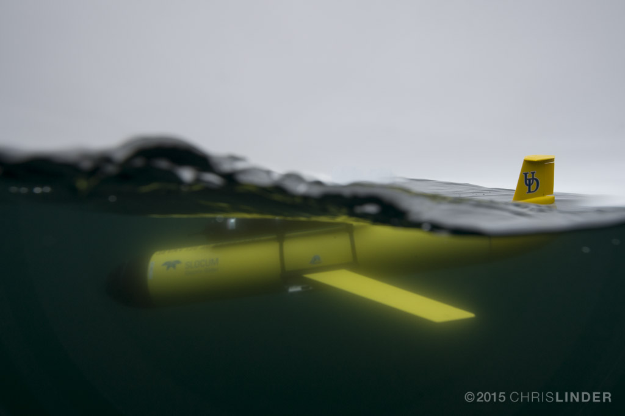
Notes:
Sampled palmer canyon with three gliders
Only looking at the Station Keeping

Slide 10
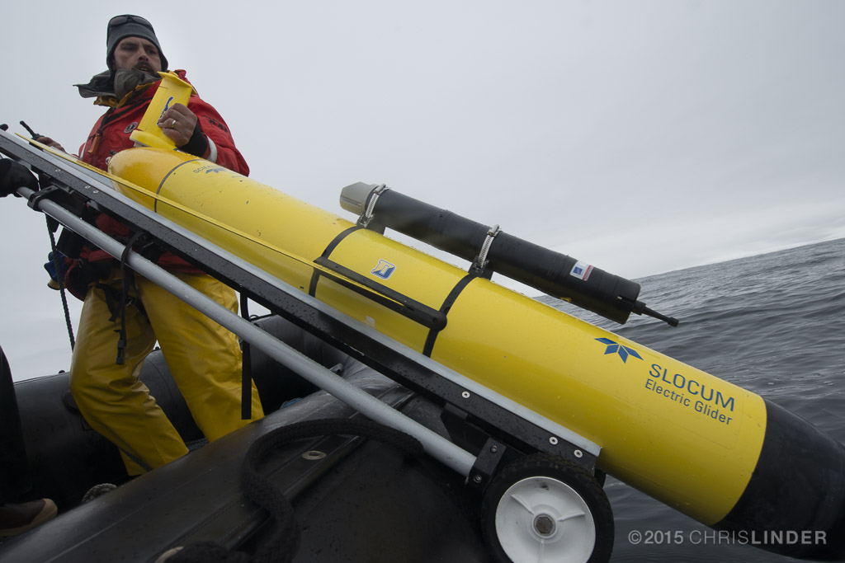
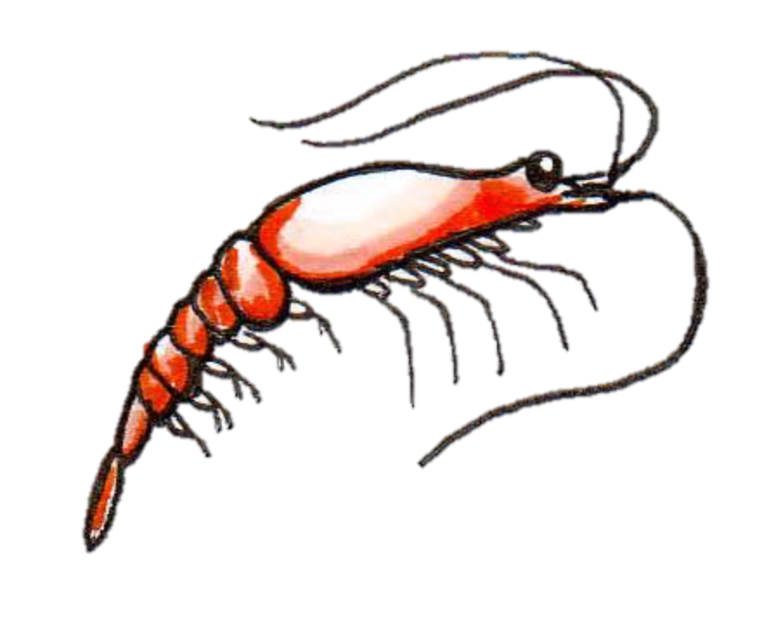
1 MHz Acoustic Doppler Current Profiler (ADCP) mounted on Glider
Detecting particles > 640μm
Low High
Relative Acoustic Backscatter
Distribution of Acoustic Return to Determine Presence and Absence of Zooplankton
Notes:
What we are interested in is the areas of high relative acoustic return,
where the ADCP is measuring krill.
Point out what it looks like
this isnt a krill instrument. Dont want to make assumptions about the number of krill but can say something about the presence or absence of krill
So we are going to take values above the 95th percentile and label them as krill presence and the rest is labeled as an absence.

Slide 11
Zooplankton presence at the 95th percentile
Mixed layer depth
Notes:
Classic Antarctic temperature plot
Warmer surface water, deep winter water and MCDW coming up from underneath
MLD occurs between the warm surface water and the cold winter water
MCDW : modified circumpolar deep water

Slide 12
Diel Vertical Migration
91st Zooplankton Threshold
95th Zooplankton Threshold
99th Zooplankton Threshold
Notes:
further supports

Slide 13
Tide
Adopted from Bernard and Steinberg 2013
Near-Shore
Off-Shore
Notes:
Near shore there is a tidal effect
Offshore we wanted to test if this was also the case offshore
Its not

Slide 14
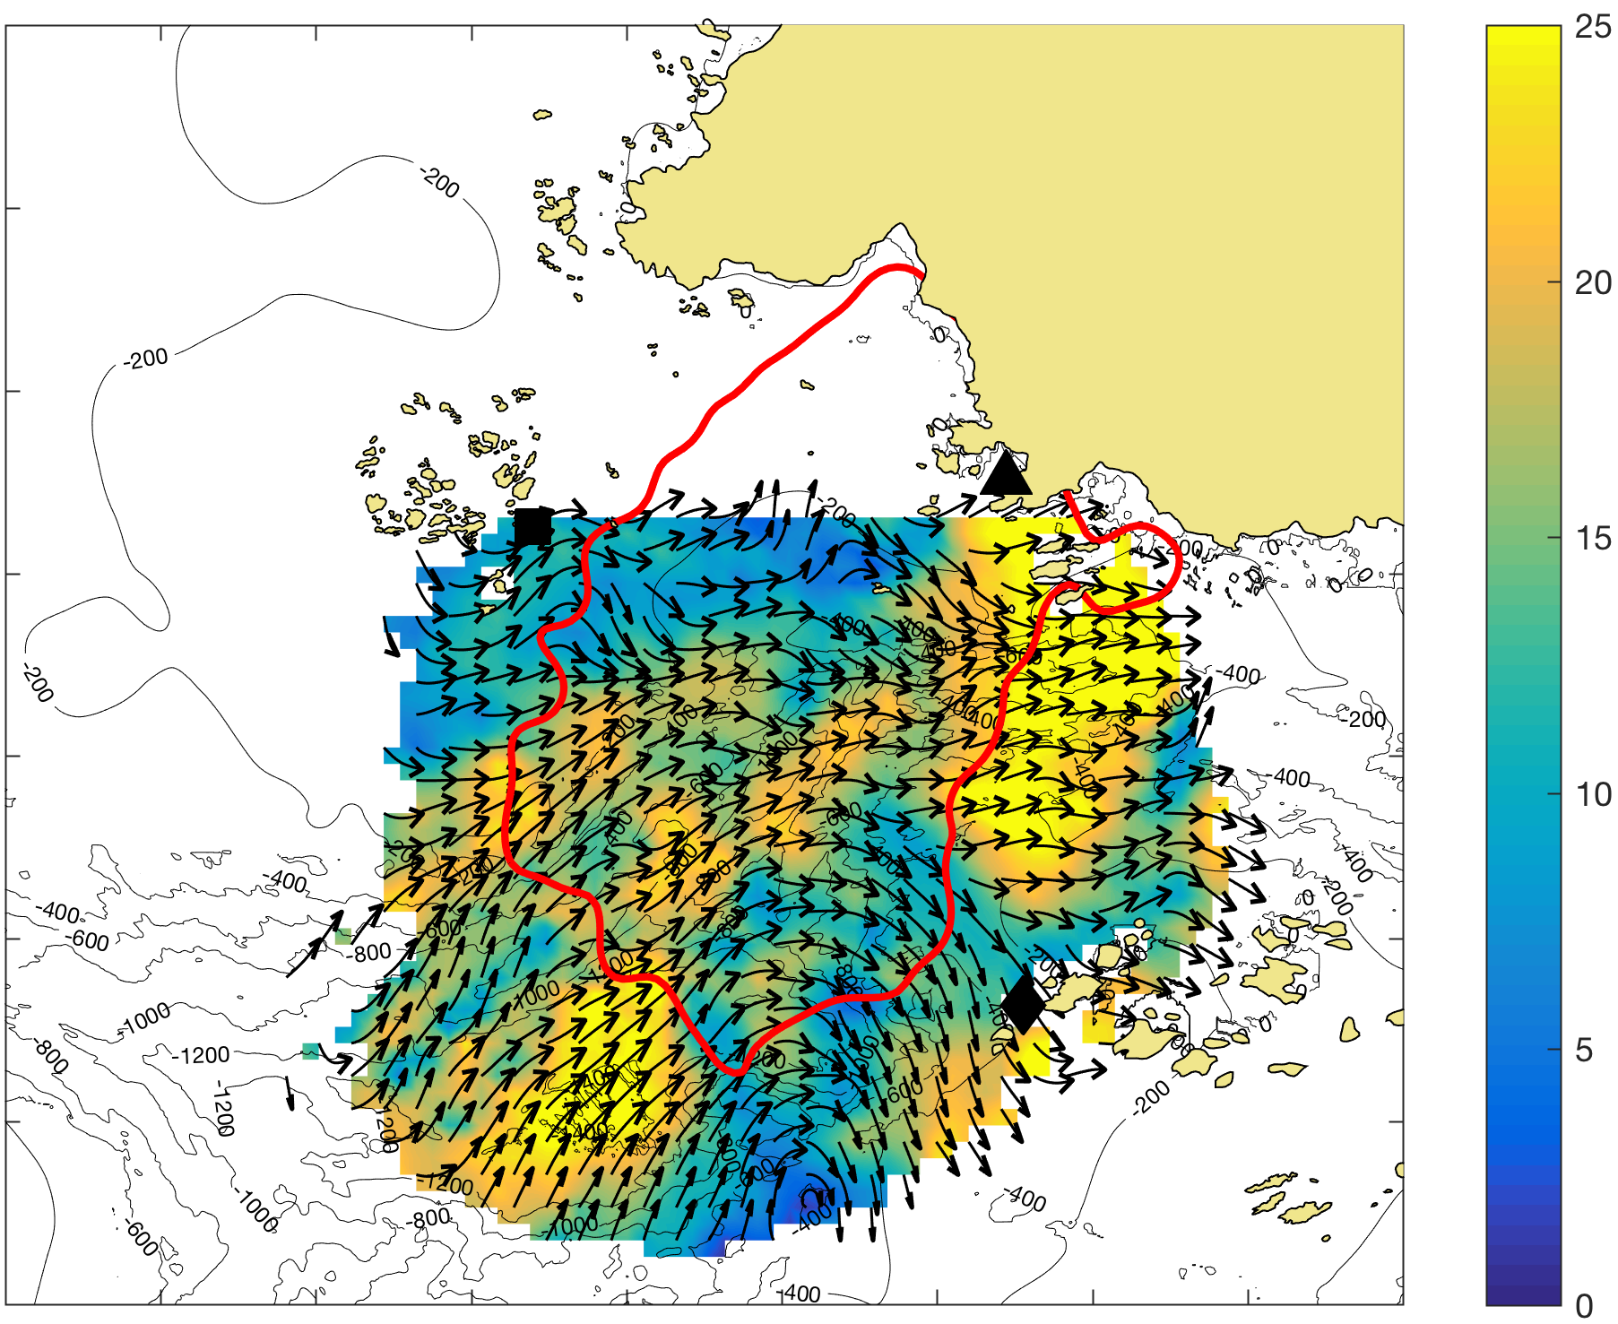
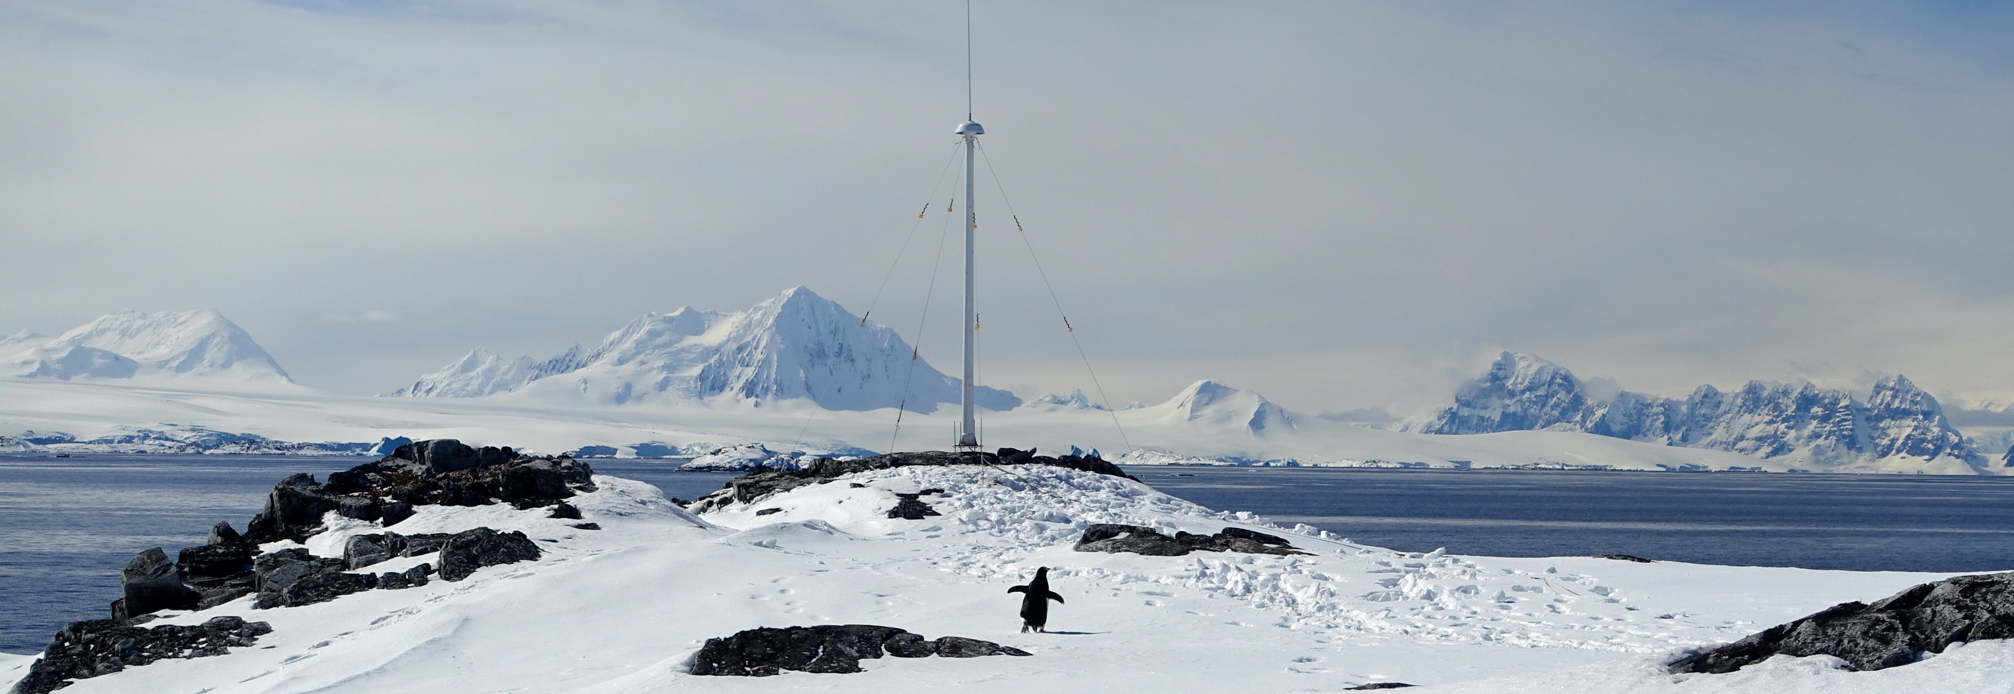


Hourly Surface Current Maps
500 m resolution
10 km
Surface Currents (cm/s)

Slide 15
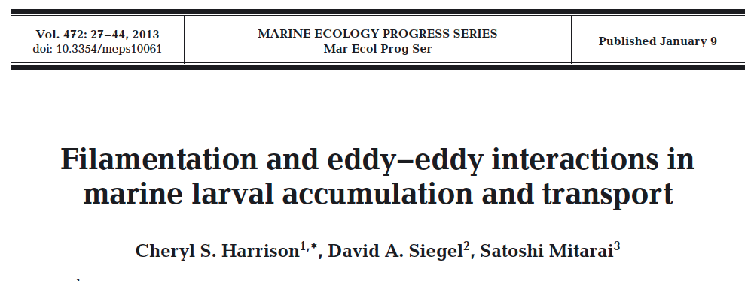
Lagrangian Coherent Structures
aLCS – blue vs. rLCS – red
Not the same as Convergence vs Divergence!
Buoyant particles tend to move toward, and then along aLCS
Buoyant particles tend to move along, and then away from rLCS
Net result for simulated buoyant particles:
Both aLCS and rLCS have higher than background particles, but aLCS has more than rLCS.
d₀
d
Attracting LCS
Repelling LCS
If
then
is the FTLE

Slide 16
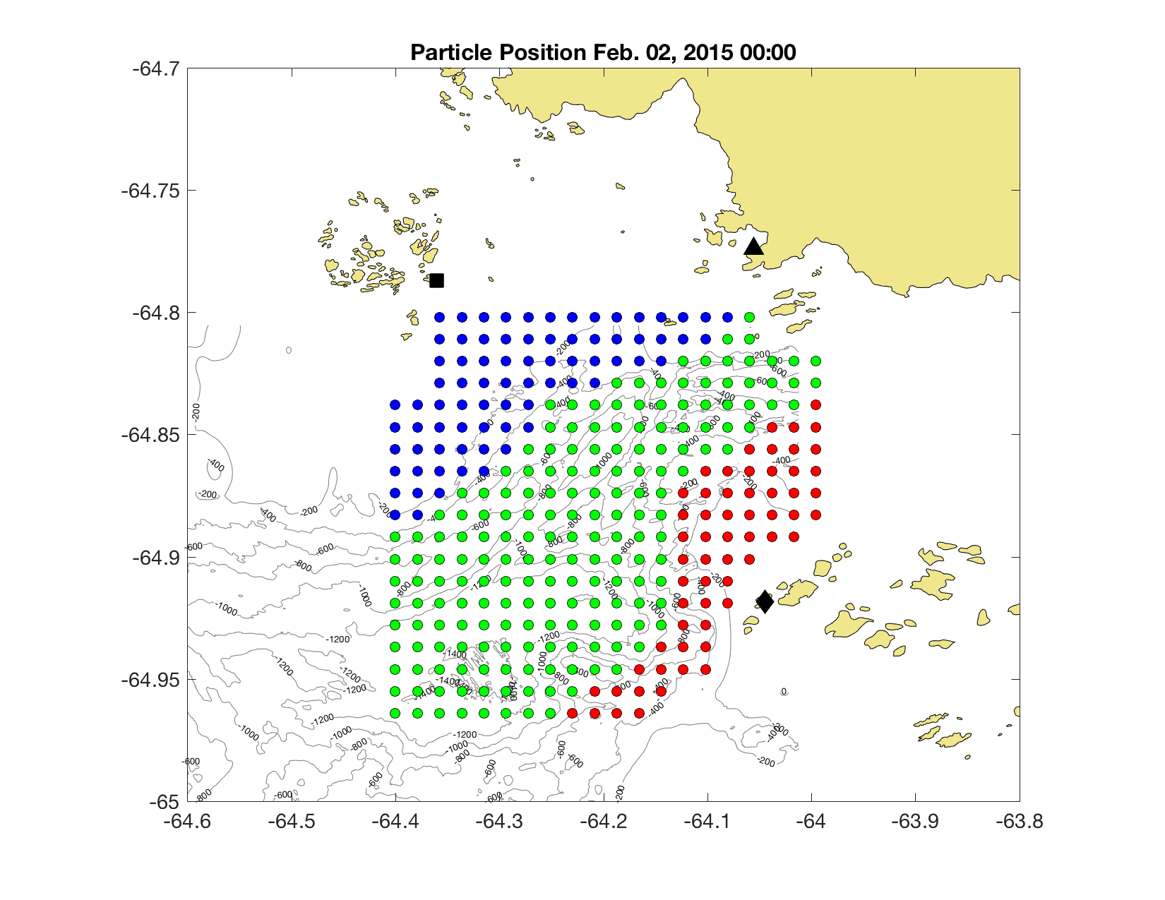
Hourly Surface Current Maps
500 m resolution
10 km
Surface Currents (cm/s)
10 km

Slide 17
Match of particles and ftles
Notes:
Write con vs div
Low FTLE values?

Slide 18
FTLE Selectivity Test
Kolmogorov-Smirnov Test:
91st Threshold: p-value = 0.04216
95th Threshold: p-value = 2.213 x 10⁻⁴
99th Threshold: p-value = 0.012
Kolmogorov-Smirnov Test:
91st Threshold: p-value = 1.637 x 10⁻⁵
95th Threshold: p-value = 1.732 x 10⁻⁵
99th Threshold: p-value = 0.005604

Slide 19
Vertical and Horizontal

Slide 20
Generalized Linear Mixed Model

Slide 21
Possible reason for div
Accumulation areas form close to divergence
Upwelling
Behavior
Dispersion of zooplankton, less concentrated

Slide 22





Acknowledgements

Slide 23
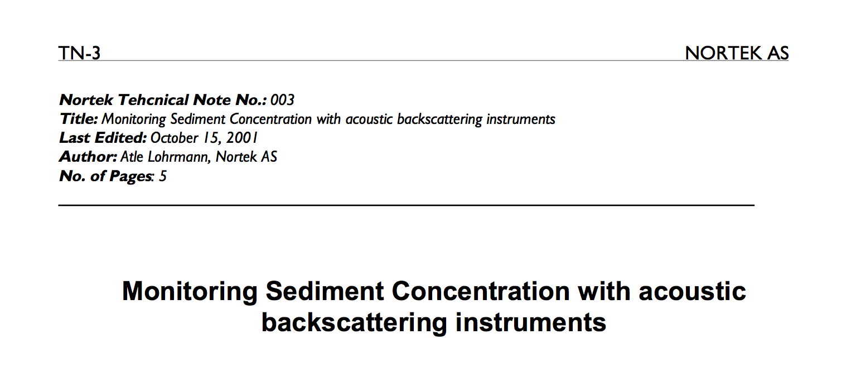
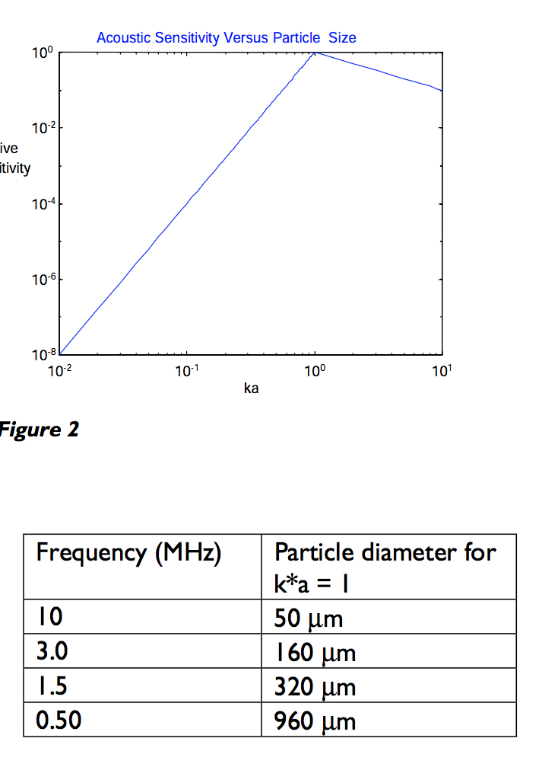

Slide 24
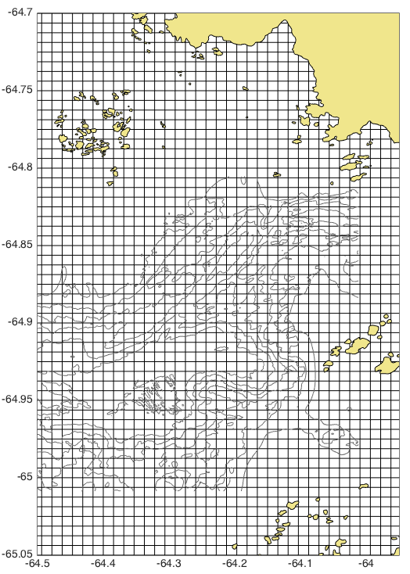
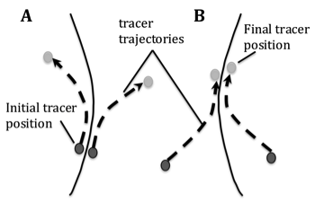
Lagrangian Coherent Structures
800 m
800 m
t₀ = 00:00 hours
t₁ = 12:00 hours

Slide 25
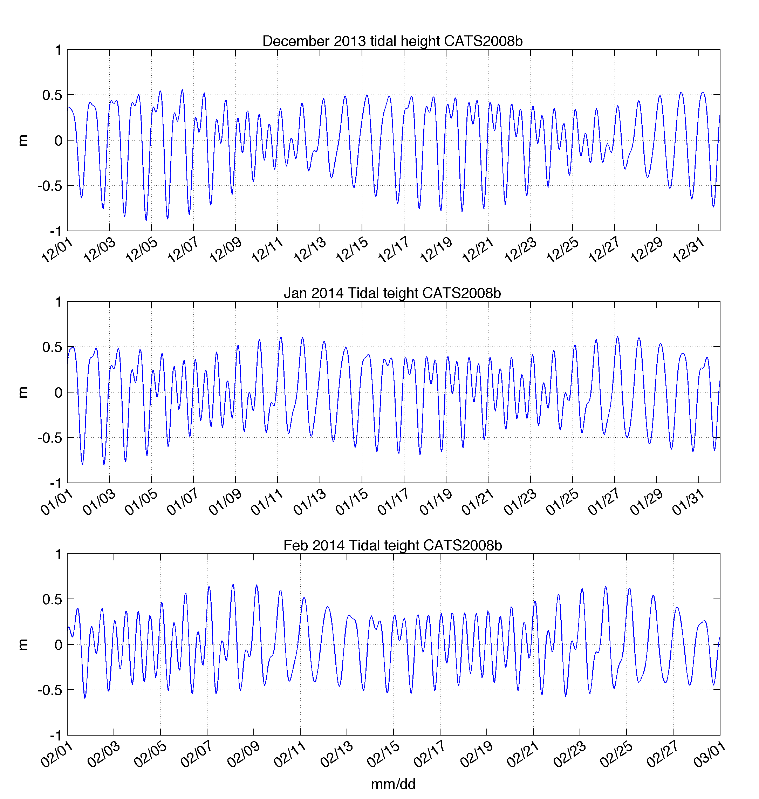
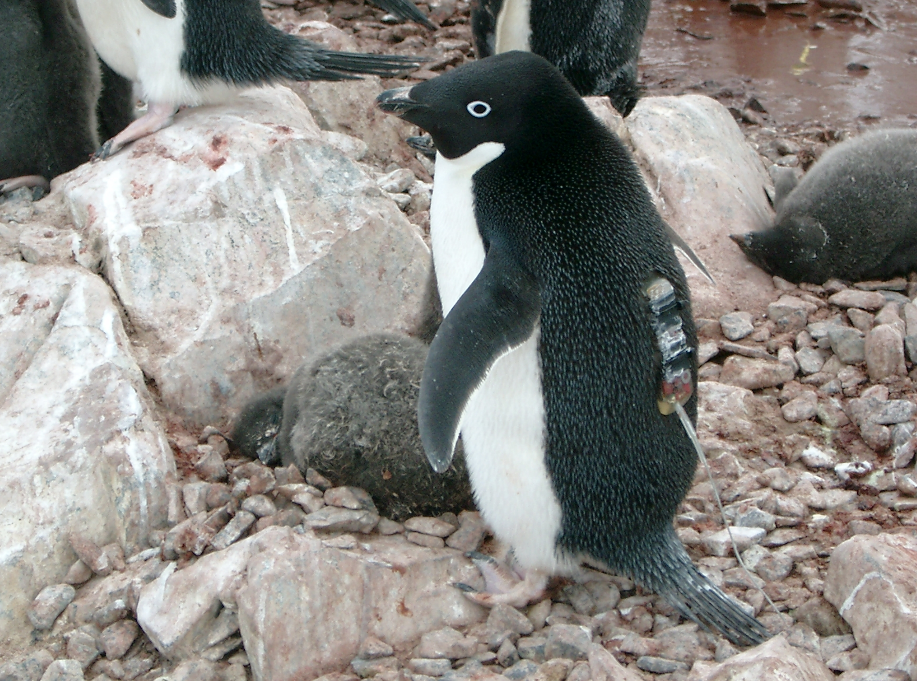
Tidal Dependence on Penguin
Foraging Behavior?
December 2013
Diurnal
January 2014
February 2014
Semi-Diurnal
Oliver et al., 2013
Notes:
----- Meeting Notes (7/7/17 10:22) -----
add Adeilie

Slide 27
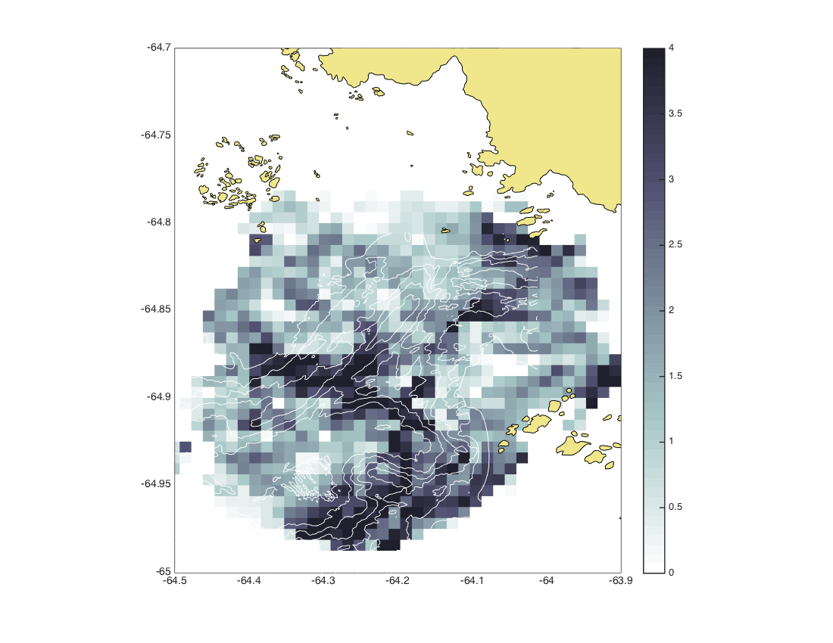
Zooplankton are associated with repulsive Lagrangian coherent structures
4.0
3.5
3.0
2.5
2.0
1.5
1.0
0.5
0
FTLE (day⁻¹)

Slide 28
Dynamical Systems Approach:
Fixed Points and Transport Pathways
ALCS
Attracting
`
`
Lagrangian Coherent Structures
(LCS)
E
H
Fixed Points:
Elliptical
Hyperbolic
Repelling
RLCS

Slide 29
Lagrangian Coherent Structures
4.0
3.5
3.0
2.5
2.0
1.5
1.0
0.5
0
January 27, 2015
Finite Time Lyapunov Exponent (FTLE)
The FTLE field measures maximal linear attraction between initially neighboring particles over a pre-determined finite time interval.
We calculate daily FTLE fields for January and February 2015.
FTLE (day⁻¹)
Notes:
Two simulations run s

Slide 30
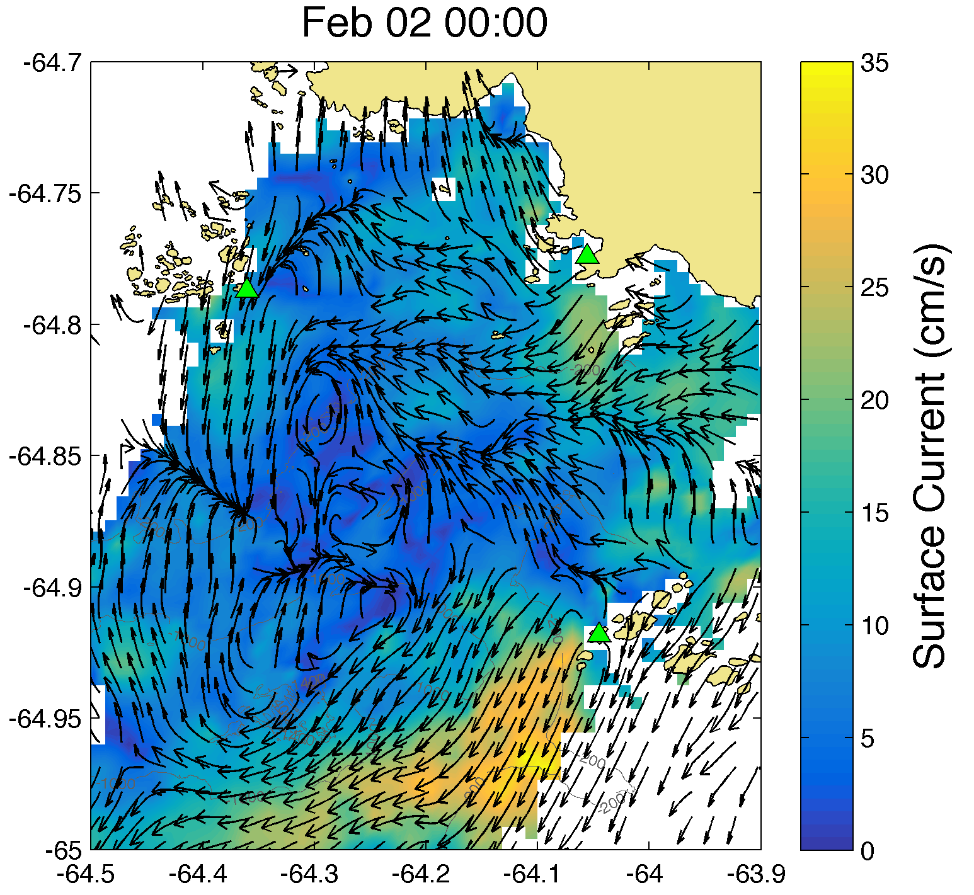
Hourly Surface Current Maps
500 m resolution
Notes:
To investigate other convergent features that might be influencing where the krill are distributed we looked at sea surface currents
point out arrows coming together
Features appearing and dispersing

Slide 31
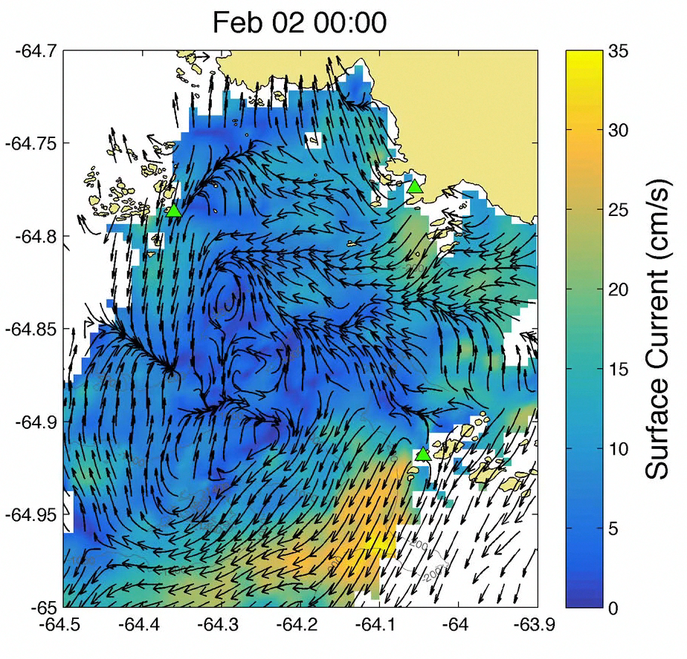
Hourly Surface Current Maps
500 m resolution

