Slide 1
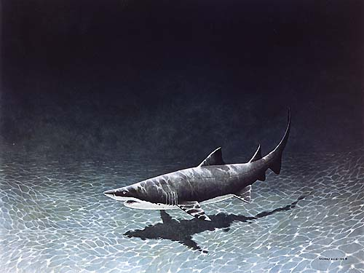
Sifting Through Sand Tiger Shark Acoustic Tag Data
Danielle Haulsee
MAST 853
4/27/12

Slide 2
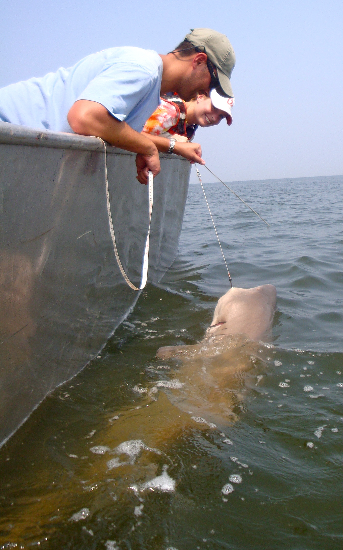
Outline
History of marine animal tracking
Acoustic telemetry 101
DE Bay Project: Case Study
Dataset Positives
Dataset Limitations
Questions
Notes:
Small dataset size
Increased interaction with fish because you have to catch it twice to get movement data
Only provides large scale movements, and doesn’t show movements in terms of seasons or environmental forcings

Slide 3
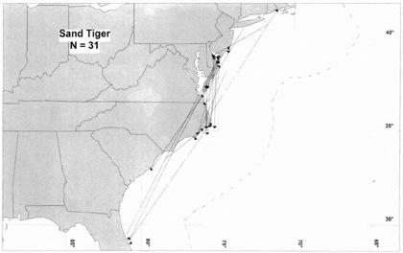
Marine Animal Tracking
Tag and recapture studies only record two locations for every individual tagged
Notes:
Small dataset size
Increased interaction with fish because you have to catch it twice to get movement data
Only provides large scale movements, and doesn’t show movements in terms of seasons or environmental forcings

Slide 4
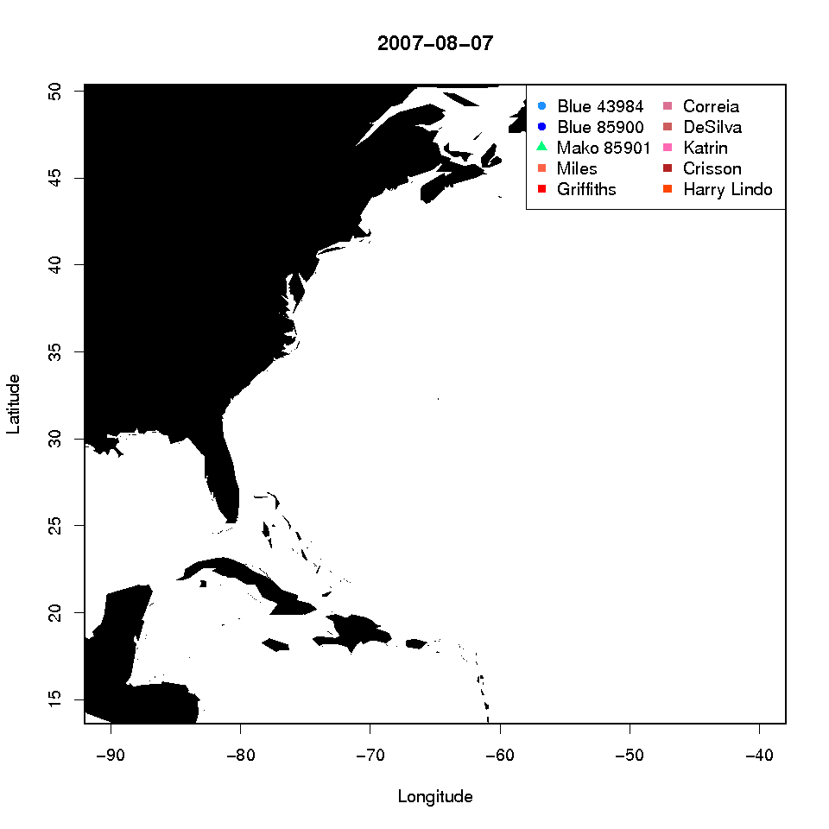
Marine Animal Tracking
Satellite tags record large scale offshore movements, but only if the animal surfaces!
Notes:
Lower sample size
Tags are expensive and short lived

Slide 5
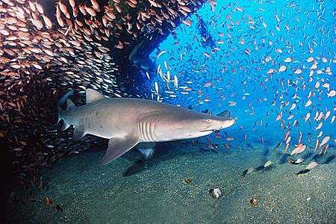
Marine Animal Tracking
Solution!
Acoustic telemetry
Advantages
Animals are not required to surface
Low power requirement, long tag life
Relatively inexpensive, higher sample sizes

Slide 6
Acoustic Telemetry 101
Transmitters
Transmit sequence of pings (180khz)
Unique sequence is encoded with the unique tag serial number
Spacing in between the pings is what makes each ping sequence unique
A69-1303-47796

Slide 7
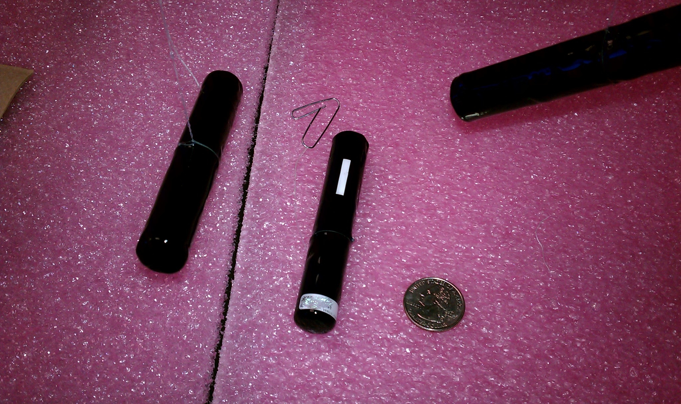
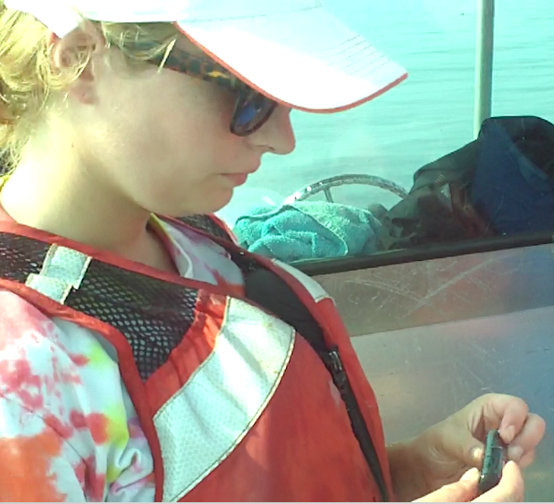
Acoustic Telemetry 101

Slide 8
Acoustic Telemetry 101
Receivers
Pings are detected by moored receivers
Receiver decodes ping and records the tag serial number
Transfer stored data to computer via Bluetooth connection (in air)
Transfer 100,000 bytes in ~8 seconds or roughly 10,000 detections
Detection range depends on ocean conditions
Usually <1km

Slide 9
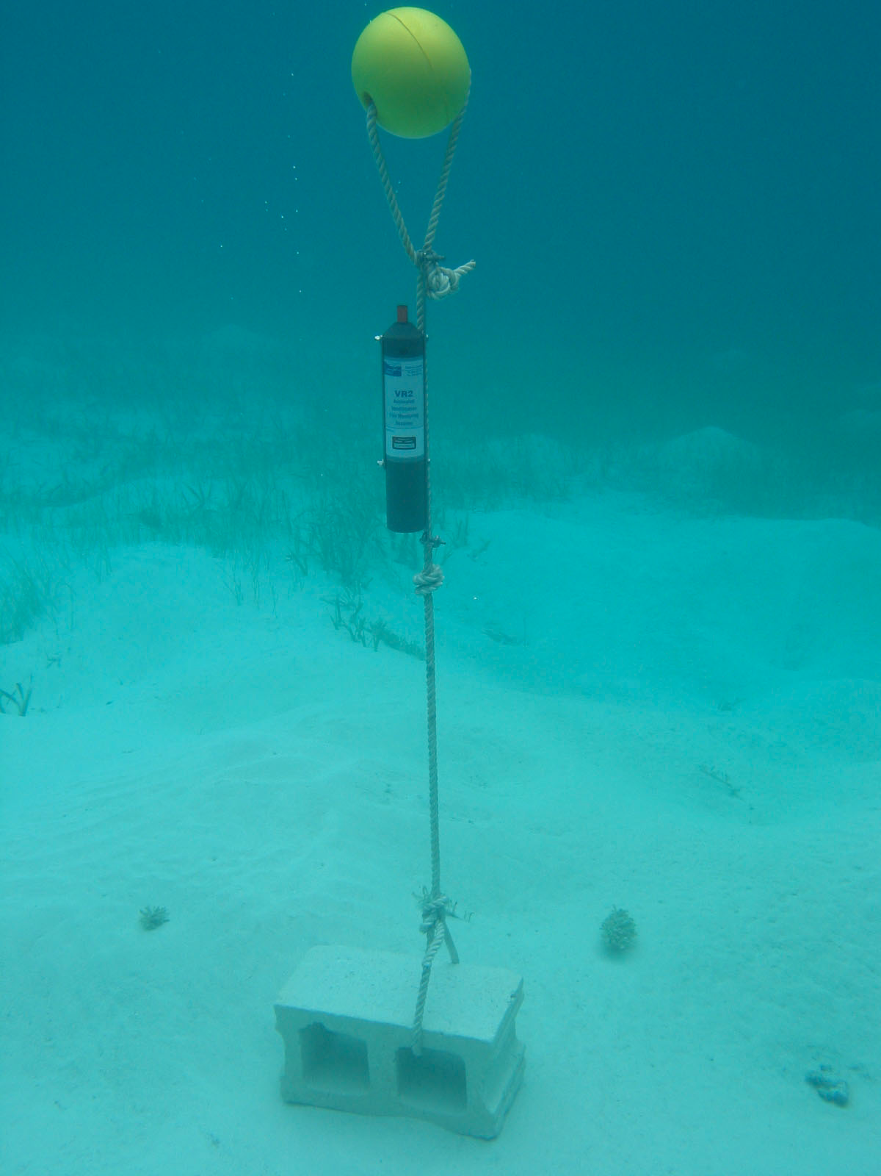
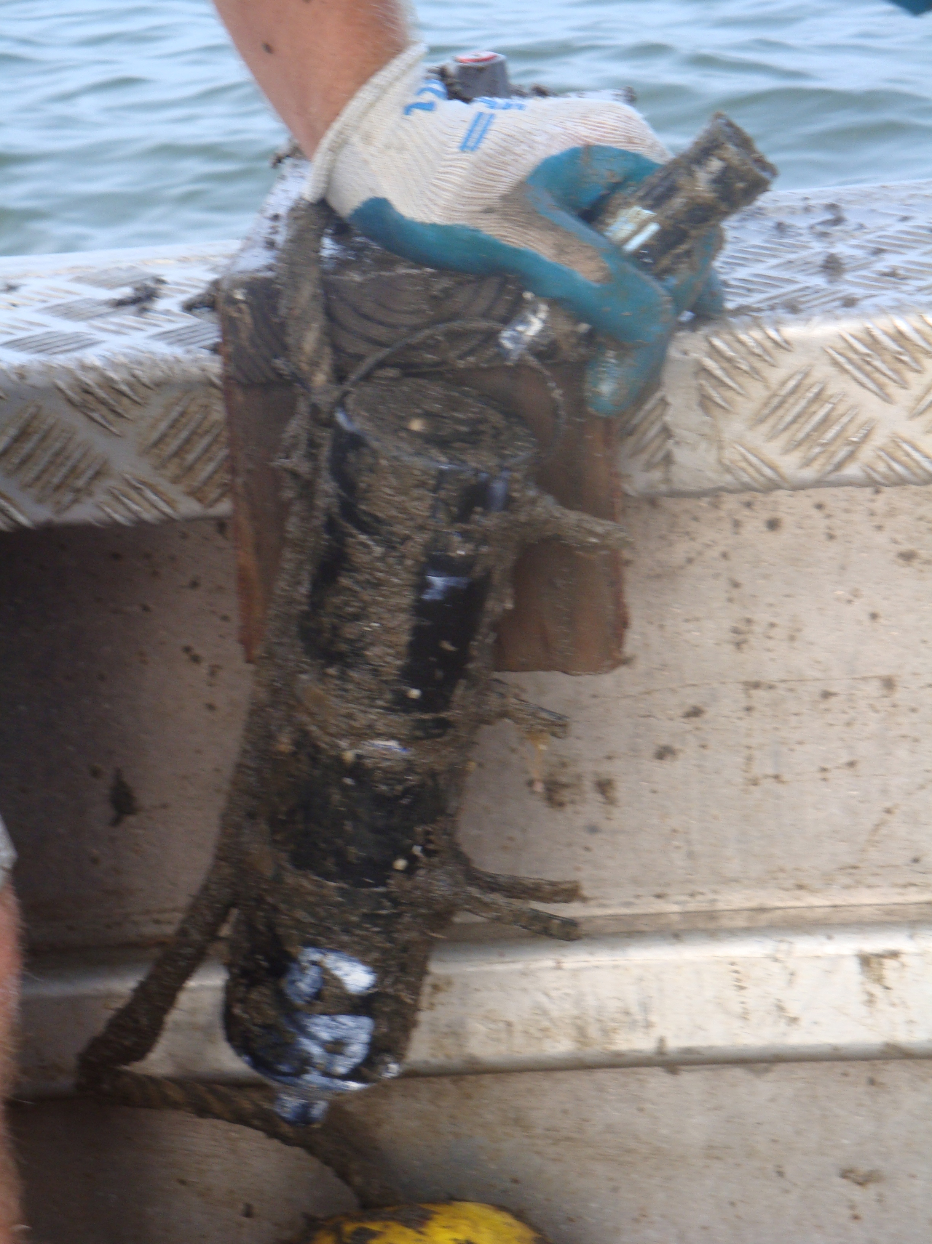
Acoustic Telemetry 101

Slide 10
DE Bay Project
Monitor and analyze sand tiger shark populations and movements within and around the DE Bay
Why sand tiger sharks?
Large, apex predators, summer residents in DE Bay
Unique life history traits that lend itself to exploitation
Adelphophagy or uterine cannibalism == 2 pups every other year
Slow growing
Late maturing (>2m)
Long gestation (9-12 mo)
http://www.iucnredlist.org/

Slide 11
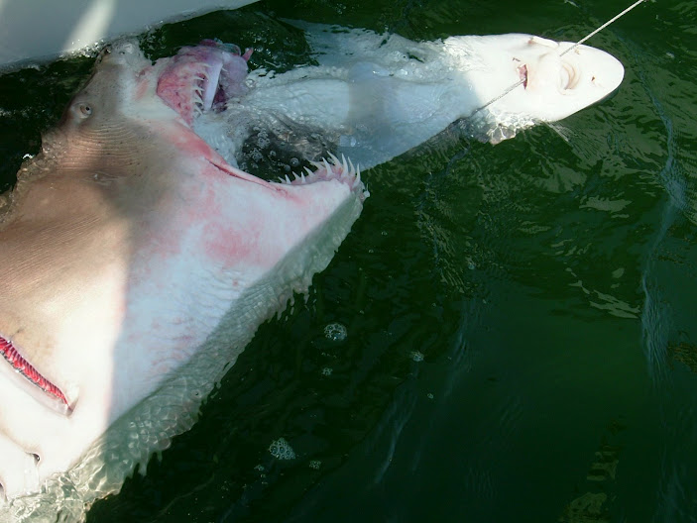
DE Bay Project

Slide 12
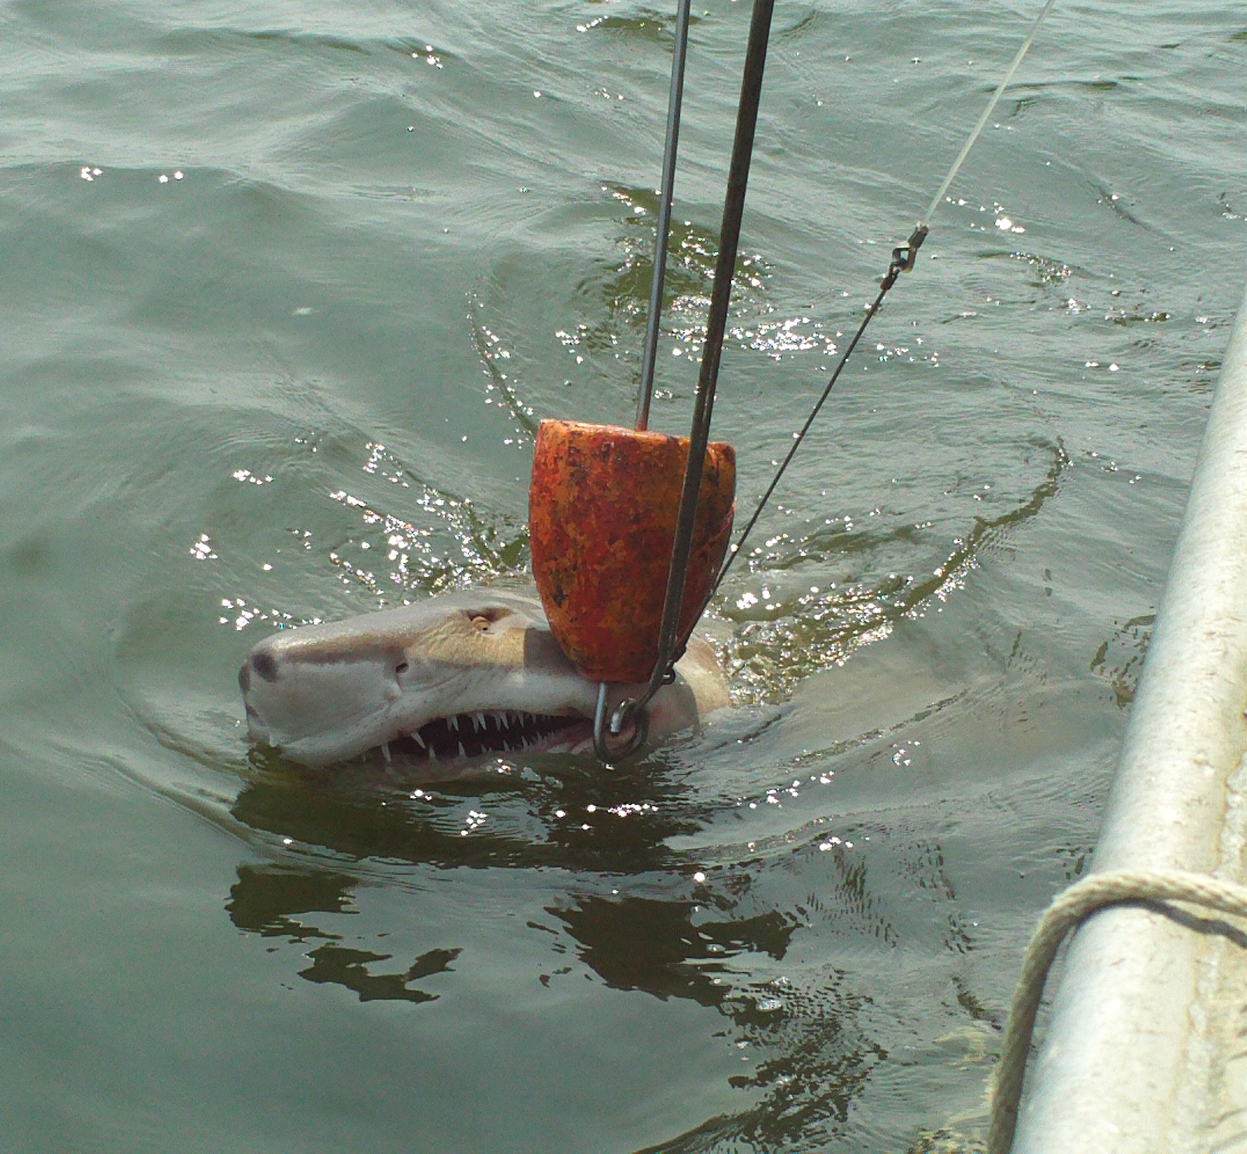
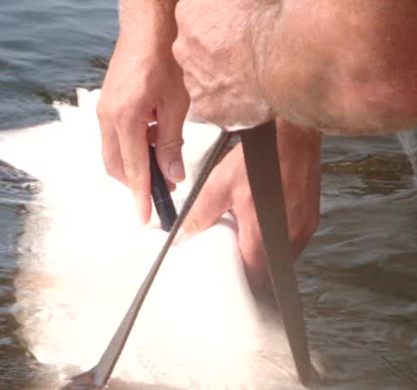
DE Bay Project
Project started by DSU (2007-current)
~400 STS tagged in DE Bay
~ 50 receiver locations in DE bay and coastal ocean
~50,000 shark hits per summer
~200,000 known presences of STS in bay

Slide 13
DE Bay Project
Receiver

Slide 14
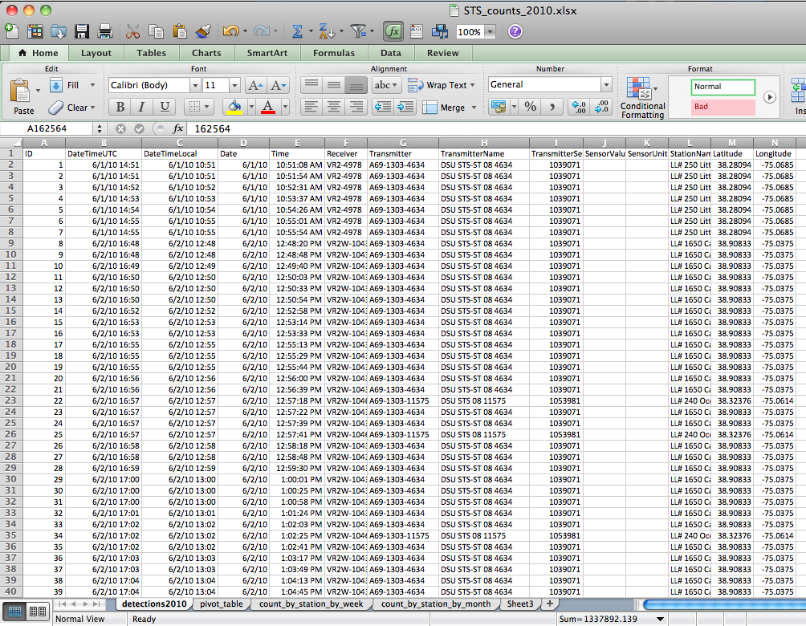
DE Bay Project
Shark presence records
Data comes to me in Excel files
Date
Time
Long/Lat
Receiver serial #
Receiver name
Tag serial #
Tag name
Files separated
by year

Slide 15
DE Bay Project
Data Management
Convert .xlsx files to .csv files
Write script to combine the multiple files into master files
Files separated out by year the sharks were tagged, and what year they were detected
i.e. STS_2008_in_2009.csv
This data was pretty clean, but occasionally need to fix mistakes in data recording
Remove blank spaces if the transmitter ID was not recorded
Code interference
Mistakes in data recording, data transfer, my code…

Slide 16
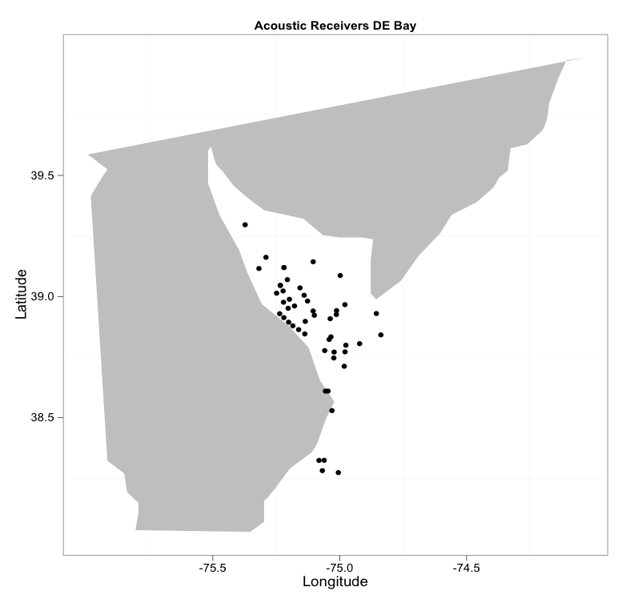
DE Bay Project
Notes:
To make this plot, I found the unique lat and long combinations from the acoustic receivers log because I know the sharks will only be heard where a receiver is.
This means that this plot shows were all receivers were during all years, but does not show that the receiver locations may have changed throughout the years.

Slide 17
DE Bay Project
Questions:
Where are most of the acoustic hits in the DE Bay?
What is the distribution of males vs females in the DE Bay?
What are the environmental conditions like when the sharks are within the acoustic array?

Slide 18
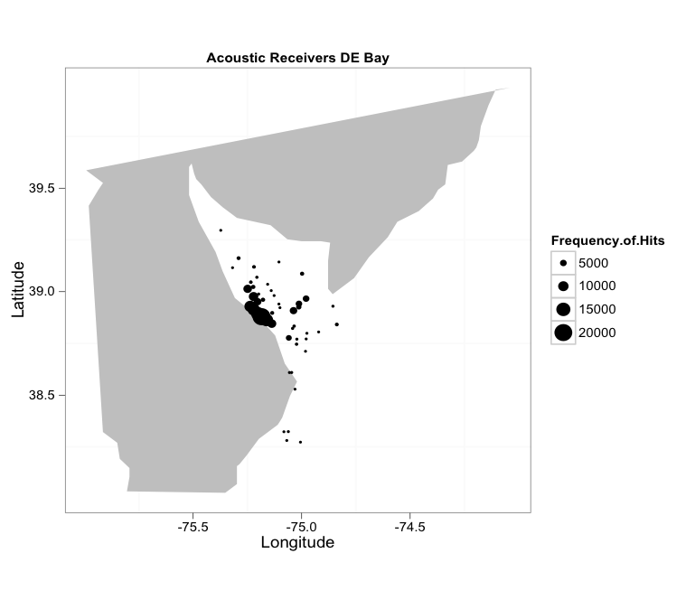
Where are most of the acoustic hits in the DE Bay?
Notes:
Highest concentration of animals off of Broadkill and Slaughter Beach

Slide 19
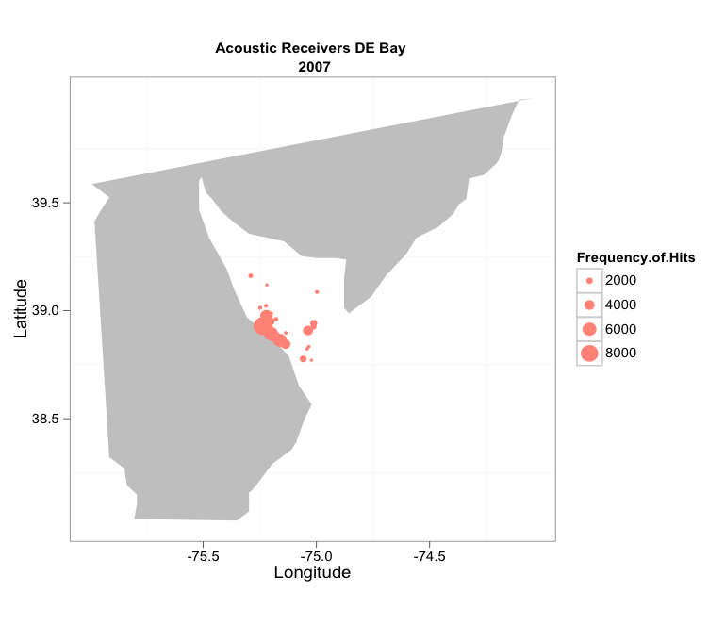
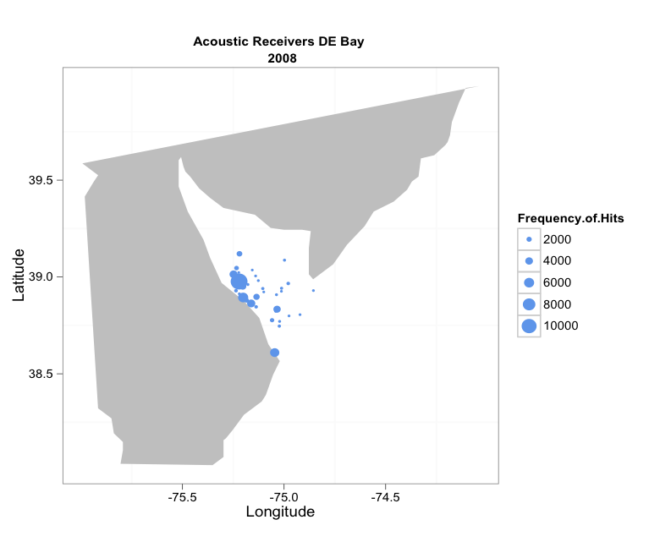
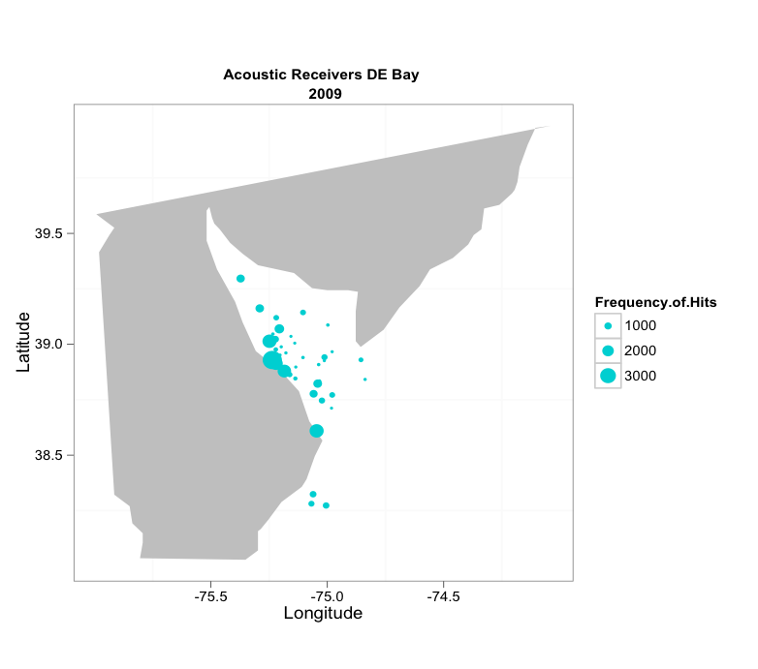
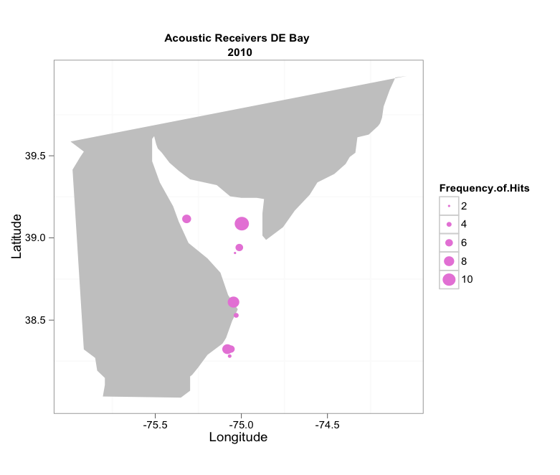
Where are most of the acoustic hits in the DE Bay?
Notes:
We see that throughout the years, the patterns of shark density are generally the same, but we do see some differences in 2009
click

Slide 20
Where are most of the acoustic hits in the DE Bay?
Notes:
Sharks appear to be further up in the bay, as well as further out side of the bay
it is possible that these appearances represent new receiver deployments in this year however.
Also, I should note that in the dataset I am showing does not have the full record for 2010, so it appears that there are less sharks in 2010, but really the dataset just isnt complete.

Slide 21
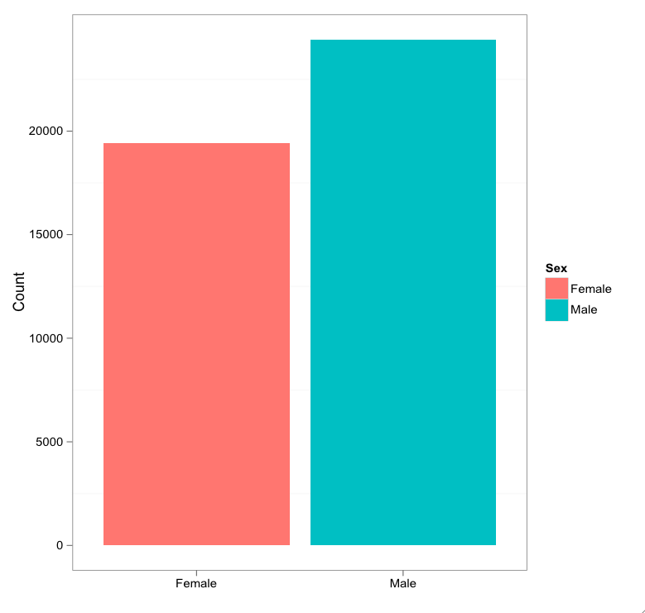
What is the distribution of males vs. females in the DE Bay?
2010
Notes:
I matched the metadata for each tagged shark, with the tag codes recorded by the receivers in 2010. This allows me to see if there are differences in the data based on sex.
In 2010 we see that there were slightly more presences recorded for males than females. I don’t know if there are more males than females that have been tagged in the whole study, which could explain why we hear from more males than females.

Slide 22
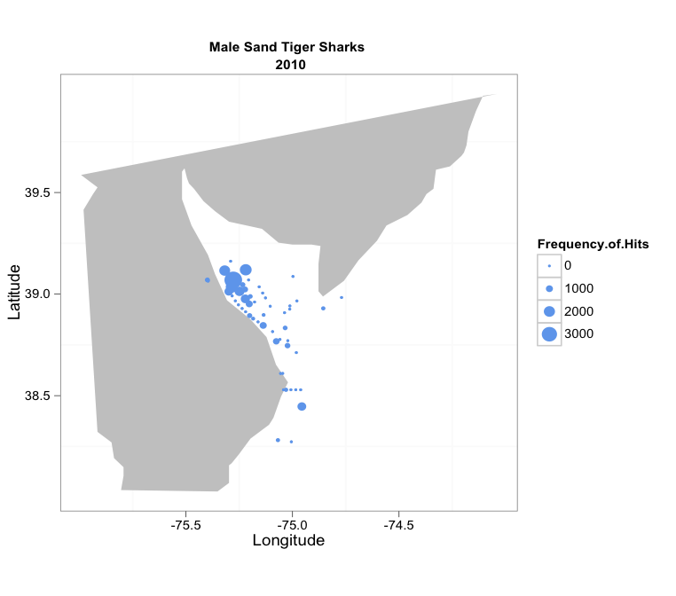
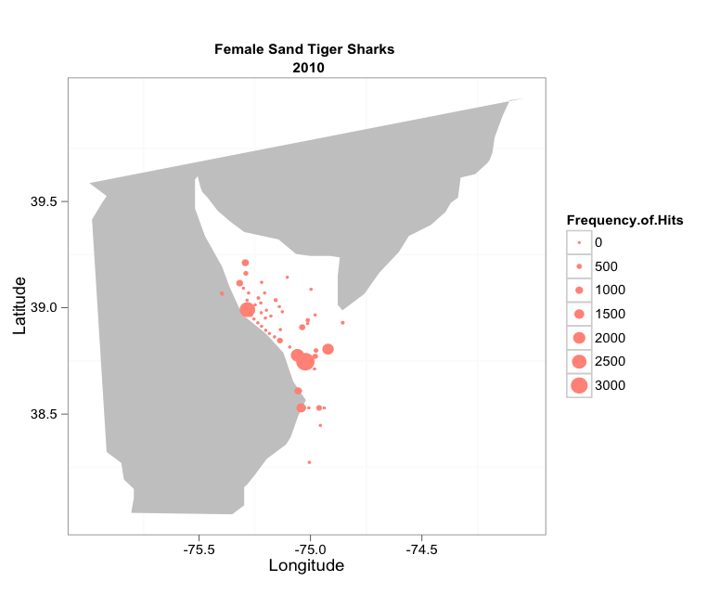
What is the distribution of males vs. females in the DE Bay?
2010
Notes:
You can see the males appear to be more dense further north in the bay, while the females seem to be more dense further south in the bay
Some species of sharks do partition habitats differentially depending on the sex
especially because breeding behavior often leads to bites, which could lower the fitness of a female
Not implying that breeding is occurring in the Delaware bay, only that there are reasons why fish, and sharks especially, separate out by sex.

Slide 23
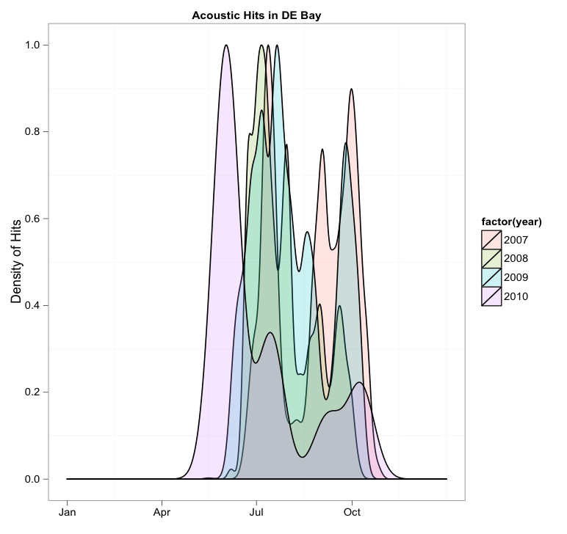
What are the environmental conditions like when the sharks are within the acoustic array?
Notes:
If we look at when the sharks are at any station within the array, we can see that on average, they arrive to the array early May, and leave the bay in late October.
We see that in 2010, it appears that the sharks arrived earlier than other years, and seem to have remained in the array for a little bit longer than previous years as well.

Slide 24
What are the environmental conditions like when the sharks are within the acoustic array?
Notes:
If we look at when the sharks are at any station within the array, we can see that on average, they arrive to the array early May, and leave the bay in late October.
We see that in 2010, it appears that the sharks arrived earlier than other years, and seem to have remained in the array for a little bit longer than previous years as well.

Slide 25
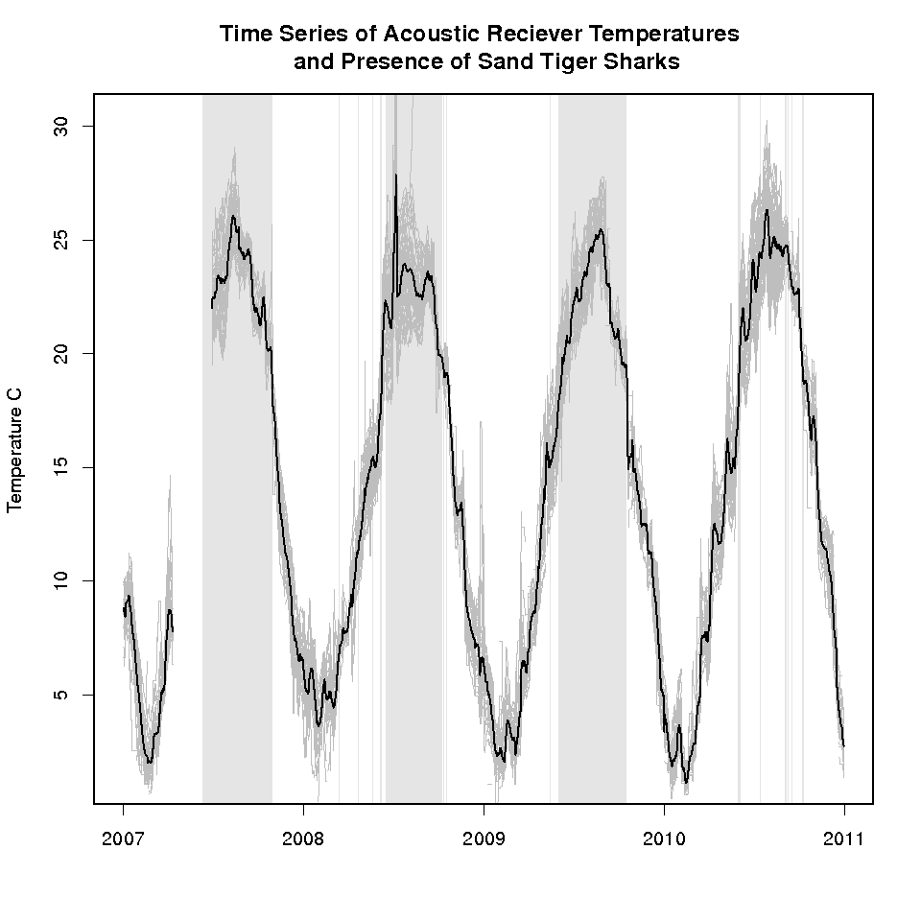
What are the environmental conditions like when the sharks are within the acoustic array?
Notes:
If we look at the temperatures at all of the stations in the array, and compare that to the presence of sand tiger sharks at any receiver in the array, we can see some general trends related to temperature.
Using satellite measured sea surface temperature data, I have plotted here the range and mean sea surface temperature at all stations within the bay, and am showing the presence of a sand tiger shark at any receiver in the bay as the vertical grey stripes. You can see that every year, the sharks arrive around the same time of the year, like we saw in the previous figure, but also that the sharks appear to arrive and depart after the bay has reached some threshold temperature, around 23C

Slide 26
What are the environmental conditions like when the sharks are within the acoustic array?
Notes:
If we look at the temperatures at all of the stations in the array, and compare that to the presence of sand tiger sharks at any receiver in the array, we can see some general trends related to temperature.
Using satellite measured sea surface temperature data, I have plotted here the range and mean sea surface temperature at all stations within the bay, and am showing the presence of a sand tiger shark at any receiver in the bay as the vertical grey stripes. You can see that every year, the sharks arrive around the same time of the year, like we saw in the previous figure, but also that the sharks appear to arrive and depart after the bay has reached some threshold temperature, around 23C
This gives us an idea as to what sort of environmental preferences the sharks may have, or environmental constraints that may effect their distribution.

Slide 27
Dataset Positives
Long term dataset
>4 years now
High sample size
>400 sharks have been tagged
Tags can last as long as 3-4 years
Allows us to document return rates
Gives insight into areas of intensive use by sharks
Gives insight into the seasonality of the sharks presence in the bay

Slide 28
Dataset Limitations
Only records the presence of a shark (up to 1km away in good conditions)
Does not show movement tracks
Possibility for code collision
Sand tiger sharks like to aggregate in groups, increasing chances of code collision
False detections
Decrease receiver performance
Conditions in a bay are perfect/imperfect for acoustic telemetry
Shallow water makes mooring receivers easy, and easy to maintain
Waves, boats, dense animal populations produce sound interference

Slide 29
Questions?

