Slide 1
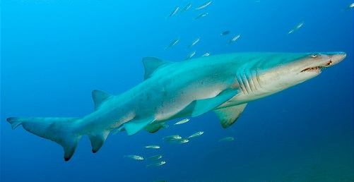
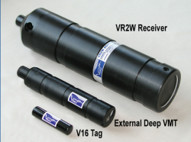
Sand Tiger Shark
NOAA Species of Concern (SOC)
38mm D
180mm L
16mm D
75mm L

Slide 2
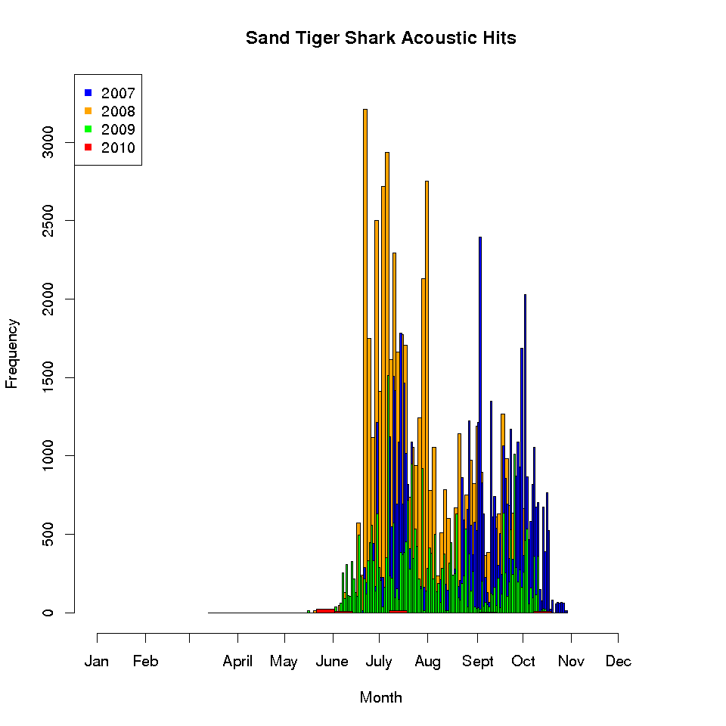
Are there environmental parameters that trigger the large-scale movements of the sand tiger, blue and tiger sharks?
Sand tiger shark acoustic hits
  Analyze the phenology of sand tiger shark residency within the Delaware Bay

Slide 3
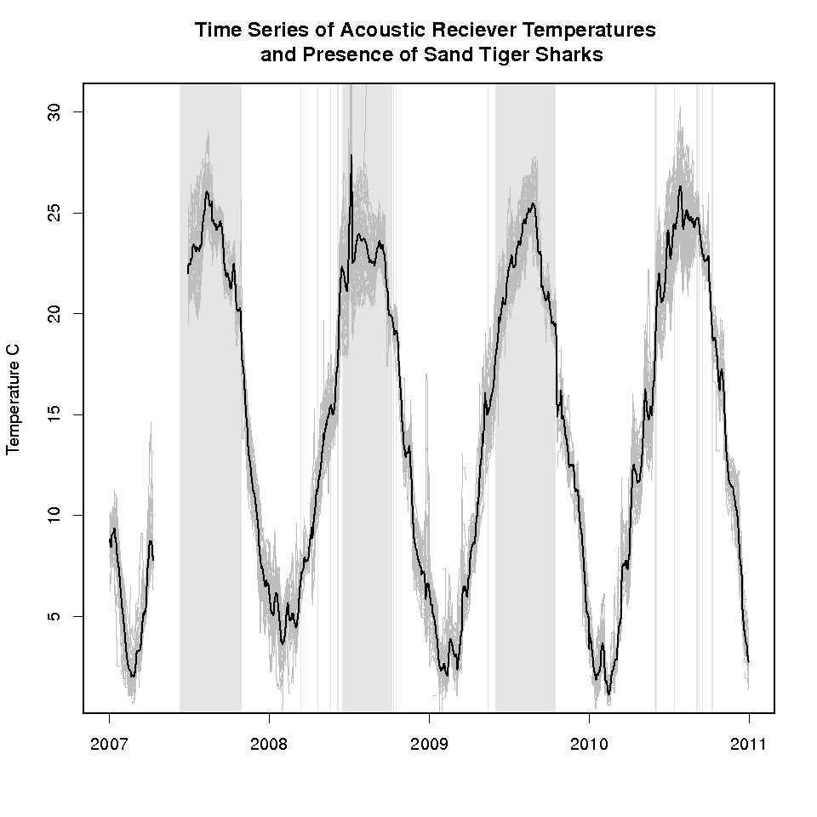
Are there environmental parameters that trigger the large-scale movements of the sand tiger, blue and tiger sharks?
Sand tiger shark acoustic hits
  Mine environmental parameters near the arrival and departure of sand tiger sharks within the Delaware Bay

Slide 4
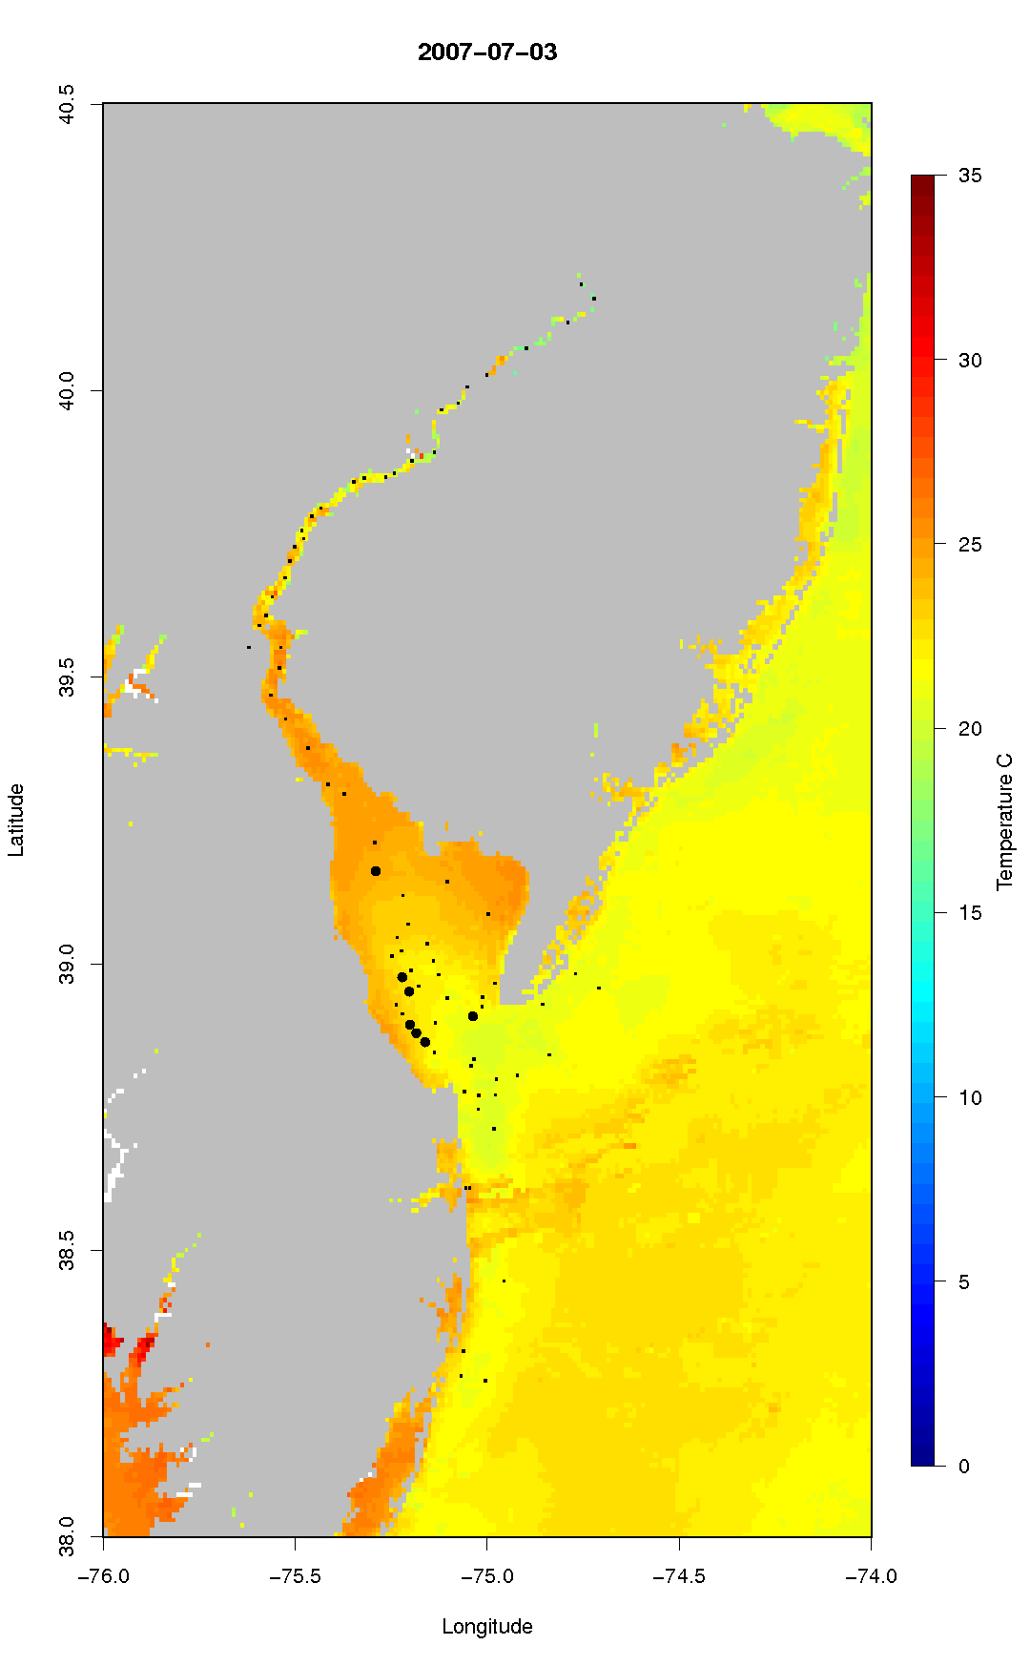

Slide 5
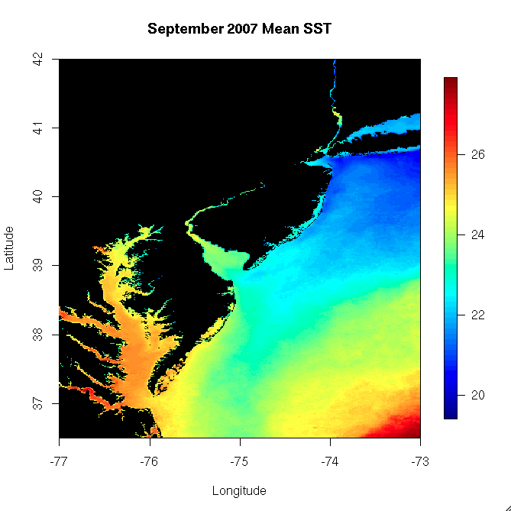
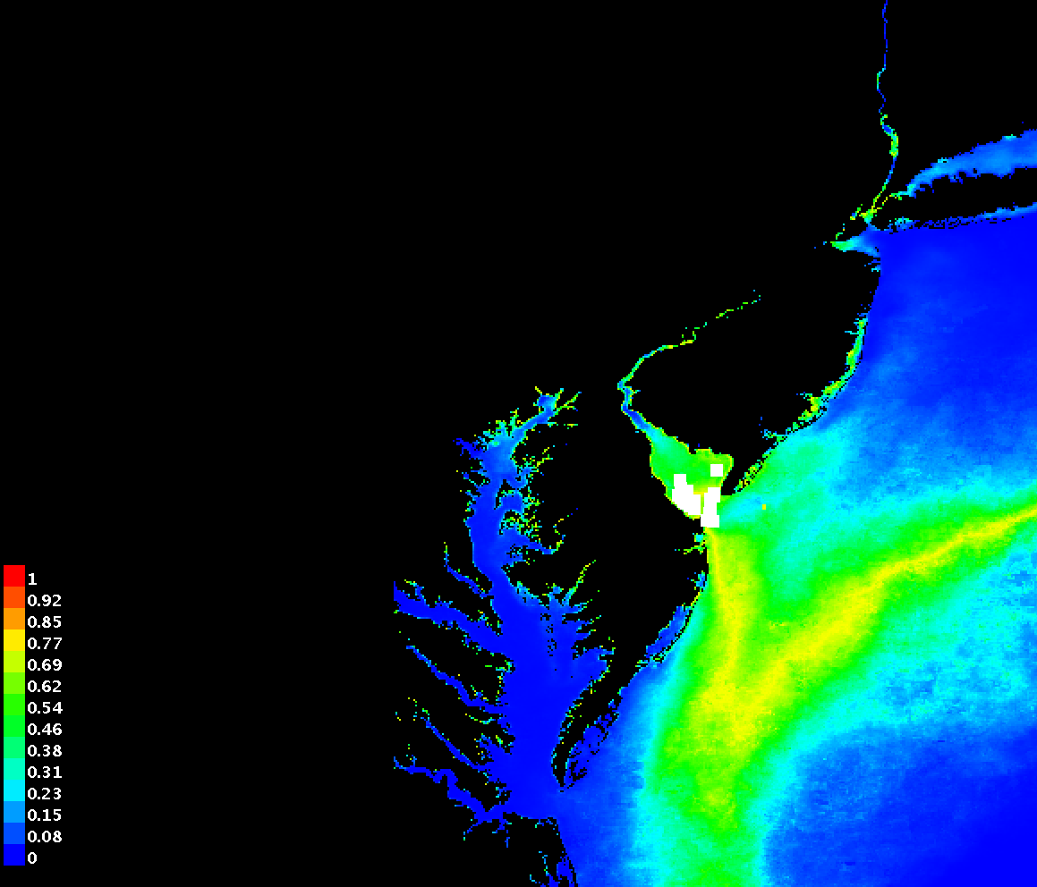
What is the nature of the pelagic environment preferred by sand tiger sharks, blue sharks and tiger sharks in the Atlantic Ocean?
Sand tiger shark acoustic hits
  Create maximum entropy (Maxent) models to predict ideal shark habitat based on environmental parameters
Maxent Probability Model
September 2007
Probability

Slide 6
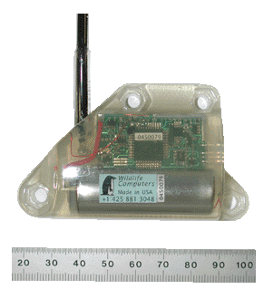
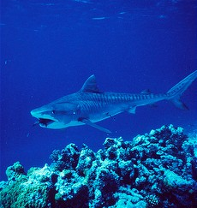
Sand Tiger Shark
NOAA Species of Concern (SOC)
SPOT5 Satellite Tag

Slide 7
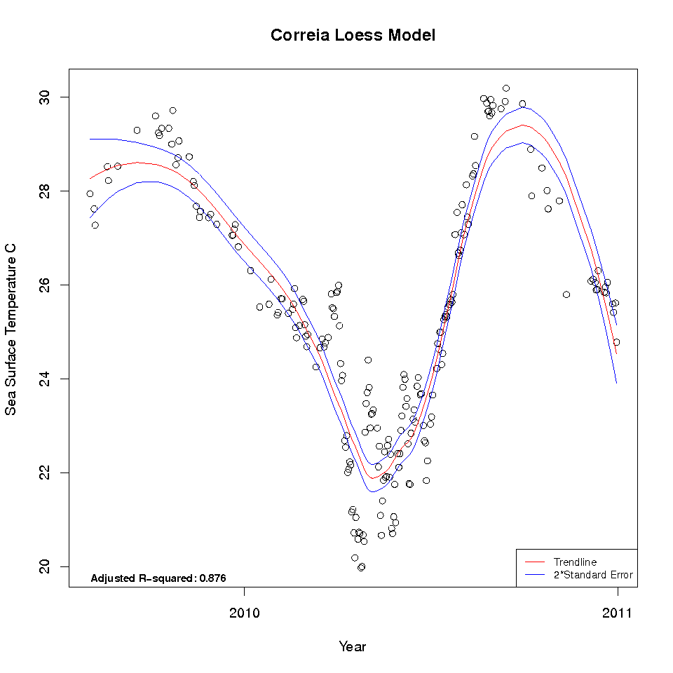
What is the nature of the pelagic environment preferred by sand tiger sharks, blue sharks and tiger sharks in the Atlantic Ocean?
Blue and Tiger Shark Satellite Tracks
  Use loess-fitting routine to parameterize the relationship between shark location and environmental parameters

Slide 8
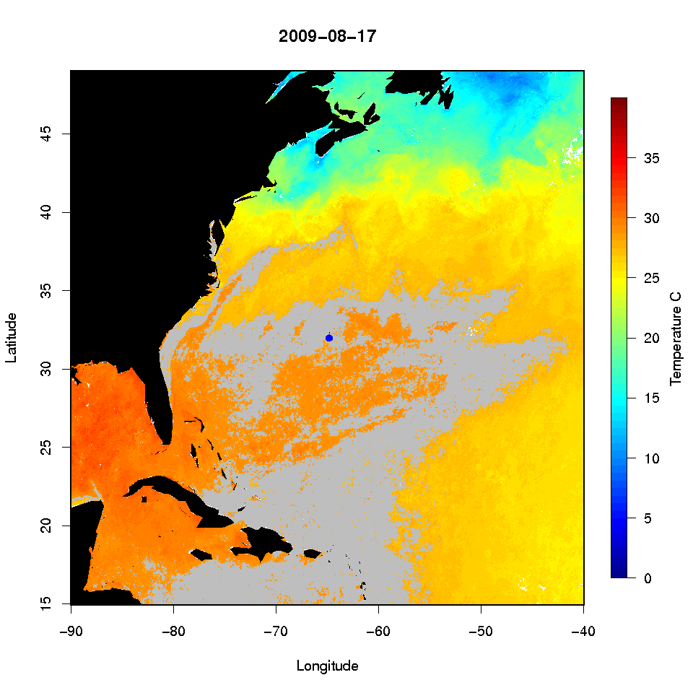
What is the nature of the pelagic environment preferred by sand tiger sharks, blue sharks and tiger sharks in the Atlantic Ocean?
Blue and Tiger Shark Satellite Tracks
  Use loess-fitting routine to parameterize the relationship between shark location and environmental parameters

Slide 9
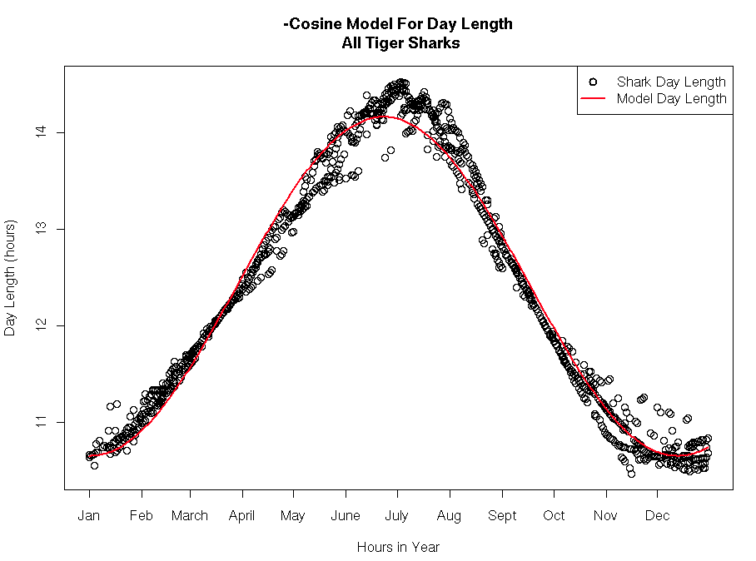
Are there environmental parameters that trigger the large-scale movements of the sand tiger, blue and tiger sharks?
Blue and Tiger Shark Satellite Tracks
y = A * -cos(x/B) + C

